Slide 1
WELCOME to the Association of the U.S. Army MORNING “ZOOM” BRIEFING (18 August 2020)
Guest Speaker:
General Carter Ham U.S. Army, Retired
AUSA President & CEO
GENERAL MEETING

Slide 2
PLATINUM ($5,000)
2020-2021
PREMIER SPONSORS
GOLD ($2,500)
SILVER ($1,000)
SCHOLARSHIP

Slide 3
3RD REGION PRESIDENT – MS. KRIS MCBRIDE

Slide 4
2020 Third Region Award Recipient
EARLE L. DENTON AWARD –
“BEST SOLDIER OF THE YEAR”
1ST
PLACE
DR./CSM(R)
TOM CLARK
DR./CSM(R) THOMAS CLARK

Slide 5
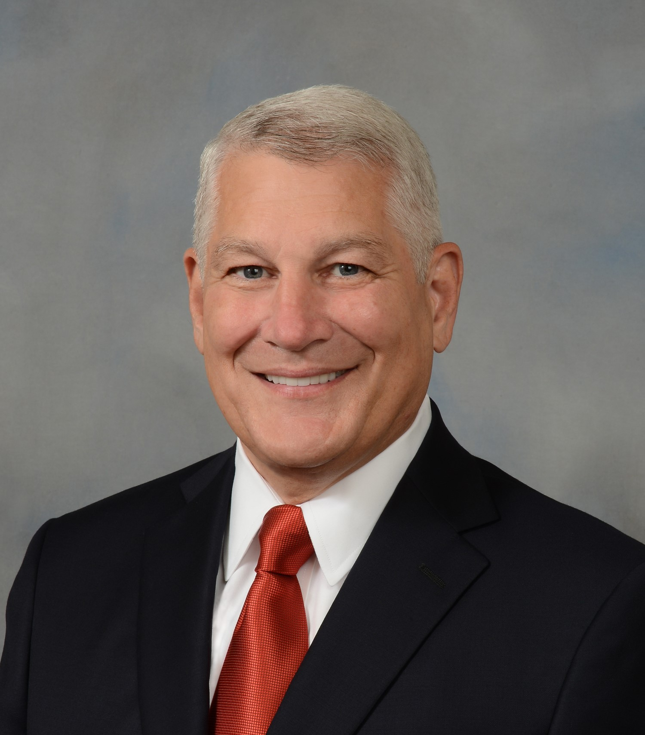
Please Welcome
General Carter Ham, U.S.Army, Retired
AUSA President & CEO

Slide 6
SPONSORS
…SPONSORS!
PETSCH RESPIRATORY SERVICES
HERBERT HOMES
FIRST COMMAND FINANCIAL RESOURCES
AMENTUM
GEORGIA POWER
MAU WORKFORCE SOLUTIONS
MAYO & ASSOCIATES
CSRA ALLIANCE
DEFOOR REALTY
EPISCOPAL DAY SCHOOL (EDS) – SCHOLARSHIP SPONSOR

Slide 7
UPCOMING EVENTS:
27 Aug – “HOW TO SERIES” … Homeschool Tips and Tricks (ZOOM, 5-6pm); POC is Alejandra Miles/AU
15 Sep – AUSA Morning Briefing (Microsoft Teams, 8-9am)
See you next month…

Slide 8
LIKE US ON FACEBOOK… (Association of the US Army Greater Augusta-Fort Gordon Chapter)
STAY CONNECTED WITH US!
Visit our AUSA WEBSITE…
(Ausa.org.augusta)

