Slide 1
Introduction to the U.S. Army
Association of the United States Army
November 2022

Slide 2
Overview
YOUR UNITED STATES ARMY
The Army is older than the country it serves. Authorized by the Second Continental Congress, the Continental Army was established on 14 June 1775.
THE ARMY:
is the oldest and largest of the military departments;
has Soldiers in every state and U.S. territory (Total Army);
is the second largest U.S. employer (Wal-Mart is the largest);
has over 250 Military Occupational Specialties and Officer specialties; and
is the foundation of the Joint Force.
Fewer than 1% of Americans currently serve in the military; 79% of Soldiers come from families that have served in the military.

Slide 3
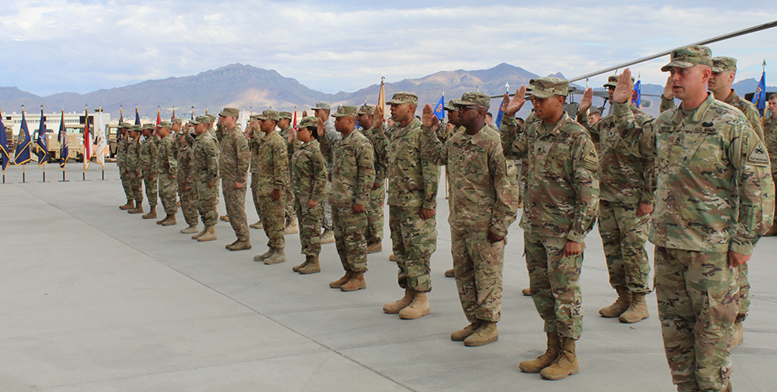
People Are Our Army
Soldiers serve and
live by a set of seven common values:
Loyalty
Duty
Respect
Selfless Service
Every soldier
is a volunteer
Honor
Integrity
Personal Courage
Soldiers are not in the Army—
Soldiers are the army.
Gen. Creighton Abrams,
26th Chief of Staff of the Army

Slide 4









America’s Army
1.012 million*
Soldiers
~187,000
worldwide deployed
340,216
pieces of equipment
284,344
wheeled
vehicles
26,232
combat
vehicles
82%
MALE
18%
FEMALE
20,742
MRAP
vehicles
4,300
Aircraft
55% Caucasian
21% African American
16% Hispanic
5% Asian/Pacific Islander
3% Other/Unknown
4,466
STRYKER
VEHICLES
132
Watercraft
*AS OF May 21

Slide 5
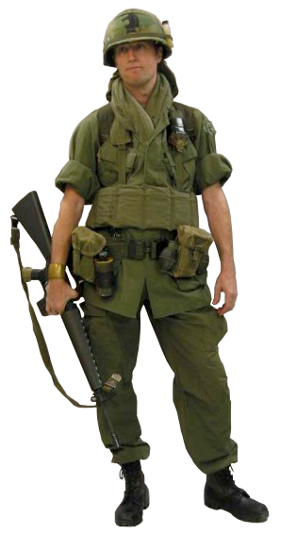
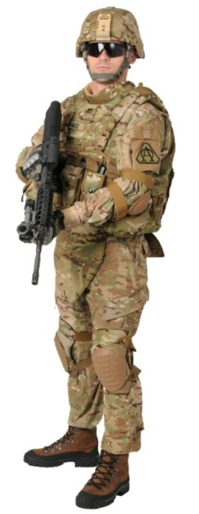
The American Soldier: Then & Now
1968
(enlisted)
22 years old
79% high school graduates
< 1% female
21% minority
60% draftees
36% married
SGT base pay = $279/mo*
SGLI coverage = $10,000*
35 lbs of equipment ($1,856)*
Individual replacements
62% survival rate if wounded
2020
(enlisted)
28 years old
96% high school graduates
18% female
42% minority
100% volunteers
52% married
SGT base pay = $3,001/mo
SGLI coverage = $400,000
75+ lbs of equipment ($19,454)
Unit rotations
88% survival rate if wounded
* Not adjusted for inflation

Slide 6
What Your Army Does
The U.S. Army is globally engaged with approximately 187,000 Soldiers supporting Combatant Commanders in 140 countries. These Soldiers conduct combat operations, deter aggression and assure our allies and partners.
Critical enabling capabilities
Joint and Theater logistics, including support to allies
Military training and education centers
Military healthcare – Operating the majority of military hospitals
Civil Engineering (Army Corps of Engineers)
Domestic natural disaster response
Administering Arlington National Cemetery
Infectious disease research
State Partnership Program (ARNG: 79 International Partnerships)

Slide 7
The United States Army
The U.S. Army is a total army—one Army—comprised of three components: Regular Army, Army National Guard and Army Reserve.
2020
endstrength
(as of sep 20)
2021 NDAA
endstrength
(enacted)
2022 NDAA
endstrength*
(request)
Regular Army:
485,383
485,900
485,000
Army National Guard:
336,131
336,500
336,000
Army Reserve:
188,703
189,800
189,500
Total Army:
1,010,217
1,012,200
1,010,500
The Army depends on the support of 196,710 Department of the Army civilian employees.
*AS OF 28 may 21

Slide 8
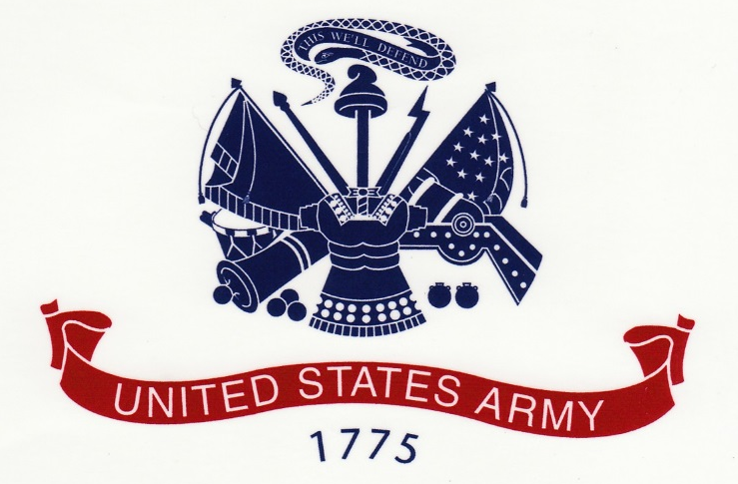
Constitutionally Authorized
The Congress shall have the power: “To provide for the common defense...To raise and support Armies...
To provide and maintain a Navy...To make rules for the Government and Regulation of the land and naval forces...To declare war...And to make laws which shall be necessary and proper for carrying out the foregoing powers.”
        —Article I, Section 8,
        —The Constitution of the United States

Slide 9

Role of the Army
Federal law, under Title 10 of the United States Code, states that the Army “shall be organized, trained and equipped primarily for prompt and sustained combat incident to operations on land.”
The purpose of the U.S. Army is to deploy, fight and win our nation’s wars by providing ready, prompt and sustained land dominance by Army forces across the full spectrum of conflict as part of the joint force.
Prevent: The Army deters conflict by maintaining credibility based on capacity, readiness and modernization.
Shape: The Army shapes the environment by sustaining strong relationships with other armies, building their capacity and facilitating strategic success.
Win: If prevention fails, the Army rapidly applies its combined arms capabilities to dominate the environment and win decisively.

Slide 10
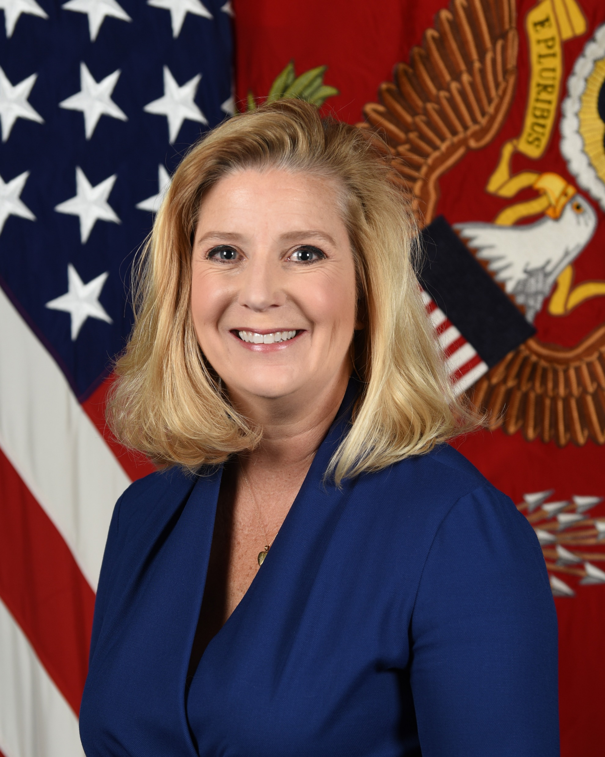
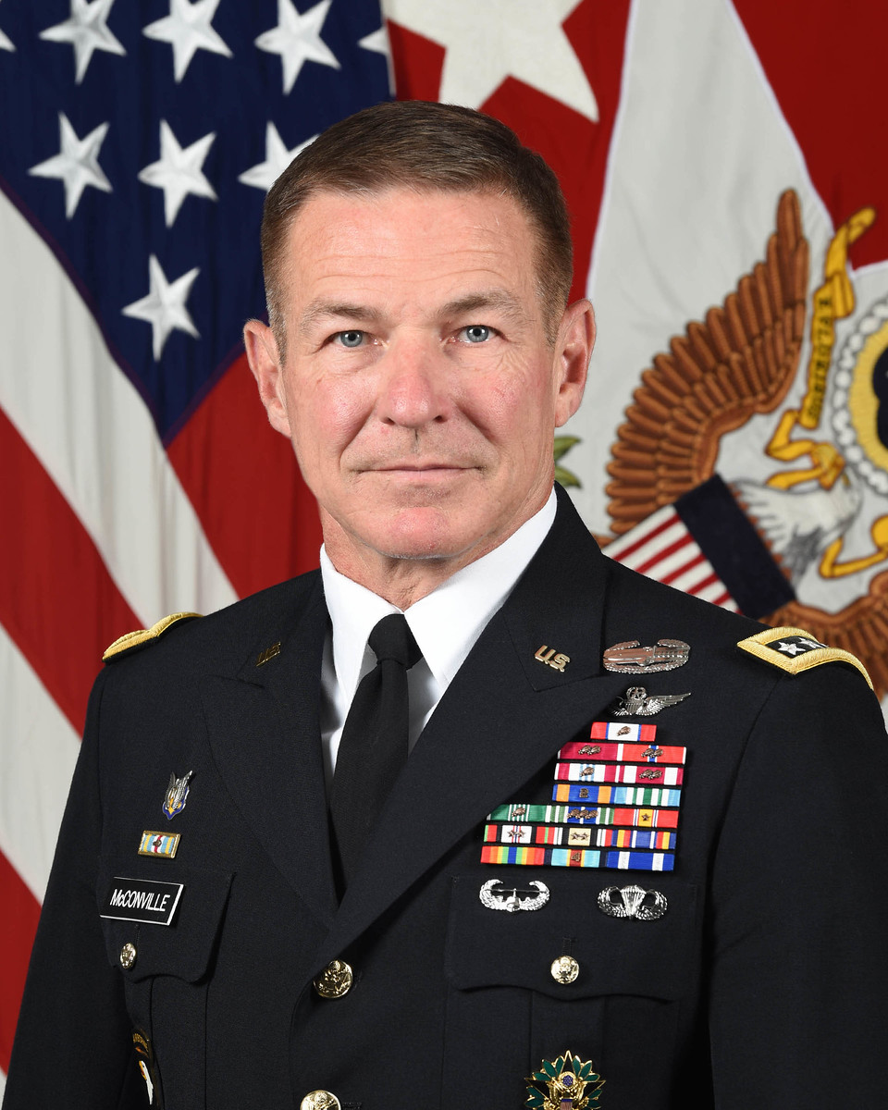
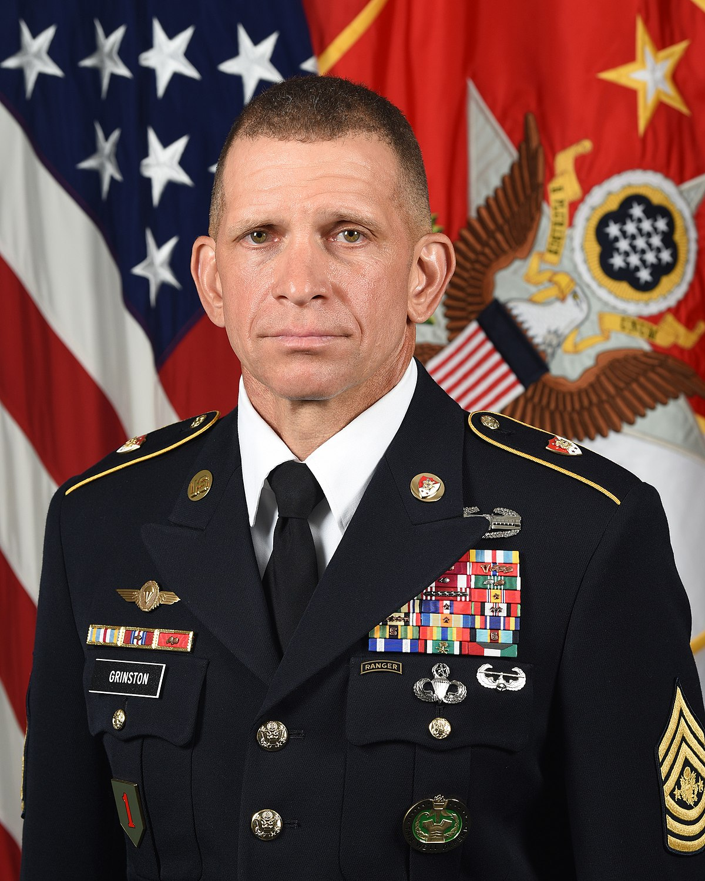
Army Leadership
Secretary of the Army
Christine Wormuth
40th Chief of Staff of the Army
General James C. McConville
16th Sergeant Major of the Army
SMA Michael Grinston
Exercises civilian control of the Army
Formulates and implements policy guidance for the Army
Resources the Army
Senior officer of the Army, primary advisor to the Secretary of the Army
Readiness of the force
Shaping the Future Army
Senior enlisted advisor to the Chief of Staff
Advocates for Soldiers

Slide 11
Army Priorities
People
Support Our People - Soldiers, Civilians, and their Families
readiness
Maintain Tactical and Build Strategic Readiness
modernization
Modernize the Force; Deliver Concepts and Capabilities,
and support Joint All Domain Operations

Slide 12
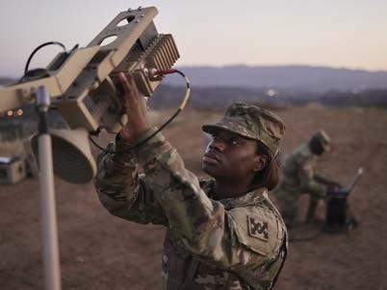
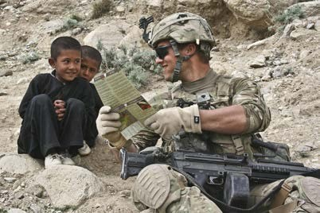
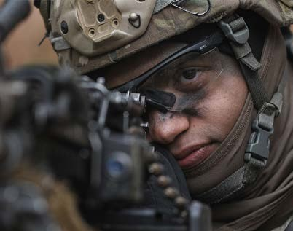
The Soldier Profession: Enlisted
Basic Combat Training
10-week training course that transforms Civilians into Soldiers.
Advanced Individual Training
4 to 56 weeks of hands-on training and field instruction to develop proficiency in specific career fields.
Private – Specialist
Warrior and a member of a team
Disciplined, physically and mentally tough, trained and proficient in warrior
tasks and drills
Non-Commissioned Officer: Corporal – Sergeant Major
Leaders are responsible for the preparation and accomplishment of the mission and welfare and training of Soldiers
Backbone of the Army
Continually advance in expert knowledge and skills throughout their careers

Slide 13
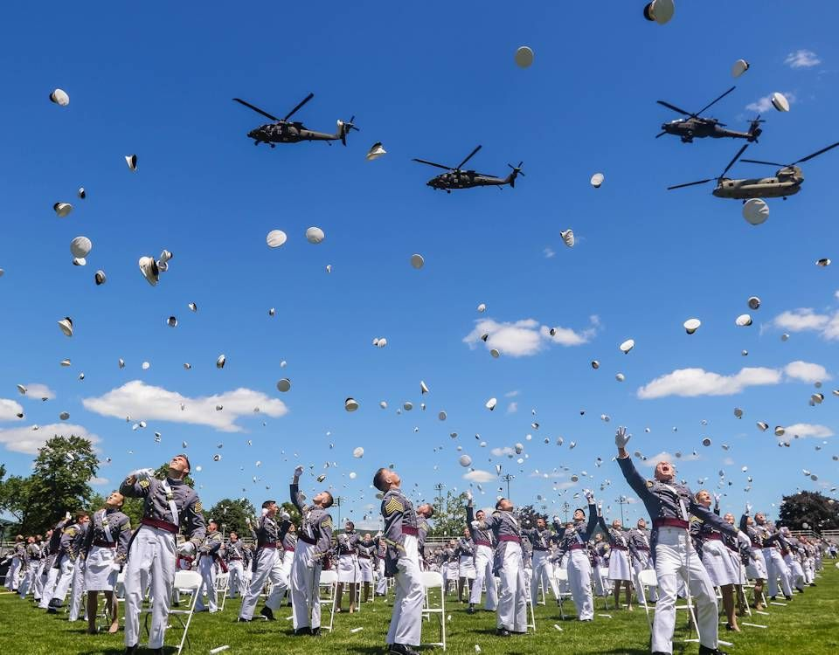



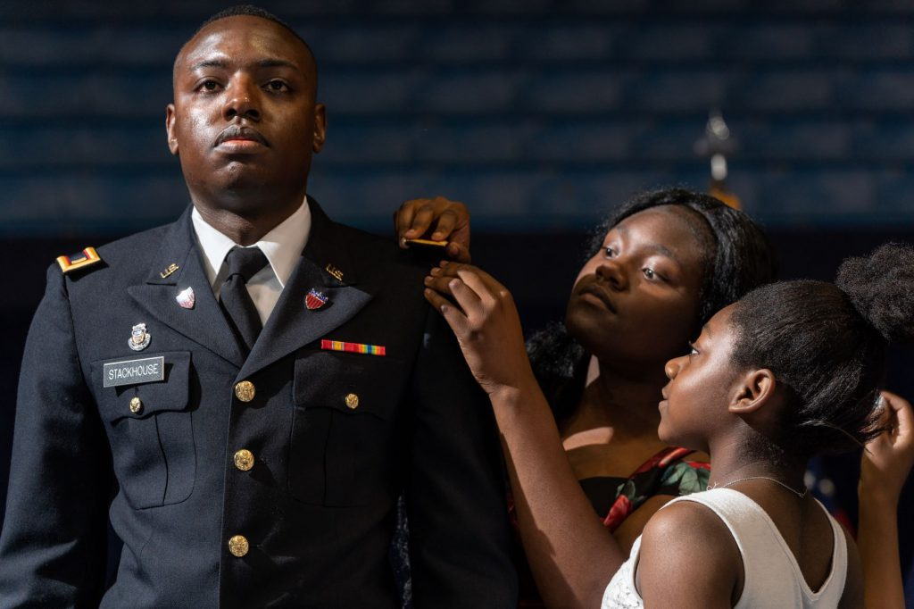
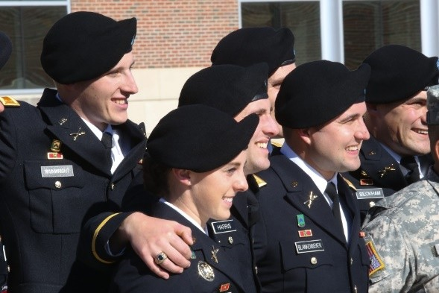
The Soldier Profession: Officer
Basic Officer Leader Course (Pre-Commissioning Training)
West Point
Reserve Officer Training Corps
Officer Candidate School
Basic Officer Leader Course
Provides newly commissioned Army officers with progressive and sequential training at branch schools, in order to produce adaptive officers, who are technically and tactically competent, confident and capable of leading in unified land operations.
Career Progression
Officers attend additional professional schools as they progress in their career.
Options are available to obtain advanced civilian degrees, train with foreign militaries and work with industry.

Slide 14




















Army Rank Insignia
OFFICERS*
WARRANT OFFICERS*
ENLISTED
O-1
O-2
O-3
O-4
W-1
W-2
E-1
E-2
E-3
E-4
No
Insignia
Second
Lieutenant
(2LT)
First
Lieutenant
(1LT)
18 Months
Captain
(CPT)
4 Years
Major
(MAJ)
10-11 Years
Private E-1
(PV1)
Private E-2
(PV2)
6 Months
Private First Class
(PFC)
16 Months
Specialist
(SPC)
Corporal
(CPL)
Warrant
Officer
(W01)
Chief Warrant
Officer (CW2)
2 Yrs + WOBC
30 Months
O-5
O-6
O-7
O-8
W-3
W-4
E-5
E-6
E-7
E-8
Lieutenant
Colonel
(LTC)
16.5 Years
Colonel
(COL)
22 Years
Brigadier
General
(BG)
Major
General
(MG)
Chief Warrant
Officer (CW3)
7-8 Years
+ WOAC
Chief Warrant
Officer (CW4)
12-14 Years
+ WOILE
Sergeant
(SGT)
4.5 Years
Staff Sergeant
(SSG)
8 Years
Sergeant First Class
(SFC)
12.5-14 Years
Master Sergeant (MSG)
First Sergeant (1SG)
17.7-20 Years
O-9
O-10
SPECIAL
W-5
E-9
SENIOR
ENLISTED ADVISOR
Chief Warrant Officer
(CW5)
17-20 Years + WOSSE
Sergeant Major (SGM)
Command Sergeant Major (CSM)
Sergeant Major of the Army (SMA)
Lieutenant
General
(LTG)
General
(GEN)
General
of the Army
(GA)
22.6-24 Years
* Only counts commissioned time.
WOBC – Warrant Officer Basic Course
WOAC – Warrant Officer Advanced Course
WOILE – Warrant Officer Intermediate Level Education
WOSSE – Warrant Officer Senior Service Education

Slide 15

Combat Force Structure
Field Army
(3 Corps)
GENERAL
Corps
(2–5 Divisions)
Lieutenant General
Division
(3-6 Brigades)
10,000–18,000 soldiers
major General
Brigade
(3- 6 Battalions)
3,000–5,000 Soldiers
Colonel
Battalion
(3–5 Companies)
500–600 Soldiers
Lieutenant Colonel
Company
(3–4 Platoons)
100–200 Soldiers
Captain
Platoon
(3–4 squads)
16–40 Soldiers
Lieutenant
Squad
4–10 Soldiers
Staff Sergeant

Slide 16




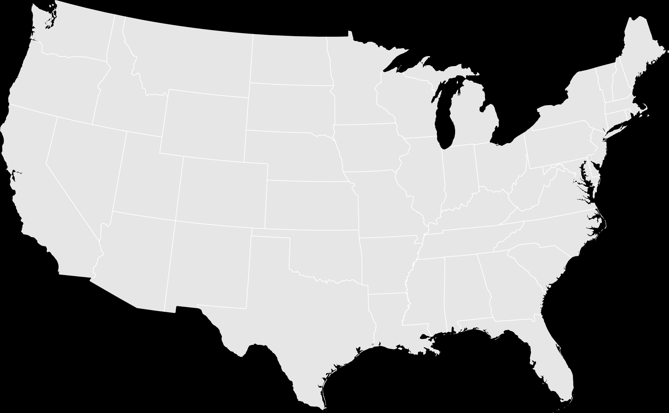


























Regular Army: CONUS-based Units
10th Mountain Division
Fort Drum, NY
11th Airborne Division
Joint Base Elmendorf-Richardson, AK
Headquarters, Department of the Army
Pentagon – Arlington, VA
U.S. Army Cyber CMD
Fort Belvior, VA
I Corps
Joint Base Lewis-McChord, WA
101st Airborne Division
Fort Campbell, KY
U.S. Army Training
& Doctrine Command
Joint Base Langley–Eustis, VA
7th Infantry Division
Joint Base Lewis-McChord, WA
Surface Deployment & Distribution Command
Scott Airforce Base, IL
U.S. Army Central
Shaw Airforce Base, SC
82nd Airborne Division
Fort Liberty, NC
1st Infantry Division
Fort Riley, KS
U.S. Army Forces CMD
Fort Liberty, NC
4th Infantry Division
Fort Carson, CO
XVIII Airborne Corps
Fort Liberty, NC
U.S. Army Space & Missile Defense CMD
Redstone Arsenal, AL
1st Armored Division
Fort Bliss, TX
U.S. Army Special Operations Command
Fort Liberty, NC
Legend
U.S. Army Materiel Command
Redstone Arsenal, AL
Army Command
U.S. Army Futures Command
Austin, TX
3rd Infantry Division
Fort Stewart, GA
Army Corps
III Corps
Fort Cavazos, TX
Army Division
1st Cavalry Division
Fort Cavazos, TX
V Corps
Fort Knox, KY
U.S. Army Recruiting CMD
Fort Knox, KY
U.S. Army North
Fort Sam Houston, TX
Army Service
Component Command
U.S. Army South
Fort Sam Houston, TX
U.S. Army Cadet CMD
Fort Knox, KY
Human Resources CMD
Fort Knox, KY

Slide 17


















Army Reserve: Divisions & Functional Commands
200 MP CMD
Fort Meade, MD
ARCD
Fort Knox, KY
99 RSC
JB McGuire-Dix-Lakehurst, NJ
USAR AVIATION CMD
Fort Knox, KY
USAR LEGAL CMD
Gaithersburg, MD
88 RSC
Fort McCoy, WI
84 TNG CMD (UR)
Fort Knox, KY
MIRC
Fort Belvoir, VA
76 ORC
Salt Lake City, UT
80 TNG CMD (TASS)
Richmond, VA
807 MDSC
Fort Douglas, UT
85 SPT CMD
Arlington Heights, IL
U.S ARMY RESERVE HQ
Fort Liberty, NC
416 TEC
Darien, IL
63 RSC
Moffett Field, CA
USACAPOC
Fort Liberty, NC
FIRST ARMY SPT CMD
Rock Island, IL
108 TNG CMD (IET)
Charlotte, NC
79 TSC
Los Alamitos, CA
81 RSC
Fort Jackson, SC
75 INNOVATION CMD
Houston, TX
3 MDSC
Fort Gillem, GA
Legend
Army Reserve Division
412 TEC
Vicksburg, MS
335 SC(T)
East Point, GA
Army Reserve
Functional Command
377 TSC
Belle Chase, LA
AR MEDCOM
Pinellas Park, FL

Slide 18
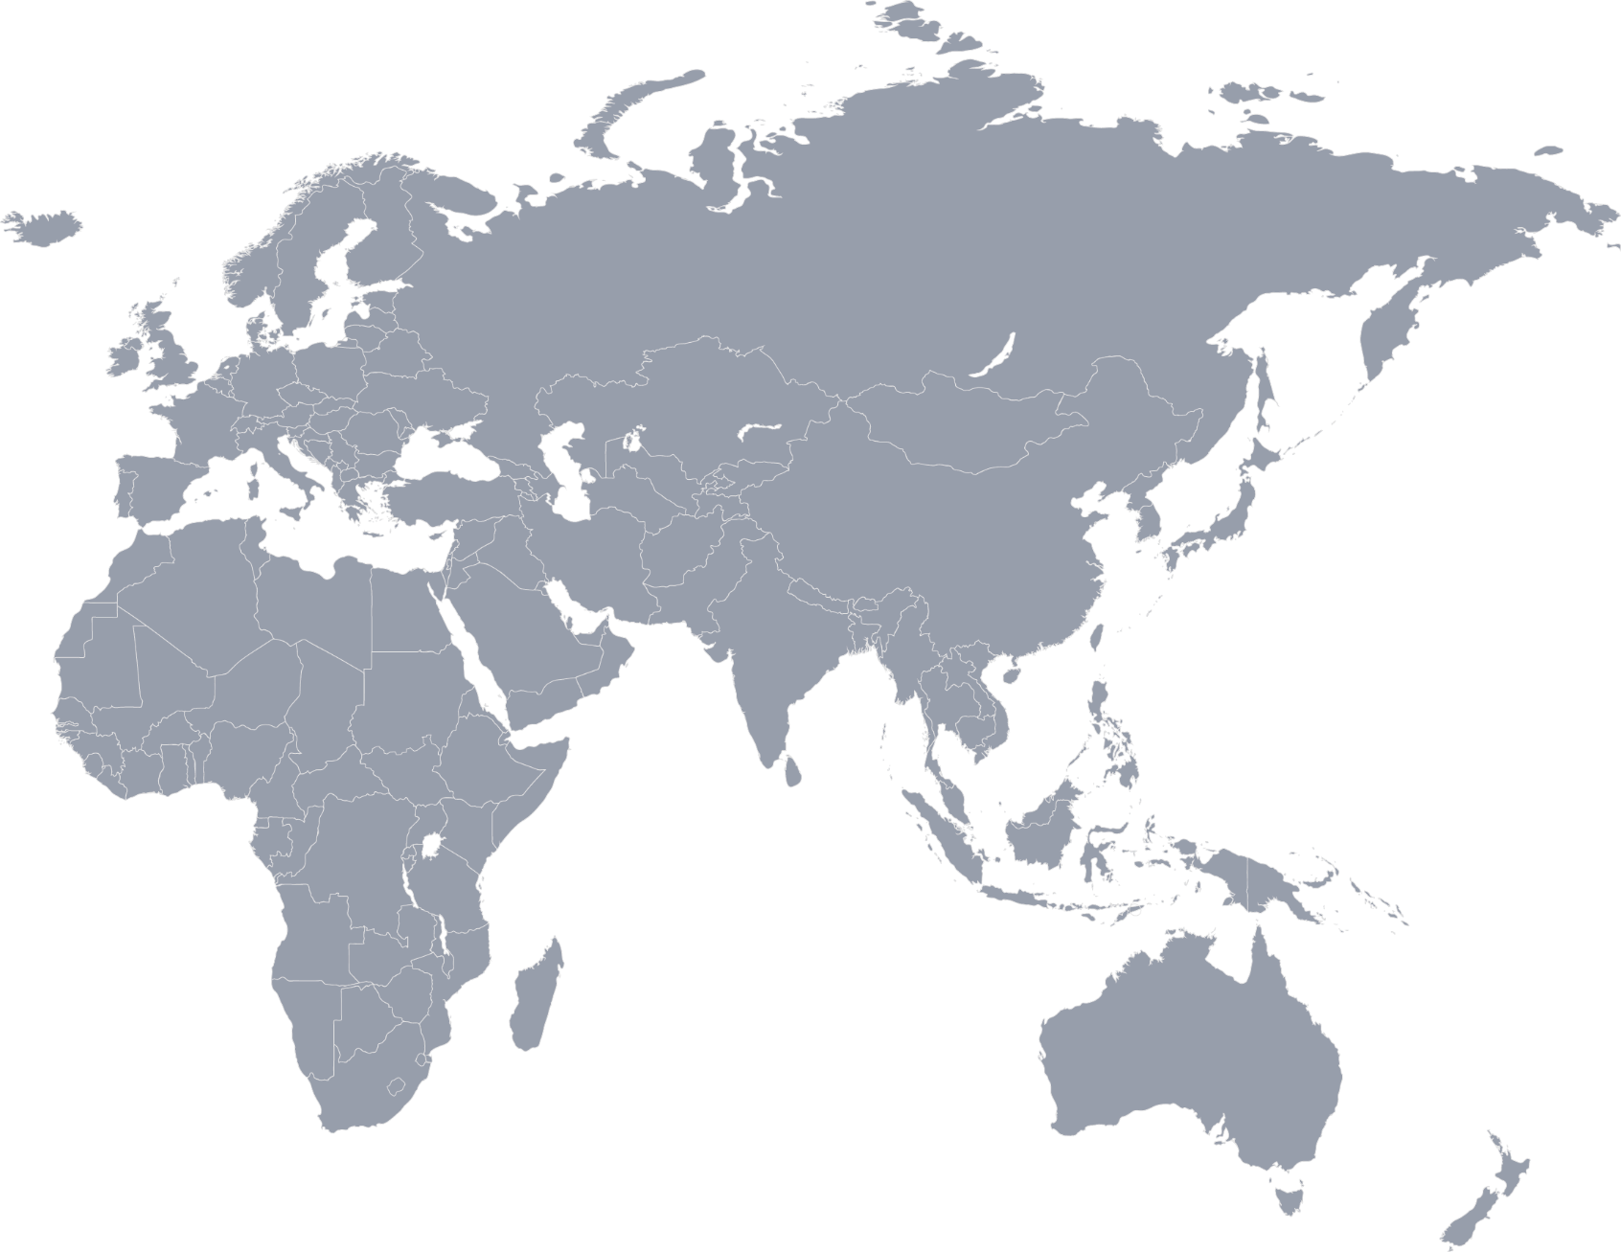











Regular & Reserve Army: OCONUS-based Units
V Corps (Forward)
Poznań, Poland
Eighth Army
Camp Humphreys, Korea
U.S. Army Europe and Africa
Wiesbaden, Germany
2^{d} Infantry Division
Camp Humphreys, Korea
7 MSC
Schwetzingen, Germany
U.S. Army Japan
Camp Zama, Japan
25th Infantry Division
Schofield Barracks, HI
U.S. Army Pacific
Fort Shafter, HI
Hawaii
Legend
Army Division
9 MSC
Fort Shafter, HI
Army Service
Component Commands
311 SC (T)
Fort Shafter, HI
Army Reserve Division
Puerto Rico
1 MSC
Fort Buchanan, PR
Army Reserve
Functional Command

Slide 19






























Army National Guard: Divisions & Brigade Combat Teams
28th Infantry Division
Pennsylvania
29th Infantry Division
Virginia & Maryland
34th Infantry Division
Minnesota
35th Infantry Division
Kansas & Missouri
36th Infantry Division
Texas
38th Infantry Division
Indiana
40th Infantry Division
California
42^{d} Infantry Division
New York
Hawaii
Guam
Alaska
Puerto Rico

Slide 20










Regular Army: Centers of Excellence
Combined Arms Center
Fort Leavenworth, KS
U.S. Army Mission Command CoE
Fort Leavenworth, KS
U.S. Army Sustainment CoE
Fort Gregg-Adams, VA
U.S. Army Special Operations CoE
Fort Liberty, NC
U.S. Army Maneuver Support CoE
Fort Leonard Wood, MO
U.S. Army Intelligence CoE
Fort Huachuca, AZ
U.S. Army Cyber CoE
Fort Gordon, GA
U.S. Army Fires CoE
Fort Sill, OK
U.S. Army Maneuver CoE
Fort Moore, GA
U.S. Army Aviation CoE
Fort Novosel, AL

Slide 21
FY24 Army Budget Request: President’s Budget Proposal
Base funding program
Request ($B) | FY22 _{Actuals} | FY23 _{Enacted} | FY24* (requested)
Military Personnel¹ | 66.5 | 68.0 | 69.8
Operation and Maintenance² | 66.3 | 70.6 | 72.1
Procurement/RDTE | 37.5 | 40.8 | 39.2
MILCON/Family Housing/BRAC | 3.2 | 3.9 | 2.8
Other Base³ | 2.0 | 1.8 | 1.7
Totals | 175.5 | 185.2 | 185.5
$185B
(REQUEST)
¹ Includes Medicare Eligible Retirement Healthcare Fund
² Includes Environmental Restoration Account (ERA) Funding
³ Other Base: Chemical Agent and Munitions Destruction; Army Working Capital Fund; Arlington National Cemetery; Counter-Islamic State of Iraq/ Syria Train and Equip Fund; Afghanistan Security Forces Fund (FY22 Only)
FY 2024 Army budget is committed to People First, sustaining readiness gains and continuing modernization within its topline.
Army’s budget request is a real growth rate of -2.4% with best estimate of inflation
Stable funding is necessary to:
  Support Our People - Soldiers, Civilians, and their Families
  Modernize the Force; Deliver Concepts and Capabilities
  Maintain Tactical Readiness and Build Strategic Readiness
*AS OF 9 may 23

Slide 22

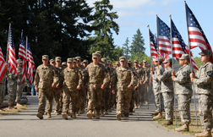
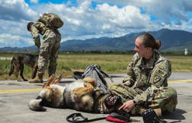

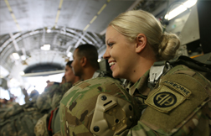


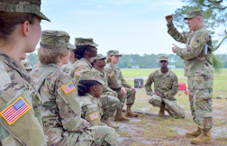
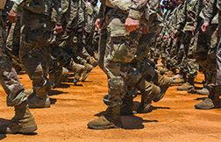
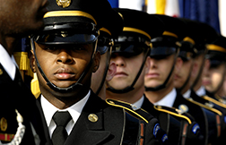
ASSOCIATION OF THE UNITED STATES ARMY

