Slide 1
PEO IEW&S Update
21 Sep 2021

Slide 2
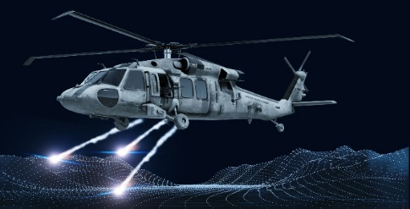

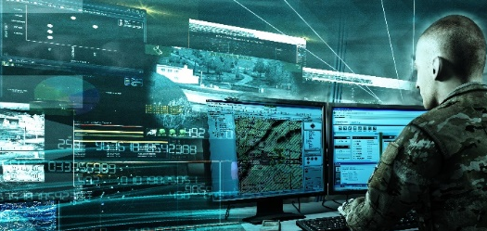

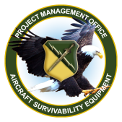

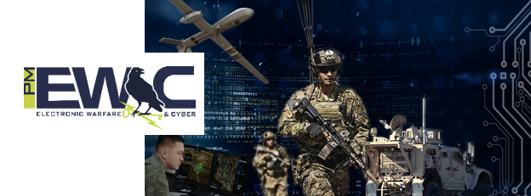
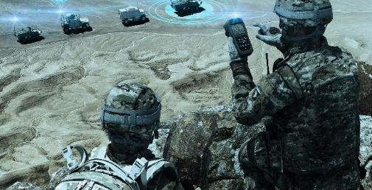

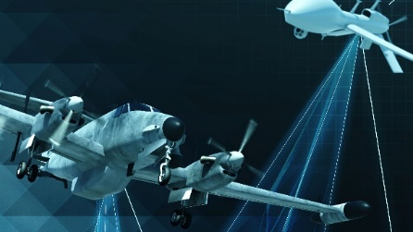


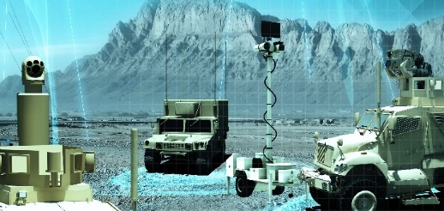

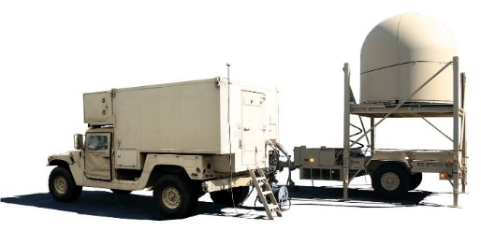
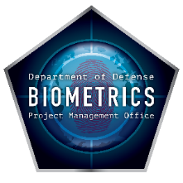

Mission Overview
PM Aircraft Survivability Equipment (ASE)
Develop and field aircraft survivability systems to maximize survivability of Army aircraft without degrading combat mission effectiveness.
PM Intel Systems and Analytics (IS&A)
Support the Army’s ISR mission for processing, exploitation, and dissemination (PED) of information and intelligence data across echelons.
Integration Directorate
Develop system architectures, threat and gap analyses, open standards, S&T plans, and modeling and experimentation across the portfolio in support of the CFTs, AFC, ISR TF, and IEW&S strategic growth.
PM Electronic Warfare & Cyber (EW&C)
Acquire integrated Intelligence, Electronic and Cyber Warfare capabilities to provide Spectrum and Cyberspace Superiority and enable freedom of maneuver on the Battlefield.
PM Position, Navigation, & Timing (PNT)
Positioning, Navigation and Timing leads the Army in developing and integrating PNT technology and also collaborates with the other Department of Defense (DoD) Services to deliver interoperable, reliable products.
PD Sensors Aerial Intelligence (SAI)
Develop, acquire, field, and supply life cycle support to modernized, integrated, and tactically relevant aerial ISR sensor and sensor processing payloads.
PM Terrestrial Sensors (TS)
Provide sensors for enhanced situational awareness and decisive action and Integrated Base Defense
PD Tactical Exploitation of National Capabilities (TENCAP)
Enable the Army to rapidly exploit and influence national capabilities and architectures to conduct advanced development and rapid prototyping to enhance and inform Army capabilities and CONOPS to pace the threat.
PM DOD Biometrics
Design, engineer, acquire, deploy, and sustain enterprise biometric solutions in multiple operating environments enabling identity dominance on the battlefield and across the DOD.
SENSOR AND SENSOR PROCESSING SYSTEMS ACROSS THE PEO PORTFOLIO
ENABLE ISR, INTELLIGENCE PRODUCTION, INTEGRATED BASE DEFENSE, FORCE PROTECTION

Slide 3
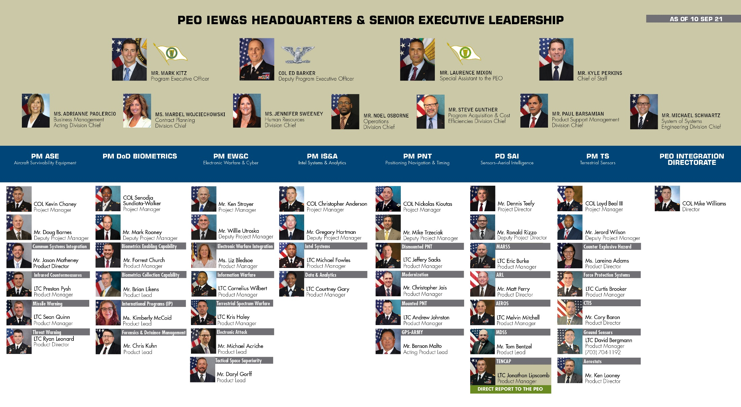
PEO IEW&S Leadership Updates
ACC
DIVISION CHIEFS
Bryan McGann ACC APG
Geoffrey Gill
ACC Belvoir
Cassandra Boyd ACC RSA
PEO IEW&S is made up of 7 project managers across 3 locations, dedicated to designing, delivering, and sustaining advanced technologies to give our Soldiers the decisive edge.

Slide 4
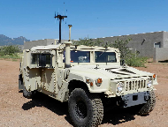
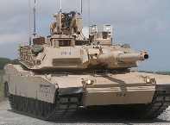
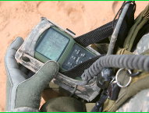
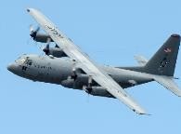
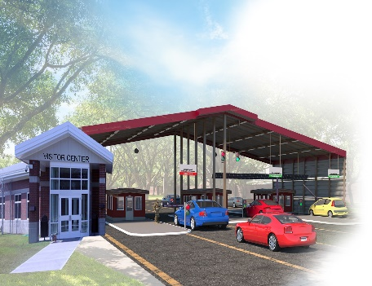
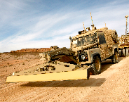
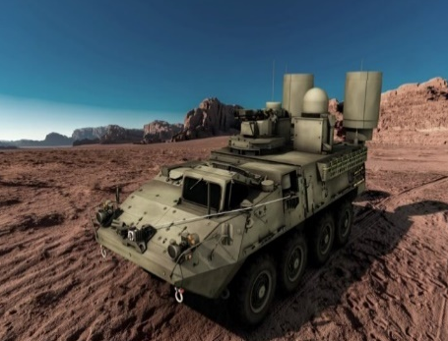
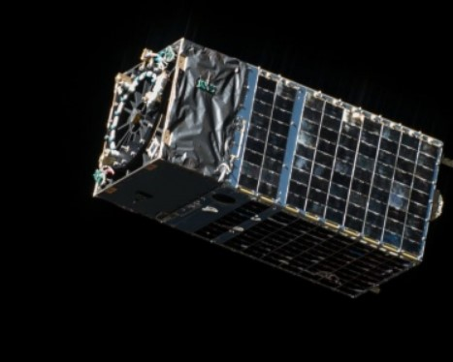
PEO IEW&S Acquisition Snapshot
29 ACAT III’s
10 ACAT II’s
4 ACAT I’s
16 ACAT IV’s
1 BCAT II
1 MTA
PROGRAM
57 QRC’s
17 PROJECTS**
CONTRACT ACTIONS
Total # of Contract Actions in FY19: 1,144
Total # of Contract Actions in FY20: 1,185
BUDGET
Total $ Executed in FY19: $2.4B
Total $ Executed in FY20: $3B
**A project is an effort with executing resources that does not yet fit the definition of a formal program of record or other acquisition pathway.
*** 10x other efforts are currently being worked but have not yet initiated the formal acquisition process to include MDSS and TITAN POR.

Slide 5
The Army’s Challenge
THE NEXT QUARTER CENTURY WILL NOT BE LIKE THE LAST
  Regional, existential threats are the reality today with a global threat possible, risking stability and alliances.
  The US needs to maintain overmatch in key areas like cyber, space, fires, and air defense.
Current Threats and Missions Will Endure and Evolve
  Challenges to US interests require the Army to sustain only minimal commitments to current CT/COIN/deterrence demands as the deterrence of near peer threats become the priority.
  Threats aim to secure regional interests rapidly and keep the US out by contesting force projection in all domains (maritime, cyber, space, air, and ground).
  Conflict with regional military peers could prove high risk with projected manning, equipment & readiness levels.
Need to Adapt to Threats Within Available Resources
  Honest examination of experiences and institutional preferences; retain what is effective, change others.
  Restructure and reorganize to meet today’s challenges without overinvesting against a single adversary.
  Prepare to fight and win outnumbered against one or more emerging global peer military powers.
For PEO IEW&S, this means a shift to Sense and Assess Deep with
continued investments in the EW, Cyber, and Tactical Space Domains

Slide 6
MDO Enablers
CROSS-CUTTING CAPABILITIES ACROSS MULTIPLE FUNCTIONS & PORTFOLIOS
  Space to Tactical Edge Intelligence Architectures
  Artificial Intelligence to Reduce Sensor to Shooter Timelines
  Big Data Management and Data Analytics Processing
  Sensor Technology
  Identity Management and Biometrics Collection and Processing
  Command Post and Sensor Computing Environment
  Electronic Warfare (EW) / Electronic Attack (EA) / Electronic Support (ES)
  Aircraft Survivability & Air Launched Effects (ALE)
OUTCOME:
  PROVIDES ABILITY FOR COLLECTING, ORGANIZING, ANALYZING, AND CONSUMING COMPLEX DATA TO SUPPORT THE ARMY OPERATIONAL CONCEPT AND INTELLIGENCE SUPPORT TO OPERATIONS

Slide 7


CFT and Modernization Alignment
  TITAN, DAPS, MAPS, ALTNAV, EWPMT
  EWPMT, TLS, CD1, CD2,ABE,
  Intel Apps, MFEW-AL, OCO
  PM PNT, PM IS&A,
  PM EW&C, TENCAP
  TITAN, TLS
  PM EW&C, PM IS&A
  PM ASE
  PM SAI,
  PM IS&A, PM EW&C,
  TENCAP
APNT CFT
Network CFT
LRPF
CFT
  3GEN, FLIR, MAPS
  CIRCM, MRWR, LIMWS, QRC
  PM PNT, PM TS
  PM ASE
NGCV CFT
FVL
CFT
MOD
ISR TF
Soldier Lethality CFT
  PM EW&C, PM IS&A, PM SAI, PM TS
  MFEW-AL, OCO, MDSS, ARL-E, TITAN
  PM DoD BIO,
  PM PNT
  DAPS, NXGBCC, BEC
STE CFT
AMD CFT
Acronym Key (A-F)
3GEN: 3rd Generation FLIR
ABE: Aircraft Survivability Equipment B-Kit Emulator
ALTNAV: Alternative Navigation
ARL-E: Airborne Reconnaissance Low-Enhanced
BEC: Biometric Enabled Capability
CD1/2: Capability Drop 1/2
CIRCM: Common Infrared Countermeasure
DAPS: Dismounted Assured PNT
EWPMT: Electronic Warfare Planning and Management Tool
FLIR: Forward-looking infrared
  PEO IEW&S
  PM IS&A, TENCAP
Acronym Key (L-T)
LIMWS: Limited Interim Missile Warning System
MAPS: Mounted Assured PNT
MDSS:Multi-Domain Sensor Systems
MFEW-AL:Multi-Function Electronic Warfare-Air Large
MRWR:Modernized Radar Warning Receiver
NXGBCC:Next Generation Biometric Collection Capability
OCO:Offensive Cyber Operations
TITAN:Tactical Intelligence Targeting Access Node
TLS:Terrestrial Layer System
  Soldier Touchpoint Opportunities,
  User Feedback
  TITAN
PEO IEW&S and CFTs are Directly Supporting Modernization, Readiness & Ongoing Operations (QRCs)

Slide 8
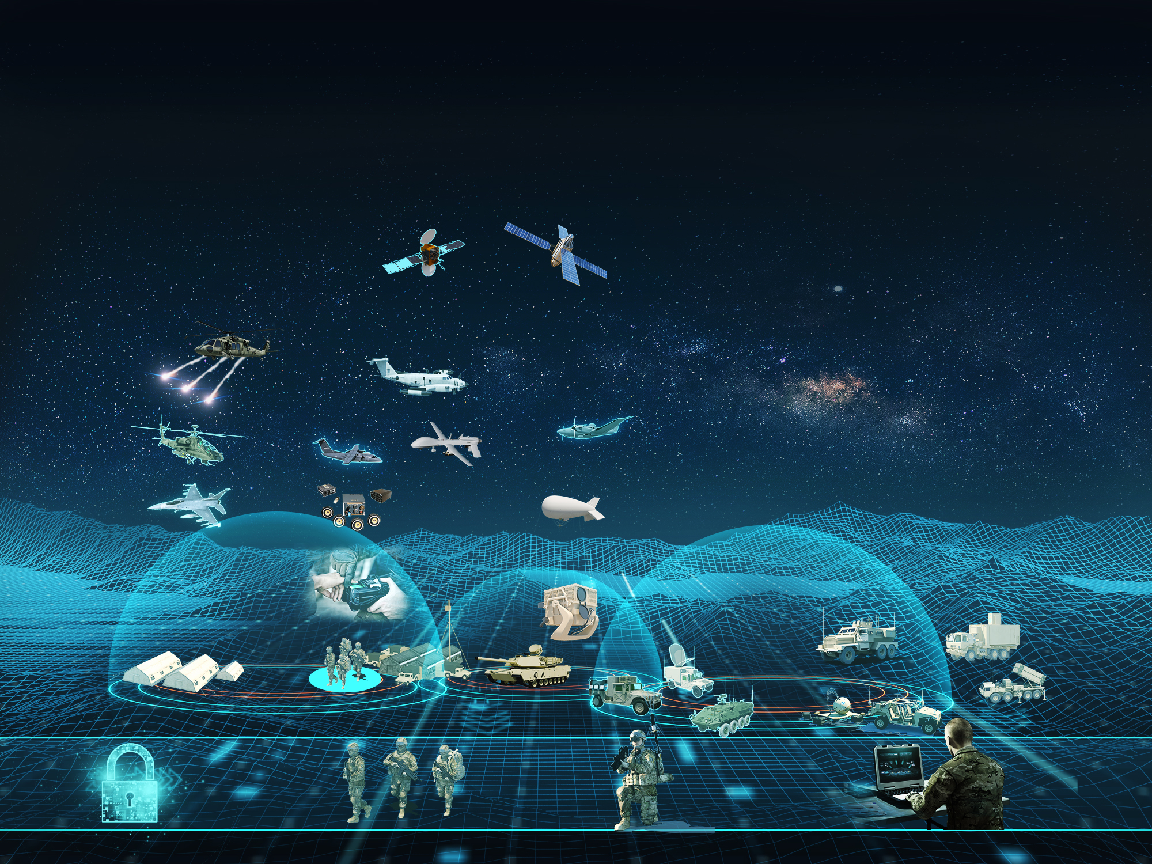
Strategic Support to MDO
PROTECT
Aircraft Survivability, Force Protection, and Biometrics Collection Systems Keep Our Soldiers Safe
SENSE
A Modernized Ground, Air, and Space Portfolio Lets the Army See Further and Support the MDO 2028 and Beyond
PROCESS
Receiving Intel and EW Data, IEW&S Systems Manage and Process Data from Across Domains, Services and Operational Layers
Maneuver & Delivery of Effects
Processed Intel Informs Non-Kinetic Effects and Maneuver Operations while PNT Provides Reliable Position, Navigation, and Timing to our Force
SPACE
AERIAL
RWR
ATIRCM
CIRCM
CMWS
LIMWS
MDSS
MFEW
ARL
EMARSS
GRCS
PSS-T
BEC
BAT-A
NXGBCC
AIE
2GF
3GEN
DCGS-A
TITAN
CD 1,2
TLS
Prophet
TERRESTRIAL
PNT
Non-Kinetic
DCO Effects
JCAP
EWPMT
Non-Kinetic
OCO Effects
Electronic Attack
CYBER
IEW&S support to MDO includes acquisition, development, and fielding of Army modernization priorities TITAN, MDSS, TLS, PNT, and Cyber Effects.

Slide 9
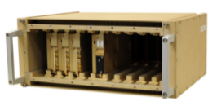
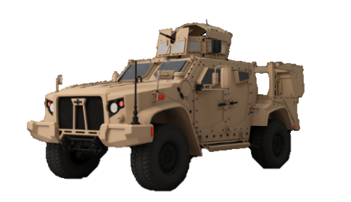

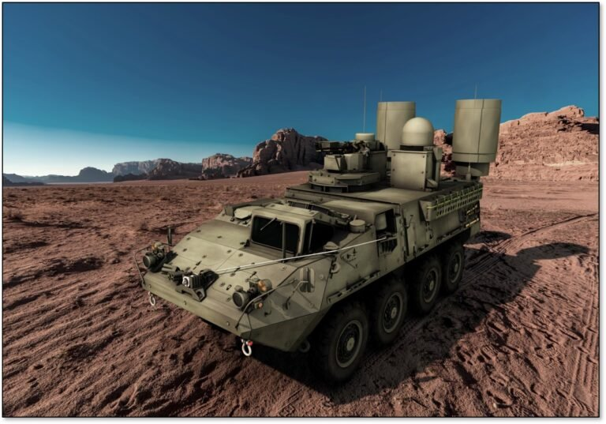
Open Systems Initiative
“The (HASC) committee is encouraged by the military services supporting Modular Open Systems Architectures (MOSA) on all future programs and platform modernization efforts. For example, the Army’s C4ISR Modular Open Suite of Standards (CMOSS), and the Air Force’s Sensor Open Systems Architecture (SOSA) standards are significant advances…. The committee commends such forward thinking and movement to unify around these standards."
-- HASC's William M. Thornberry NDAA for Fiscal Year 2021, pg. 175
ENABLING JOINT ALL DOMAIN C2 (JADC2):
ARMY INTEGRATED SENSOR ARCHITECTURE (ISA) with Sensor Computing Environment (CE):
Enabling interoperability between sensors and systems in a tactical environment
Successfully implemented by multiple PMs in PEO IEW&S
Submitted by ASA(ALT) as a MOSA Standard
Standards Based Solution for Discovery, Alerts Cross Cutting Capability
Maximize HW/SW resources, minimize SWAP, communicate between systems within a vehicle
PNT, TLS, and TITAN teams are leveraging CMOSS
Enables a Globally Integrated, All Domain, Joint Force that:
  Will be Joint Concept Driven, Threat Informed, Capability Development
  Enables Secure, Resilient C2, Battlespace Awareness, and Integrated Fires
  Has Mechanisms for Coalition Partner Participation
  Encompasses Any Sensor, Any Shooter
PEO IEW&S enablers include EWPMT, TITAN, MDSS, LEO, MFEW Air, Sensor CE, and TLS
SHAPING CMOSS OPEN SYSTEM ARCHITECTURE:
PEO IEW&S IS IMPLEMENTING LOGICAL STANDARDS ACROSS THE PORTFOLIO TO DELIVER
OPEN SYSTEMS THAT BETTER ENABLE RAPID INNOVATION AND INTEGRATION TO ACHIEVE MDO BY 2028

Slide 10
PEO IEW&S Strategic Challenges
  Theater Uncertainty
  Post Drawdown
  50% OCO Portfolio
1
2
  Talent Management in Fiscally Constrained Environment
  How to effectively grow skills to meet future need?
  Dependent on OEMs for Effective, Reliable, and Affordable Supply Chain Management
3
4
  Future Opportunities will need to be Cost Driven
5
  Technology Investments to include Quantum, AI/ML applications across the portfolio, Sensor Processing, Deep Sensing Technologies
6
  Need to Continue to Emphasize Strategic Alignment to the Joint Community
7
  Focus on growth in Force Protection, Space, and Cyber capabilities
8
  Enhance Aircraft Survivability Equipment with robust and integrated ASE to stay ahead of threat and Share Data for Intelligence Value

Slide 11
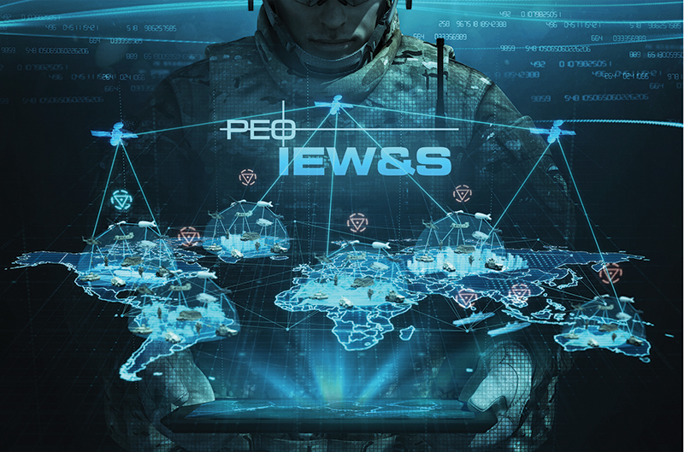
Questions
8th PEO IEW&S ALT Industry Forum
16 November 2021, 1300-1430
Virtual Event on ARMY 365 TEAMS
Register at https://peoiews-events.com/alt/

