Slide 1
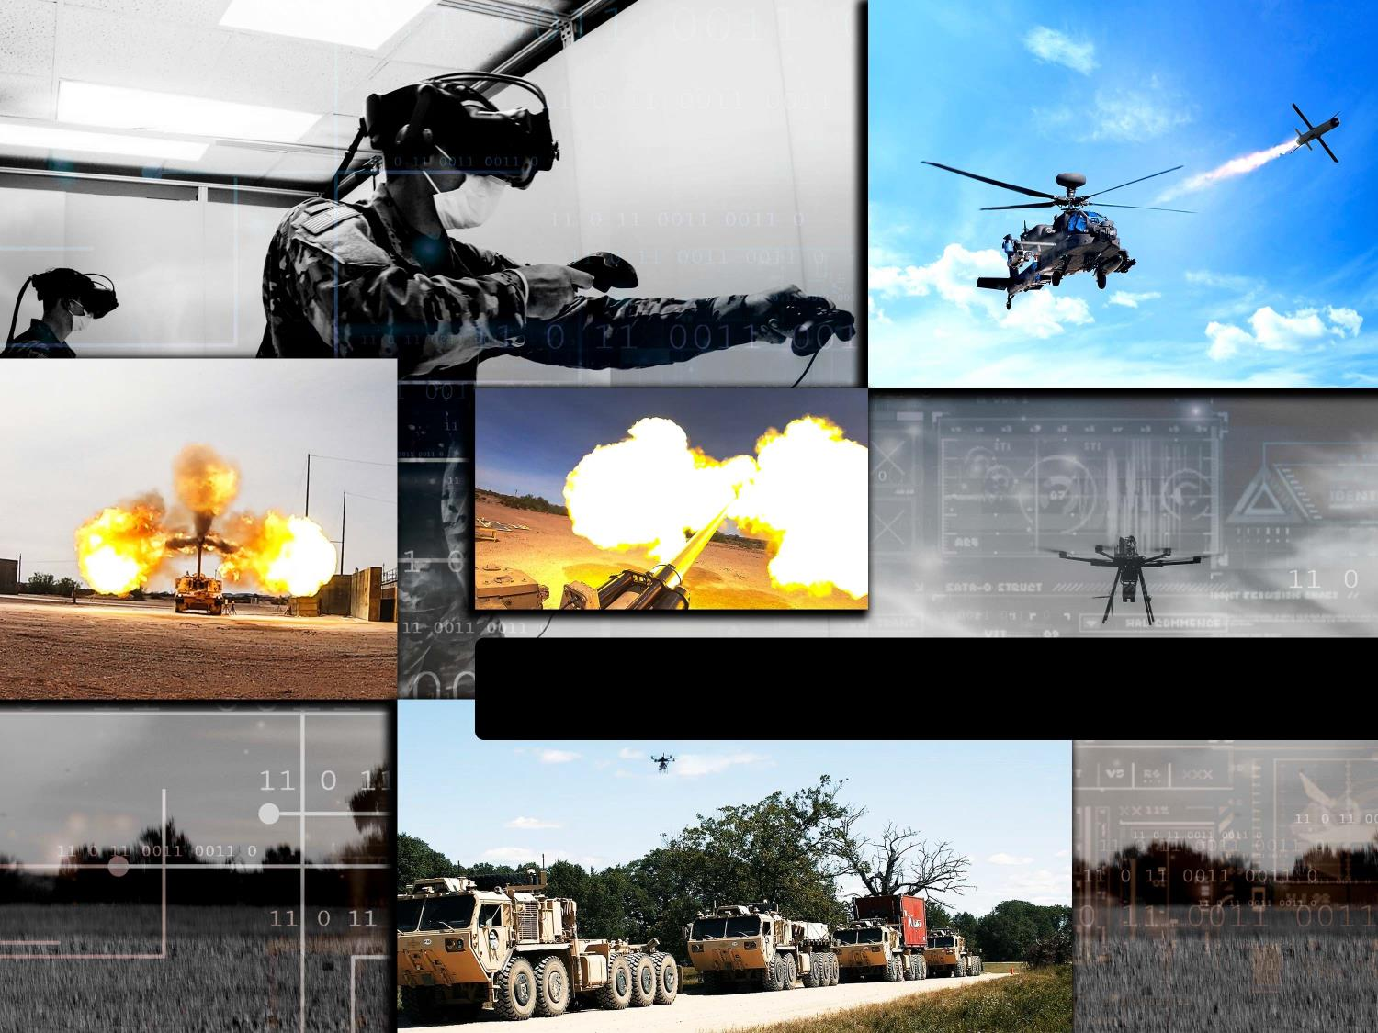
Chief Technology Officer
U.S. Army DEVCOM
Charneta Samms

Slide 2
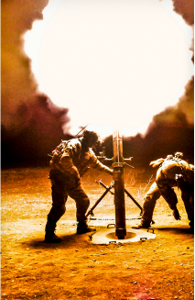
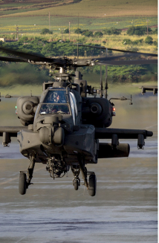
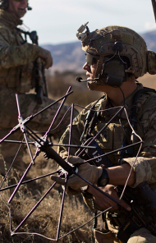
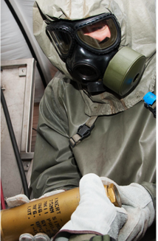
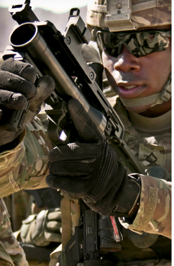
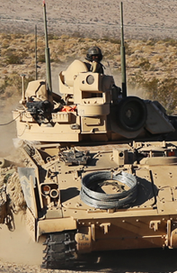
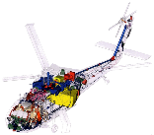
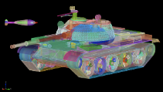
organization
U.S. ARMY FUTURES COMMAND COMBAT CAPABILITIES DEVELOPMENT COMMAND
CG DEVCOM
CSM DEVCOM
DCG DEVCOM
DtCG DEVCOM
S&T Integration Director DEVCOM
DEVCOM AMERICAS
DEVCOM ATLANTIC
DEVCOM INDO PACIFIC
Chief Technology Officer DEVCOM
Forward Element Center
Ft. Sam Houston, TX
Forward Element Center
Stuttgart, Germany
Forward Element Center
Ft. Shafter, HI
DEVCOM Army Research Lab
DEVCOM Armaments Center
DEVCOM Aviation & Missile Center
DEVCOM C5ISR Center
DEVCOM Chemical Biological Center
DEVCOM Soldier Center
DEVCOM Ground Vehicle Systems Center
DEVCOM Analysis Center
DEVCOM secures persistent innovation for a modern Army

Slide 3
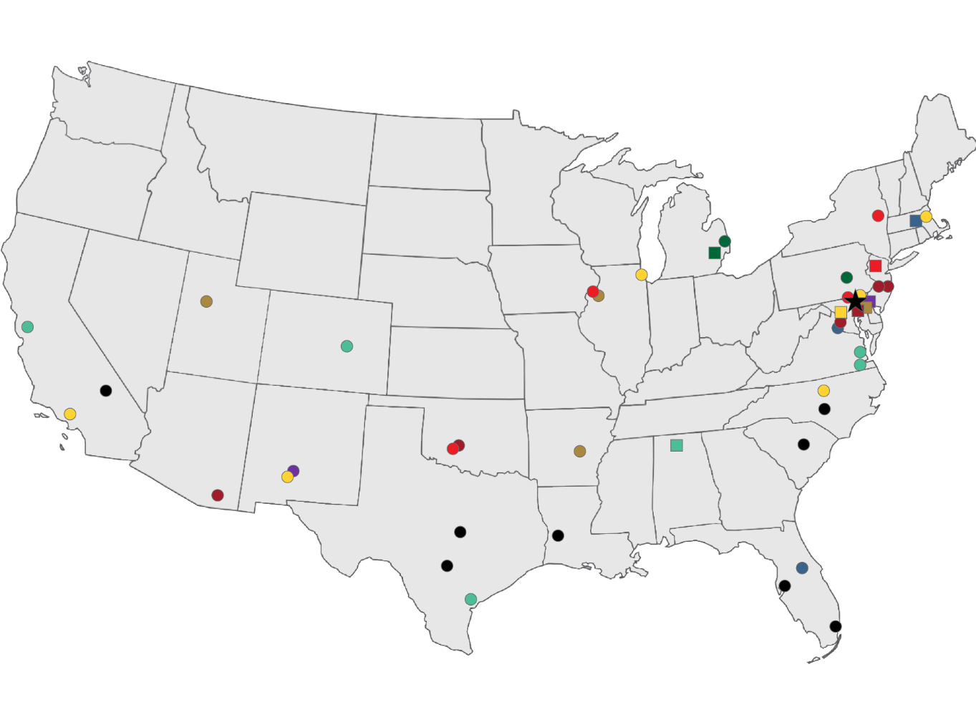
DEVCOM NATIONAL FOOTPRINT
DEVCOM
HQ APG, MD
DEVCOM HQ, APG, MD
Natick, MA
Arlington, VA
DEVCOM, NTC Support, Ft. Irwin, CA
DEVCOM, III CORPS, Ft. Hood, TX
DEVCOM, JRTC Support, Ft. Polk, LA
DEVCOM-AMERICAS, USANORTH/ USARSOUTH, Ft. Sam Houston, TX
DEVCOM, ARCENT Support, Shaw AFB, SC
DEVCOM, USSOCOM & ARCENTCOM Support, MacDill AFB, FL
DEVCOM, USSOUTHCOM Support, Miami, FL
DEVCOM, XVIII ABN Corp & USASOC Support, Ft. Bragg, NC
DEVCOM FAST HQ’s, ARL, PIF, & ARDEC APG, MD
National reach of supporting locations enables development of materiel solutions
State with DEVCOM support location
Aviation & Missile Center
HQ REDSTONE ARSENAL, AL
Armaments Center
HQ PICATINNY, NJ
Army Research Laboratory
HQ ADELPHI, MD
C5ISR Center
HQ APG, MD
Chemical Biological Center
HQ APG, MD
Soldier Center
HQ NATICK, MA
Analysis Center
HQ APG, MD
Ground Vehicle Systems Center
HQ WARREN, MI
Aviation & Missile HQ w/ PIF, Redstone Arsenal, AL
Ft. Eustis, VA
Moffett Field, CA
Corpus Christi, TX
Ft. Carson, CO
Hampton, VA
Other
Armaments Center HQ, Picatinny, NJ
Watervliet Arsenal, NY
Rock Island Arsenal, IL
APG, MD
Ft. Sill, OK
Other
Army Research Lab HQ, Adelphi, MD
APG, MD
White Sands Missile Range, NM
Raleigh-Durham, NC
UARC ICT, Los Angeles, CA
UARC ISN, Boston, MA
Other
C5ISR Center HQ, APG, MD
Ft. Belvoir, VA
Lakehurst, NJ
Ft. Dix, NJ
Ft. Huachuca, AZ
Ft. Sill, OK
Other
Chemical Biological HQ w/ PIF, APG, MD
Rock Island Arsenal, IL
Dugway Proving Ground, UT
Pine Bluff Arsenal, AR
Other
Soldier Center HQ w/ PIF, Natick, MA
Ft. Belvoir, VA
Orlando, FL
Other
Analysis Center HQ, APG, MD
White Sands Missile Range, NM
Other
Ground Vehicle Systems Center HQ w/ PIF, Warren, MI
Selfridge ANGB, MI
New Cumberland, PA
Other

Slide 4
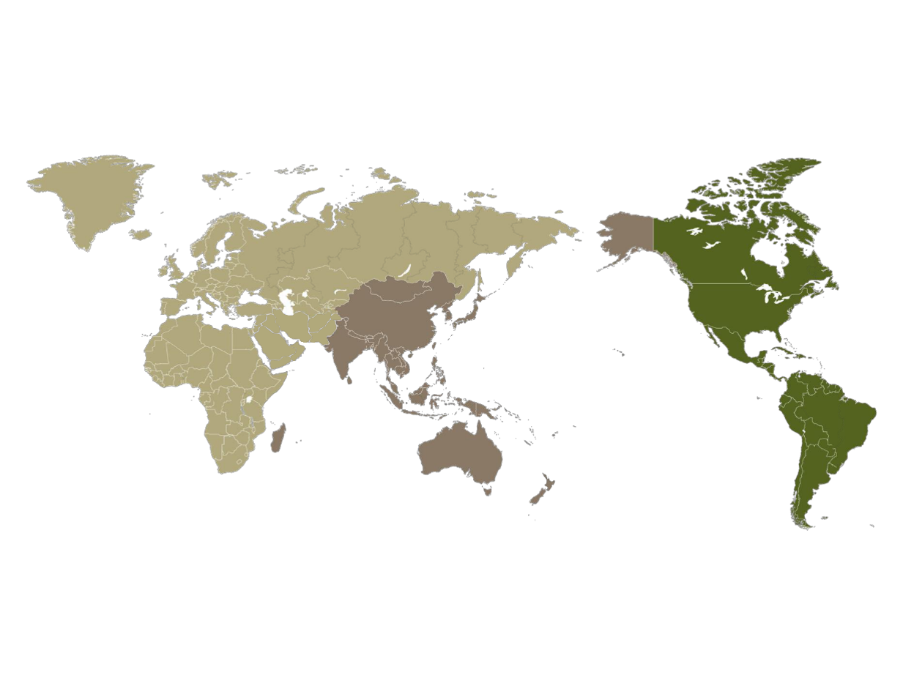
GLOBAL POSTURE
Technology Search
International Engagement
Warfighter Support
USAREUR
Wiesbaden, Germany
DEVCOM ATLANTIC
EUCOM
Stuttgart, Germany
USFK/8th ARMY
Seoul, South Korea
25th ID
Schofield Barracks, HI
ALCOM/USAARAK
Anchorage, AK
I CORPS
JBLM
Tacoma, WA
ITC NORTH AMERICA
(Canada & Mexico)
Ottawa, Canada
7th ATC
Grafenwohr & Hohenfels, Germany
USARJ
Camp Zama, Japan
DEVCOM INDO PACIFIC USINDOPACOM/ USARPAC
Oahu, HI
ITC UNITED KINGDOM
London, United Kingdom
DEVCOM HQ
APG, MD
ITC SOUTHERN EUROPE
Paris, France
FORSCOM, XVIII ABC, USASOC
Ft. Bragg, NC
SETAF-AF
Vicenza, Italy
ARCENT
Shaw AFB, SC
LEGEND
DEVCOM Americas
DEVCOM AMERICAS
USARNORTH USARSOUTH
Ft. Sam Houston, TX
DEVCOM Atlantic
DEVCOM Indo-Pacific
USCENTCOM, USASOCOM
MacDill AFB, FL
DEVCOM HQ
DEVCOM-Forward Element HQ. Provide oversight of AOR assets/partners to enable RD&E through S&T collaboration and Warfighter support
ITC MEDITERRANEAN
Tel Avis, Israel
International Technology Centers (ITC) Shape international partnerships, identify foreign technology and ensure interoperable solutions
Field Assistance in Science & Technology (FAST) Advisors provide S&T support to Combatant Commands and Army Service Component Commands (COCOMS/ASCCs)
ITC SOUTHEAST ASIA
Singapore, India
ITC NORTHEAST ASIA
Tokyo, Japan
ITC SOUTH AMERICA
(Central & South America)
Santiago, Chile
ITC BRAZIL
Sao Paulo, Brazil
ITC NORTHERN EUROPE
Koblenz, Germany
V Corps
Frankfurt, Germany
ITC SOUTH PACIFIC
Canberra, Australia
Enabling Army Modernization Around the World with Our Service Components, Allies and Partners

Slide 5
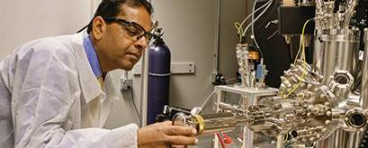
DEVCOM workforce
General Engineering (26%)
Over 27,000 Military, Civilians, and DoD contractors executing 77% of Army S&T to empower, unburden and protect the Warfighter.
Scientists, Engineers, & Analysts – 77%
Mechanical Engineering (15%)
Military 1%
Contractors – ~46%
Electronics Engineering (13%)
Civilians – 53%
Computer Engineering (7%)
14,000+
CIV/MIL Workforce
Computer Science (6%)
Analysis & Operations Research (6%)
Business 17%
Aerospace Engineering (6%)
Chemistry (3%)
Electrical Engineering (3%)
Engineering Technician 6%
Chemical Engineering (2%)
Physical Science (2%)
Physics (2%)
Materials Engineering (2%)
Other Specialties (3%)
Biology (1%)
Intelligence (1%)
**46% Contractor Workforce based on workforce total to include CIV/MIL/CTR not based on 14,279 CIV/MIL total, information updated 30 JUN 2021
Psychology (1%)
Industrial Engineering (1%)

Slide 6
MODERNIZATION AND Research Priorities Integration
ARMAMENTS
CENTER
C5ISR
CENTER
AVIATION & MISSILE
CENTER
SOLDIER
CENTER
CHEMICAL BIOLOGICAL
CENTER
ARMY RESEARCH LABORATORY
GROUND VEHICLE SYSTEMS CENTER
ANALYSIS CENTER
MODERNIZATION PRIORITIES
LONG RANGE PRECISION FIRES
NEXT GENERATION COMBAT VEHICLE
FUTURE VERTICAL LIFT
NETWORK C3I & A-PNT
AIR & MISSILE DEFENSE
SOLDIER LETHALITY
RESEARCH PRIORITIES
QUANTUM
HYPERSONIC FLIGHT
ARTIFICAL INTELLIGENCE
AUTONOMY
SYNTHETIC BIOLOGY
DISRUPTIVE ENERGETICS
RF ELECTRONIC MATERIALS
MATERIAL BY DESIGN
SCIENCE OF ADDITIVE MANUFACTURING
DEVCOM Lead
DEVCOM Investment

Slide 7
Science & Technology integration
DIRECTOR
DEPUTY DIRECTOR
MILITARY DEPUTY
CHIEF TECHNOLOGY OFFICER
FOCUSED STRATEGY GROUP
DEPUTY CHIEF TECHNOLOGY OFFICER
OFFICE OF THE DIRECTOR
S&T INTEGRATION TEAM
Office of the Chief Technology Officer (OCTO)
PLANNING DIVISION
PROGRAMS DIVISION
DATA ANALYTICS DIVISION
EXPERIMENTATION DIVISION
PARTNERSHIPS DIVISION
INTEGRATING s&t Across the command

Slide 8
Office of the chief technology officer (OCTO)
CTO GUIDING PRINCIPLE
To integrate science and technology across the command, Army, other services and agencies, academia, industry, and international.
S&T STRATEGY AND IMPLEMENTATION
Strategy development and dissemination
Implementation Plan development, dissemination, tracking
Inform research program development & guidance
INTEGRATION OF TECHNICAL EXPERTISE
Strategic integration of technical SMEs across various communities
Facilitate integrated program planning & proposal development
CTO areas of focus
INTEGRATED PICTURE OF S&T
Integrated view of S&T across and beyond DEVCOM to support decision making
Enable development of integrated S&T efforts across command
STRATEGIC INFLUENCE
Execute strategic initiatives in support of command
Explore topics of strategic interest via dedicated strategy groups
Provide recommendations and guidance to enable strategic decision making across the command
Cultivate a culture of innovation across the command

Slide 9
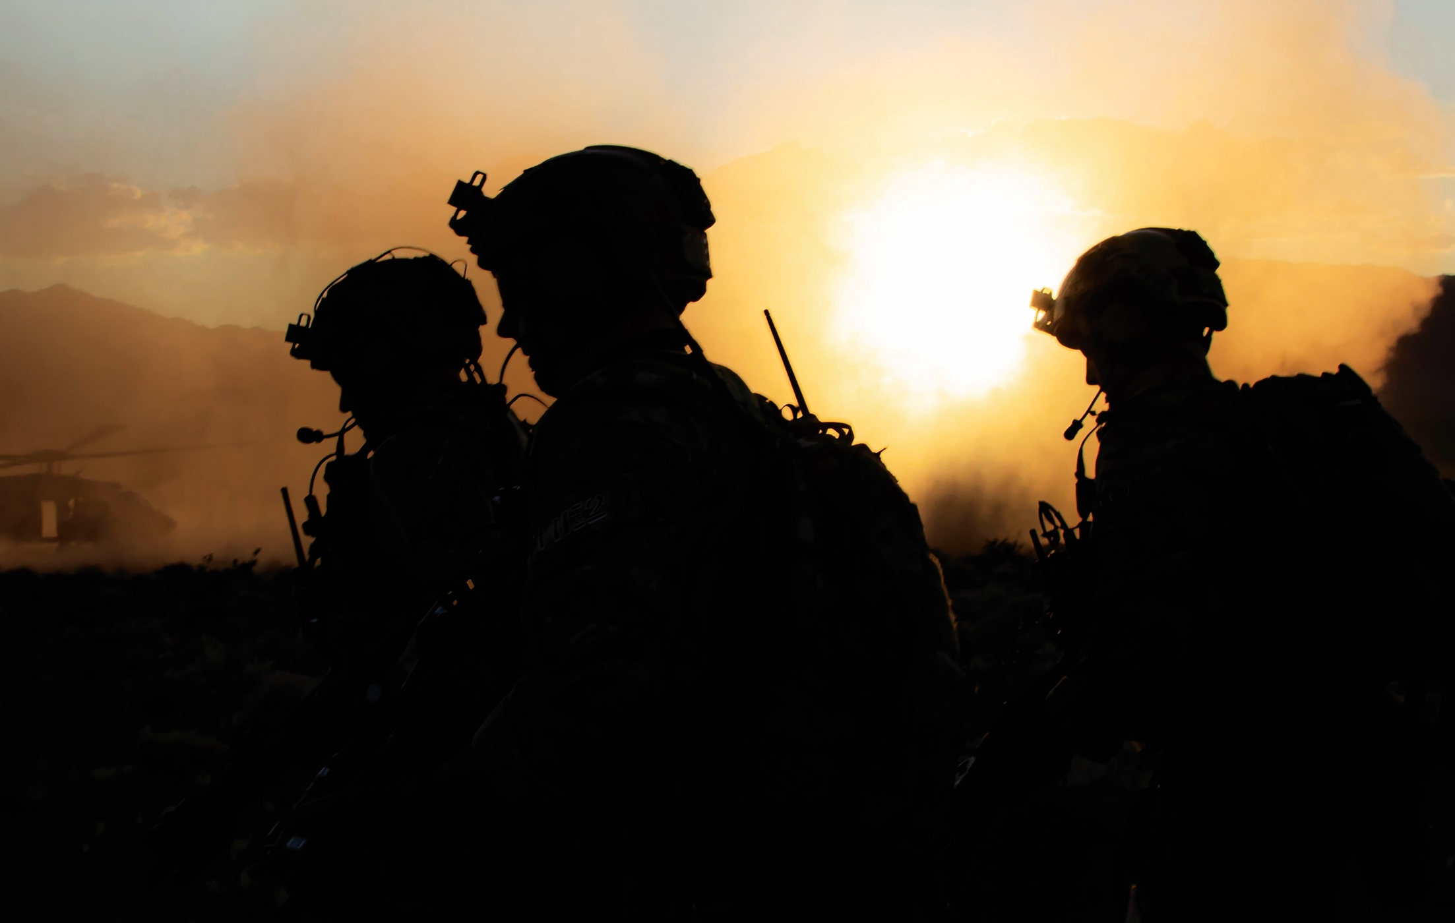
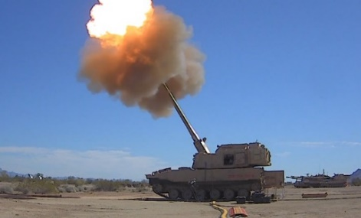
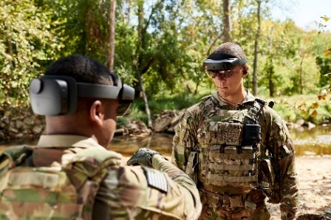
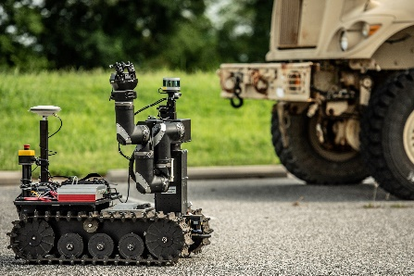
PARTNER WITH US!
AFC DEVCOM welcomes our industry, academia and non-traditional partners to collaborate with us!
Army Modernization Priorities
Long Range Precision Fires
Next Generation Combat Vehicles
Future Vertical Lift
Network
Air and Missile Defense
Soldier Lethality
Priority Research Areas
1. Disruptive Energetics
2. RF Electronic Materials
3. Quantum Technologies
4. Hypersonic Flight
5. Autonomy
6. Artificial Intelligence
7. Synthetic Biology
8. Materials-by-Design
9. Convergent Manufacturing
Potential Partnership Mechanisms:
Cooperative Research and Development Agreement (CRADA)
Broad Agency Announcements (BAAs)
Small Business Innovative Research (SBIR) Program
Small Business Technology Transfer Research (STTR) Program
Other Transaction Agreements (OTAs)
With many other opportunities to explore…
AFC Partnerships Portal Opening Soon!
Interactive portal for external Partners to submit/track AFC opportunities, including PC events
https://armyfuturescommand.com/

Slide 10
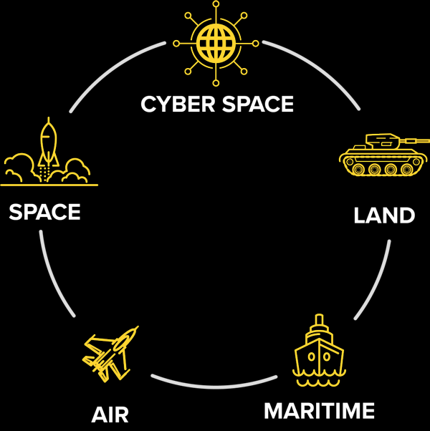
PROJECT CONVERGENCE
Project Convergence is a dedicated campaign of learning and experimentation that ensures the Army, as part of the Joint and Combined force, can rapidly and continuously converge effects across all domains – land, air, sea, space and cyberspace.
Technology Collaboration Areas
Sensor
Effect (kinetic/non-kinetic)
C2 (Maneuver, Fires, Intel)
Protection (EW, Physical)
Communications (SATCOM, Aerial, Terrestrial)
Assured PNT
Robotics
Artificial Intelligence / Machine Learning
Medical
Sustainment
Autonomy
Cloud Computing
Planning

