Slide 1
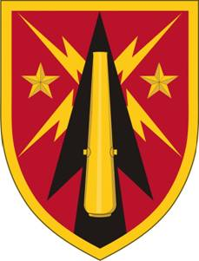
AUSA AMD Hot Topic:
Fires Conceptual Framework Supporting Multi-Domain Battle
07 Feb 17
MG Brian J. McKiernan
Commanding General,
Fires Center of Excellence

Slide 2
Emerging Operational Environment
Emerging Operational Environment:
Aggressive revisionist peer states challenge US and allied interests
US comparative military advantages diminished
Ground combat capabilities and capacities out of balance for conflict with peer adversaries
US forces not postured to deter conflict
US forces challenged in all domains, EMS, and cognitive dimension of warfare
Presumptive loss of air supremacy
Changes in the Character of War
Contested domains from air/maritime deployment to cyber & space
Enemy designed to keep US out (A2/AD)
No longer assume air superiority
Massed precision long-range fires with area effects
Increased lethality
WMD proliferation
Violent, brutal, ambiguous adversaries (hybrid warfare)
Sensor-rich environment & social media
Dense urban areas with large populations
Intense information wars
Less time to deploy and act (compressed decision cycles)
Smaller more costly force structure
Threat Overmatch:
US Fires forces have insufficient number of systems and munitions
US Fires systems are outmatched in range and lethality
US Fires forces are vulnerable to EW and cyber attack
US Fires forces’ core competencies (technical proficiency, survivability, movement) have atrophied
US Fires munitions are not cost effective
US forces have significant capability gaps (e.g., short range air defense, long range surface-to-surface, degraded electronic operations)

Slide 3
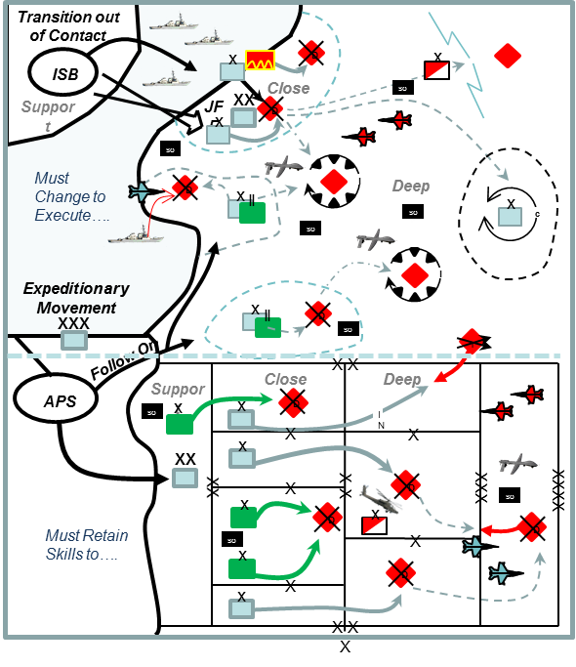
Fires in Multi-domain Battle
Fires in Multi-domain Battle:
Leverage Joint, Inter-organizational, and Multinational (JIM) Capabilities
Fires forces work closely with JIM partners
Fires systems interoperable by design to facilitate seamless JIM integration
Multifunctional Fires Convergence
Evolutionary combination of organizations, systems, skills, training, and education common to both field artillery and air defense
Enhanced Sensor-to-Shooter Linkages
To successfully deliver fires against concealed, hardened, low observable, or mobile targets, organic sensor capabilities must be expanded and integrated with JIM sensors
Cross-domain Fires
Employment of lethal fires and nonlethal effects across all domains, creating multiple dilemmas for enemies to ensure friendly freedom of action and enable Joint Force overmatch
Fires Tenets
Precise…………Operating with accuracy, achieving desired effects only on desired targets
Responsive…….Reacting quickly and appropriately
Effective………..Appropriate capacity, range and lethality
Multifunctional…Organizations, systems, leaders, and Soldiers able to conduct both fires supports and air defense tasks

Slide 5
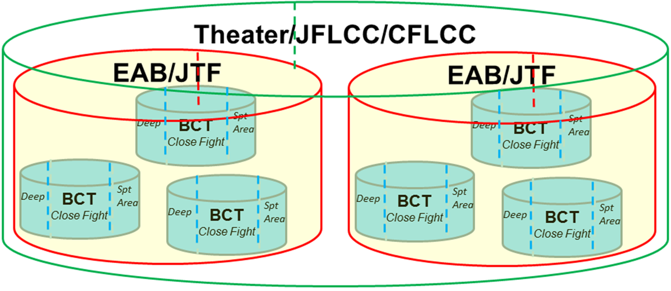
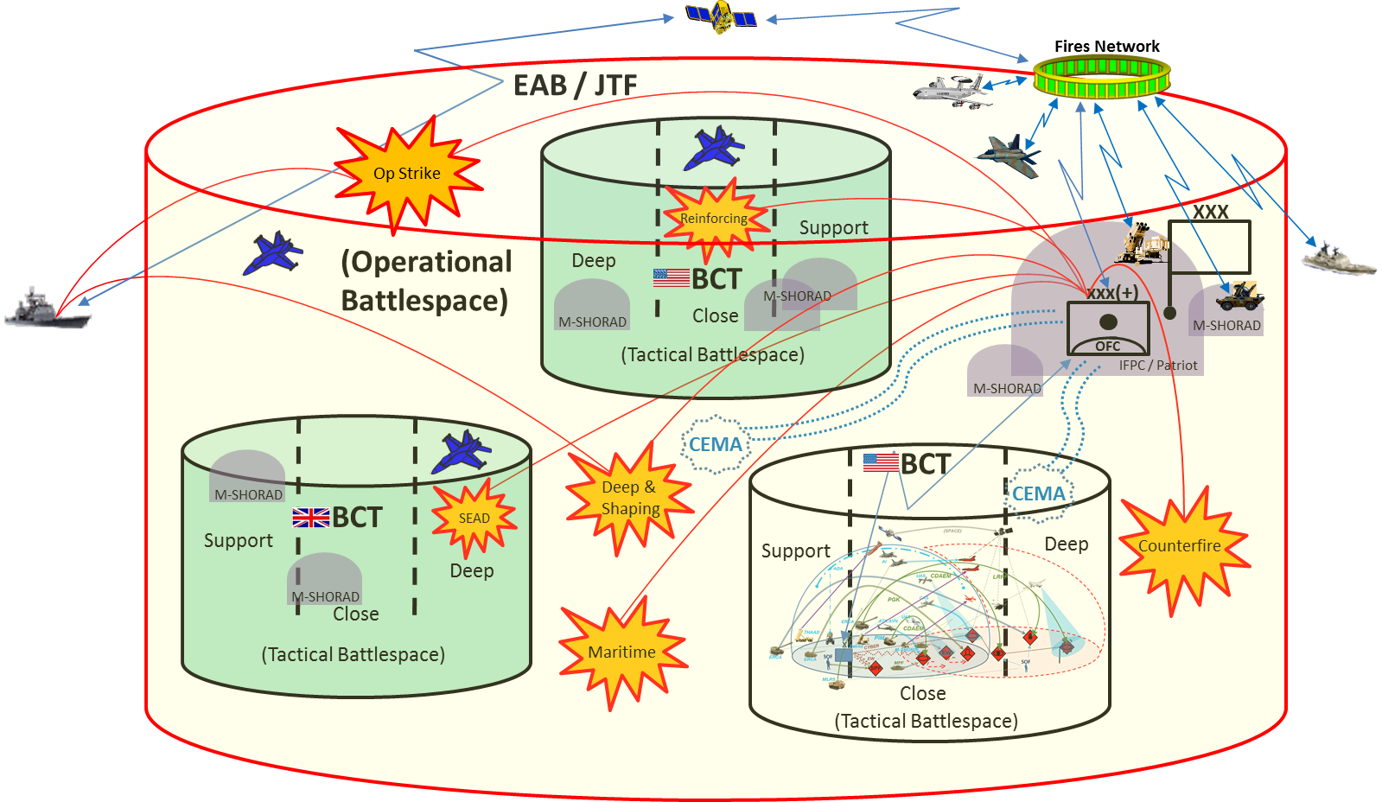
Employing Cross-domain Fires
Strategic Fires Command
Operational Fires Command

Slide 6
Questions

