Slide 1
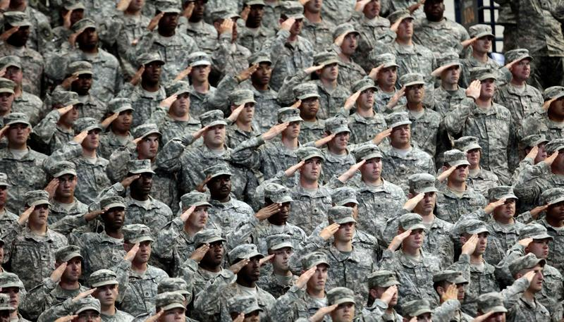
Installations:
The Army’s Platforms for Readiness
The Association of the United States Army
Contemporary Military Forum 4
Notes:
(Opening Slide – Hold to until ASA introduction)
GEN Leon Salomon, USA Retired, AUSA Senior Fellow introduces Forum and HON Hammack

Slide 2

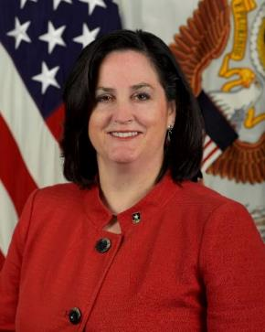
HON Katherine Hammack
Assistant Secretary of the Army
(Installations, Energy and Environment)
Notes:
(HON Hammack Slide – Hold through introduction and “thank you to GEN Salomon and AUSA)
General (Leon) Salomon, thank you.
I also like to thank AUSA for giving us the opportunity to talk about our Installations, the Army’s Platform for Readiness

Slide 3
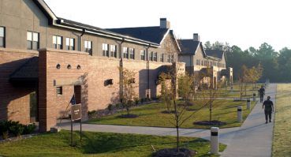
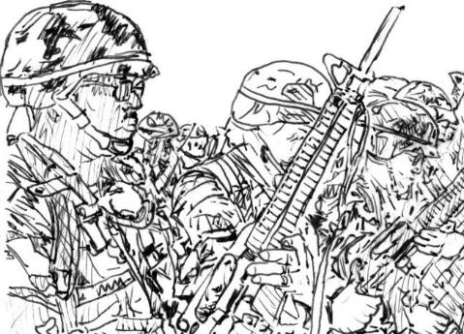
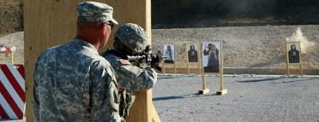
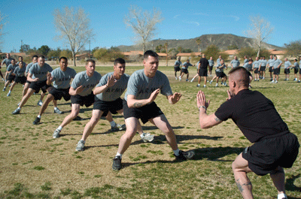
We Are The Army’s Home
Platforms for Readiness
Notes:
Ladies and gentlemen, good morning.
Before the Army can significantly increase readiness, there must be an infrastructure to support Army manning, training, equipping and leader development. Army readiness occurs on Army installations – where Soldiers live, work and train.
We must be ready to shape the global security environment, defend our homeland, and win the nation’s wars.
To meet these missions, the Army requires ready and resilient Installations – our power projection platforms – to enable regional engagement and global responsiveness. Installations ensure our operational forces have the foundational support required to prepare Soldiers and their units to train, deploy, fight, and win.
The foundational support provided by Installations encompasses the essential services and programs needed to develop and sustain ready and resilient Soldiers.
Support capabilities ranging from modern fitness centers, nutritional dining facilities, and state-of-the-art simulators and ranges ensure Soldiers have the essential components to build personal proficiency and unit readiness.

Slide 4
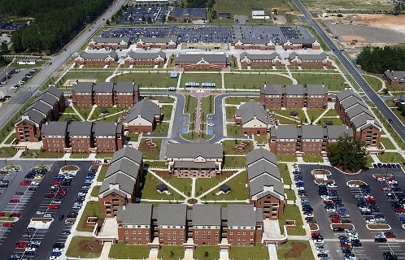
Challenges
New Missions
Budgets
Resources
Weather Changes
Fort Bragg
Notes:
Like any small city, there are challenges associated with providing these services, supporting new missions like cyber and the day-to-day upkeep of existing facilities and infrastructure. There are also costs to restoring critical facilities damaged by weather, pests, or age. Declining and uncertain budgets impact the Army’s ability to properly steward the facilities, infrastructure, land, and natural resources the public has entrusted to us.
These challenges have been further exacerbated by the impact of changes in weather patterns and climate. The Army is not immune from the impacts of extreme weather events taking place across the country, which have resulted in increased costs for repairing storm-related damage to our infrastructure. Severe weather at Fort Benning, Georgia in December 2015 and at Fort Polk, Louisiana in March 2016 resulted in over $20 million in infrastructure damages. Decreased budgets diminish our ability to repair these types of damages in order to sustain operations, including training and power projection activities.
By the end of this year, the Army will own and operate 21 percent more real estate and facilities than can be conceivably put to productive military use. The bill to sustain and support this real estate amounts to $500 million a year in unnecessary expenditures – funds that could be spent on Army priorities. In order to maintain, restore, and sustain the Army’s platforms for readiness, we need more than just adequate and reliable funding – we need the ability to divest the Army of infrastructure and facilities that are simply unnecessary. Reducing the Army's infrastructure footprint through Base Realignment and Closure (BRAC) would mean more money for training, modernization, and personnel.

Slide 5
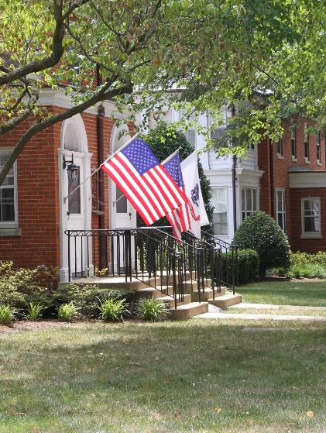
Installations of Today
Ready & Resilient
Environmental
Energy
Water
Waste
Cyber
Notes:
We must steward the properties entrusted to us, clean up and return lands to environmentally safe levels, safeguard the hundreds of endangered species, and protect thousands of archeological, natural, cultural, and tribal resources on military training and testing lands.
The Army is actively partnering with private industry on energy and water efficiency projects by leveraging alternative financing authorities through energy savings performance contracts (ESPCs) with the private sector and utilities. ESPCs allow the Army to replace failing systems with highly efficient and reliable technology. They are used to optimize energy and water usage and improve facilities on Army installations. These efforts enhance resiliency and mission effectiveness.
The Army has had great success with diversifying power with renewable energy. There are presently 19 large-scale renewable energy projects in various stages of the operations, construction, contracting, or assessment process. These projects leverage private financing in lieu of congressionally appropriated or taxpayer dollars to provide more than 400 megawatts of renewable energy. They are attracting over $888 million in private sector investment, and generate a cost avoidance of $249 million on Army utility bills. Because these renewable projects provide access to secure electricity generation assets at costs that are equal to or less than current or projected installation utility rates, the Army can focus its limited funds more on other readiness requirements.
A cyber-base future, builds new community partnerships, increases connectivity and better connects information and devices to people. High-speed audio, visual and digital communications on our installations are part of a broader national, state and local infrastructure. Cyber serves as a physical platform, increasing connectivity and enhancing security and emergency response. Along with these capabilities comes a new set of vulnerabilities which require addressing.
The Army manages over 12 million acres of land. This inevitably lead to interactions with endangered species, historic preservation requirements, or land restoration needs that permit continued Army operations.

Slide 6
Installations of the Future
Preparing for Tomorrow
Reassess functions
Increase ownership diversity
Expand efficient technologies
Community Partnerships
Notes:
Today, we are releasing our Installations, energy and environment strategy 2025. Cards that direct you to the online version were placed on each seat. This describes an updated set of goals and objectives that are helping us measure our progress in moving toward our vision for 2025.
We are now in development of our 2035 strategy. Through a newly created “Base of the Future” study, the Army will be looking to the future and rethinking what military bases should focus on over the longer term – what kind of security is really needed, what needs to be on base, and which services are better provided by the surrounding community. The Army has the opportunity to reset for the future, examine new technologies, new requirements, and current affordability. To maximize installation readiness, the 1800s model must be updated to fit the needs of today and the next century.
We will continue to explore how we can expand partnerships, strengthen community ties, and benefit both the Army and our service-providing partners, to ensure installations remain the Army’s platform for readiness.
We owe it to our men and women who wear the Army uniform to ensure they have the best resources available to defend our homeland.

Slide 7
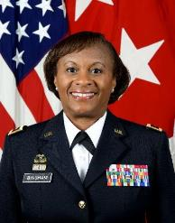
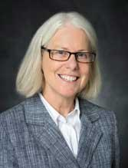
Army Installations: Soldier and Mission Readiness
LTG Gwen Bingham
Assistant Chief of Staff
Installation Management (ACSIM)
Roles of a Resilience Officer
Ms. Theresa O’Donnell
Chief Resilience Officer
City of Dallas
Notes:
Now let me introduce the distinguished members of our panel.
Starting with Lieutenant General Gwen Bingham, the principal military adviser to the Chief of Staff of the Army and Assistant Secretaries of the Army for all matters related to installations.
This includes facilities and infrastructure, environmental programs, housing, morale, welfare and recreation, family support programs, public and private partnerships, and energy and water security and sustainability.
General Bingham will discuss Soldier and Mission readiness on Army installations.
Ms. O’Donnell serves as the Chief Resilience Officer for the City of Dallas.
She leads the development and implementation of a robust Resilience Strategy for the City of Dallas within the policy framework of the 100 Resilient Cities Program and Global Network, pioneered by the Rockefeller Foundation.
She has more than 25 years of experience as a professional planner and has served the City of Dallas since 2003 in a number of roles such as the Director of Sustainable Development and Construction.
She will be speaking on the roles and challenges addressed by city resilience officers.

Slide 8
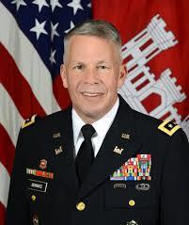
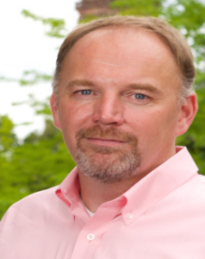
Construction technologies for efficient, resilient and sustainable installations
LTG Todd Semonite, P.E.
Chief of Engineers and Commanding General
U.S. Army Corps of Engineers (USACE)
Cyber and Information
Technology Trends
Dr. Patrick McDaniel
School of Electrical Engineering and Computer Science
Pennsylvania State University
Notes:
Lieutenant General Semonite is the Chief of Engineers and Commanding General of the U.S. Army Corps of Engineers.
He advises the Army on engineering matters and serves as the Army's topographer and the proponent for real estate and other related engineering programs.
As the USACE Commanding General, he is responsible for the Civilian and Military personnel who provide project management, construction support and engineering expertise in more than 110 countries around the world.
He will be discussing construction technologies that ensure readiness through efficiency, resiliency and sustainability.
Dr. McDaniel is a Distinguished Professor in the School of Electrical Engineering and Computer Science at The Pennsylvania State University, co-director of the Systems and Internet Infrastructure Security Laboratory, and Fellow of IEEE and ACM.
He is also the program manager and lead scientist for the Army Research Laboratory's Cyber-Security Collaborative Research Alliance. Patrick’s research centrally focuses on a wide range of topics in security and technical public policy. He will bring us up to speed on cyber and information technology trends.

Slide 9
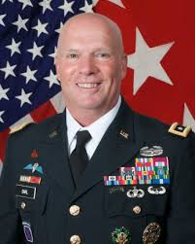

Readiness, Resources and Recent Installation Successes
LTG Kenneth Dahl
Commanding General
Installation Management Command (IMCOM)
Community Partnerships
Dr. Sarah Slaughter
CEO and President
Built Environment Coalition
Notes:
Lieutenant General Dahl supports the Army's warfighting mission by managing the day-to-day operations of most of the U.S. Army installations around the globe – They are the Army's Home.
Army installations are communities that provide many of the same types of services expected from any small city. Fire, police, housing, and child-care are just some of the things IMCOM does in Army communities every day.
He will be talking about readiness, resources and recent installation successes.
Dr. Slaughter is CEO and founder of the Built Environment Coalition, a research and education nonprofit focused on community sustainability and resilience.
She currently serves on the Green Building Advisory Committee to the U.S. General Services Administration and is a lecturer in the MIT Department of Urban Studies and Planning. She is a member of the National Academy of Construction, and an Associate National Member of the National Academy of Sciences, Engineering, and Medicine.
She will talk about community partnership roles in readiness of Installations.

Slide 10

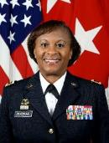
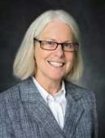
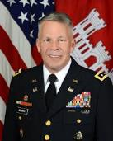
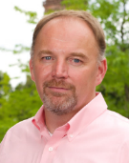
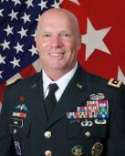

The Panel
Notes:
Ladies and Gentlemen, please join me in welcoming our distinguished panel.
We will begin with a brief presentation by each of our panel members, followed by a question and answer session.
If during the presentation you find you would like to ask a question, please write the question on the card left on your seat.
We will collect them at the end of the presentations and respond to as many as possible.

Slide 11
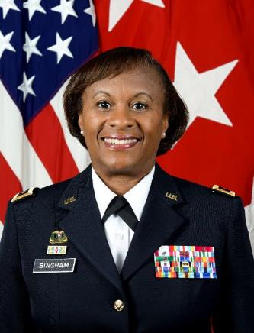

LTG Gwen Bingham
Assistant Chief of Staff
Installation Management (ACSIM)
Army Installations: Soldier and Mission Readiness
Notes:
General Bingham …

Slide 12

Who we are: The Assistant Chief of Staff for Installation Management (ACSIM) is a principal official on the Headquarters Department of the Army staff and is the advisor to the Chief of Staff of the Army on Installations and Soldier and Family Readiness.
End State
Resilient Installations
Ready Soldiers,
Civilians and
Families
Opportunities
Reduce the Footprint
Installation Service Standards
Energy Assurance initiatives
Partnerships
Challenges
End Strength Reductions
Constrained Resources
Aging Infrastructure
Emerging Missions
Rising Costs
What we do
Establish Army policies
Synchronize programs
Provide resources for infrastructure and installation services

Slide 13
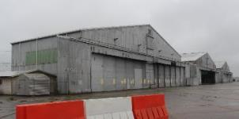
End State
Resilient Installations
Ready Soldiers,
Civilians and
Families
Opportunities
Reduce the Footprint
Installation Service Standards
Energy Assurance initiatives
Partnerships
Challenges
End Strength Reductions
Constrained Resources
Aging Infrastructure
Emerging Missions
Rising Costs

Slide 14
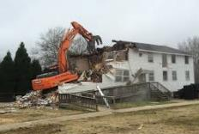
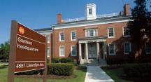
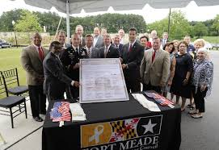
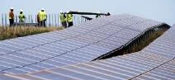
End State
Resilient Installations
Ready Soldiers,
Civilians and
Families
Opportunities
Reduce the Footprint
Installation Service Standards
Energy Assurance initiatives
Partnerships
Challenges
End Strength Reductions
Constrained Resources
Aging Infrastructure
Emerging Missions
Rising Costs

Slide 15

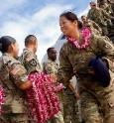
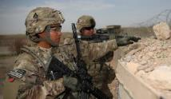




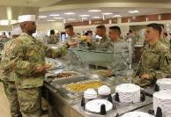
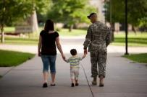
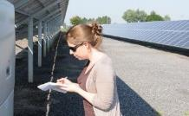


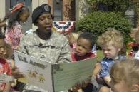
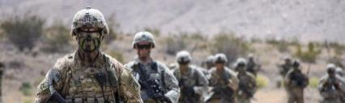








We produce ready and resilient Soldiers, Civilians and Families

Slide 16

Ms. Theresa O’Donnell
Chief Resilience Officer
City of Dallas
Roles of a Resilience Officer
Notes:
Ms. Theresa O'Donnell……..

Slide 17

URBAN RESILIENCE
Is the capacity of individuals, communities, institutions, businesses, and systems within a city to survive, adapt, and grow no matter what kinds of chronic stresses and acute shocks they experience.
Milan, Italy
Notes:
A resilient city survives and thrives no matter what challenges it faces.
Photo: Milan, Italy

Slide 18
What Are Acute Shocks?
What Are Acute Stresses?
Earthquake
Wildfires
Flooding
Sandstorms
Extreme Cold
Hazardous Materials Accident
Severe Storms and Extreme Rainfall
Terrorism
Disease Outbreak
Riot/Civil Unrest
Infrastructure or Building Failure
Heat Wave
Water Scarcity
Lack of Affordable Housing
Poor Air Quality
High Unemployment
Homelessness
Changing Demographics
Lack of Social Cohesion
Poverty/Inequity
Aging Infrastructure
Shifting Macroeconomic Trends
Crime & Violence

Slide 19
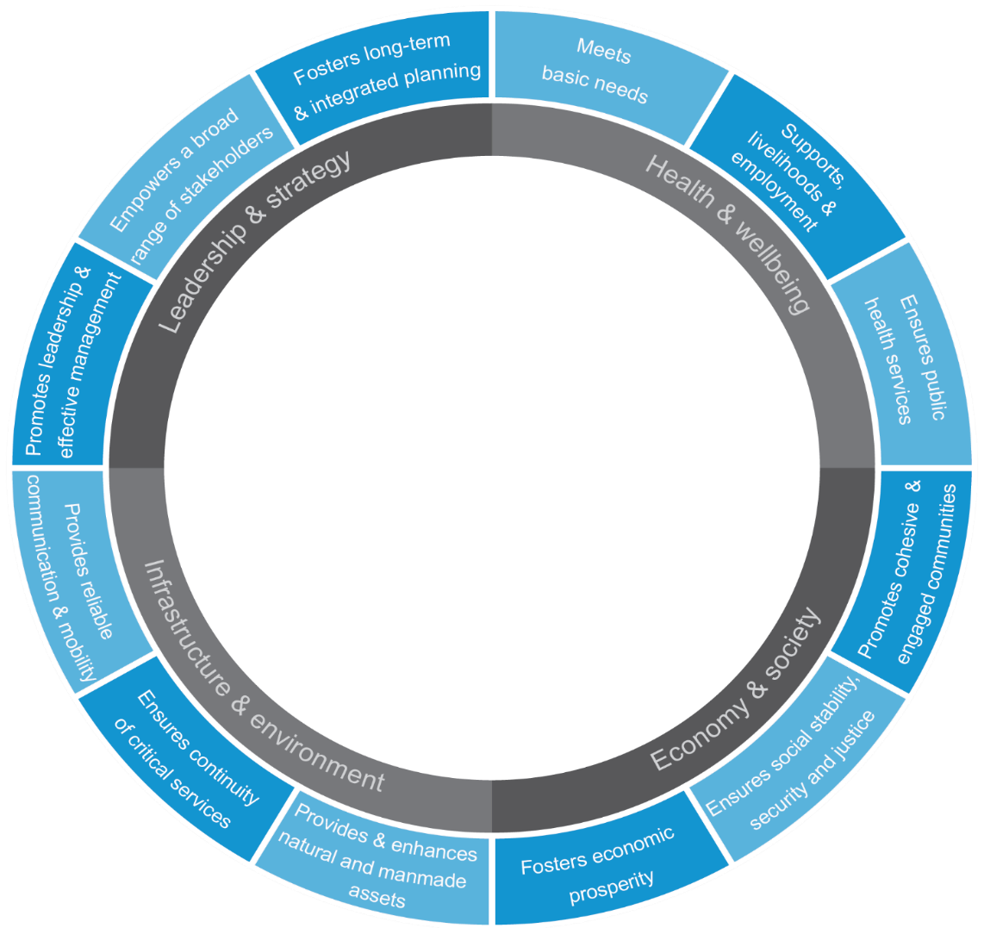
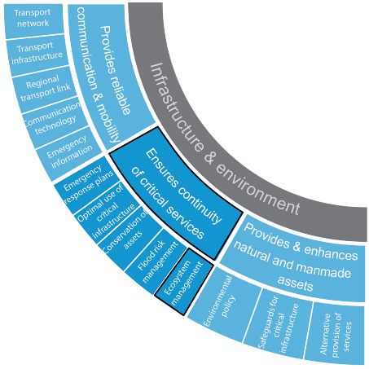
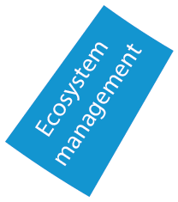
The 12 drivers collectively define the community’s ability to withstand a wide range of shocks and stresses.
Resilience Framework
Each driver is made up of 3-6 sub-drivers
© Arup, 2014
Notes:
The City Resilience Framework (CRF) developed by Arup and supported by the Rockefeller Foundation responds to this challenge. It provides a lens through which the complexity of cities and the drivers that contribute to a city’s resilience can be understood.
It is based on a rigorous bottom-up research process to understand city resilience. It embodies the knowledge from over 150 sources of literature, 14 city case studies and the perspectives of government, businesses and civil society groups in 6 cities.
Each city is unique. Yet, through this research common themes have emerged which are captured in the CRF.
The CRF identifies 12 drivers of resilient cities. Collectively, they represent the ‘immune system’ of a city; all must be present, although a weakness in one area may be compensated by strength in another. They can be used to assess to what extent a city is resilient, to identify critical areas of weakness, and to understand how a particular project contributes to the city’s resilience.
The CRF underpins the 100RC strategy development process as a framework to help guide their engagement across the cities they are working with. This common approach is intended to help knowledge sharing about different approaches, successes and lessons learned within and between cities by creating a common language to communicate through.

Slide 20
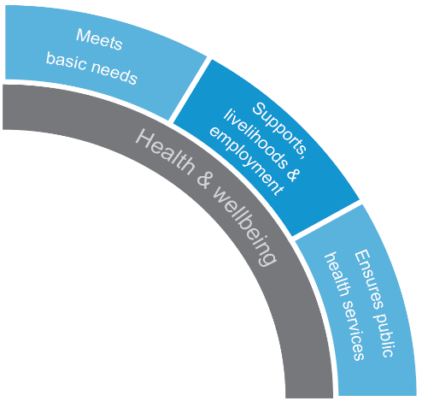
Health & Wellbeing
The health and wellbeing of everyone living and working in the city
Notes:
People is about ensuring everyone can meet their basic needs (food, water, shelter, and so on) even in times of crisis, through livelihood opportunities or aid, and have access to healthcare that prevents the spread of disease.

Slide 21
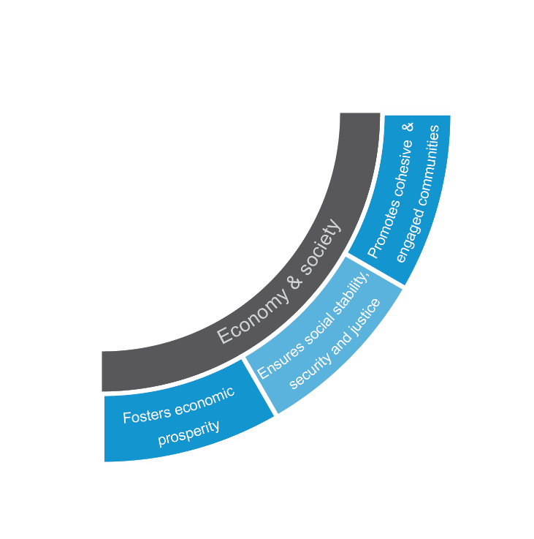
Economy & Society
The social and financial organizations that enable urban populations to live peacefully, and act collectively.
Notes:
People is about ensuring everyone can meet their basic needs (food, water, shelter, and so on) even in times of crisis, through livelihood opportunities or aid, and have access to healthcare that prevents the spread of disease.

Slide 22
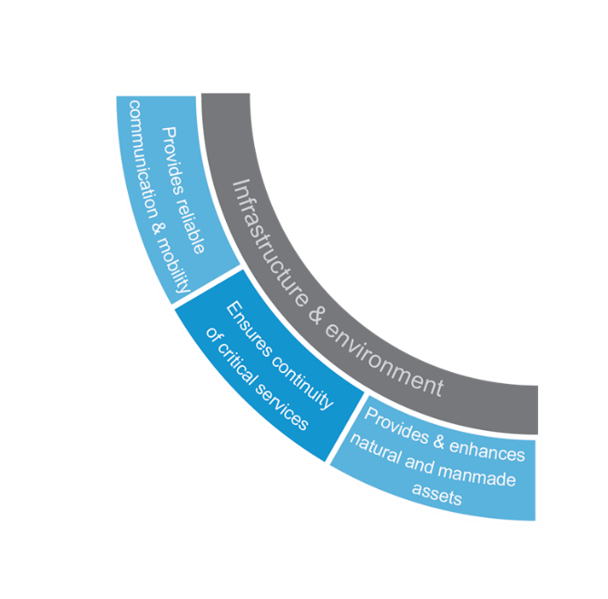
Infrastructure & Environment
The way in which man-made and natural infrastructure provides critical services and protects, and connects urban citizens.
Notes:
People is about ensuring everyone can meet their basic needs (food, water, shelter, and so on) even in times of crisis, through livelihood opportunities or aid, and have access to healthcare that prevents the spread of disease.

Slide 23
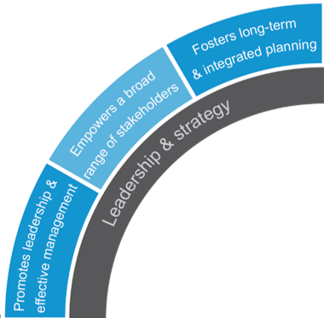
Leadership & Strategy
Effective leadership, empowered stakeholders, and integrated planning.
Notes:
People is about ensuring everyone can meet their basic needs (food, water, shelter, and so on) even in times of crisis, through livelihood opportunities or aid, and have access to healthcare that prevents the spread of disease.

Slide 24

Qualities of resilient systems
Resilient systems exhibit certain qualities that enable them to withstand, respond, and adapt more readily to shocks and stresses.
REFLECTIVE
FLEXIBLE
INTEGRATED
Able to Learn
ROBUST
Has Alternative Strategies
Systems Work Together
Limits Spread of Failure
INCLUSIVE
RESOURCEFUL
REDUNDANT
Broad Consultation & Communication
Can Easily Repurpose Resources
Has Backup Capacity
Notes:
When looking at individual systems, it is helpful to think about what qualities of those systems enhance their resilience. Through extensive research, we have identified a set of qualities that describes the behaviour or performance of resilient systems that enable them to withstand, respond, and adapt more readily to shocks and stresses.
These qualities are: reflectiveness, resourcefulness, robustness, redundancy, flexibility, inclusiveness and integration.
The qualities of resilient systems are important in preventing the breakdown or failure of a system or of enabling appropriate or timely action to be taken. These qualities, thus distinguish resilient systems from those that address other objectives like sustainability or liveability in a city.
Reflectiveness and resourcefulness are about the ability to learn from the past and act in times of crisis.
Individuals and institutions that are reflective use past experience to inform future decisions, and will modify standards and behaviours accordingly. For example, planning processes that are reflective are better able to respond to changing circumstances.
Resourceful people and institutions are able to recognise alternative ways to use resources at times of crisis in order to meet their needs or achieve their goals. For example, although households in cities in Chile’s Central Valley use water provided by municipal networks on a daily basis, the service is often interrupted after strong earthquakes. As a response, many households maintain wells to continue provision of water.
Robustness, redundancy and flexibility are qualities that help to conceive systems and assets that can withstand shocks and stresses as well as the willingness to use alternative strategies to facilitate rapid recovery.
Robust design is well-conceived, constructed and managed and includes making provision to ensure failure is predictable, safe, and not disproportionate to the cause. For example, protective infrastructure that is robust will not fail catastrophically when design thresholds are exceeded.
Redundancy refers to spare capacity purposively created to accommodate disruption due to extreme pressures, surges in demand or an external event. It includes diversity where there are multiple ways to achieve a given need. For example, energy systems that incorporate redundancy provide multiple delivery pathways that can accommodate surges in demand or disruption to supply networks.
Flexibility refers to the willingness and ability to adopt alternative strategies in response to changing circumstances or sudden crises. Systems can be made more flexible through introducing new technologies or knowledge, including recognising traditional practices. For example, in times of crisis, cities may redeploy public buses for emergency evacuations.
Inclusive and integrated relate to the processes of good governance and effective leadership that ensure investments and actions are appropriate, address the needs of the most vulnerable and collectively create a resilient city – for everyone.
Inclusive processes emphasise the need for broad consultation and ‘many seats at the table’ to create a sense of shared ownership or a joint vision to build city resilience. For example, early warning reach everyone at risk will enable people to protect themselves and minimise loss of life and property.
Integrated processes bring together systems and institutions and can also catalyse additional benefits as resources are shared and actors are enabled to work together to achieve greater ends. For example, integrated city plans enable a city to deal with multidisciplinary issues like climate change, disaster risk reduction or emergency response through coordination.

Slide 25
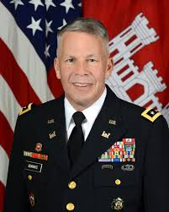

LTG Todd Semonite, P.E.
Chief of Engineers and Commanding General
U.S. Army Corps of Engineers (USACE)
Construction technologies for efficient, resilient and sustainable installations
Notes:
LTG Todd Semonite……..

Slide 26
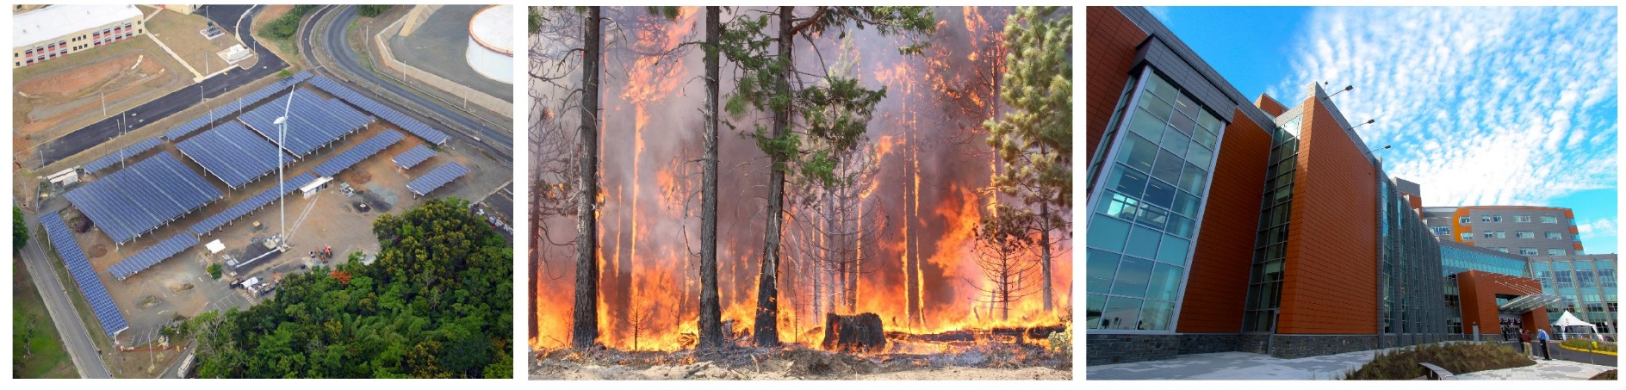
Over the last decade, a renewed focus on EFFICIENCY, SUSTAINABILITY, RESILIENCE, and a much greater reliance on systems thinking and alternative financing emerged.
Efficient use of natural and financial resources
Resilience against natural & human-caused hazards
Holistic master planning

Slide 27
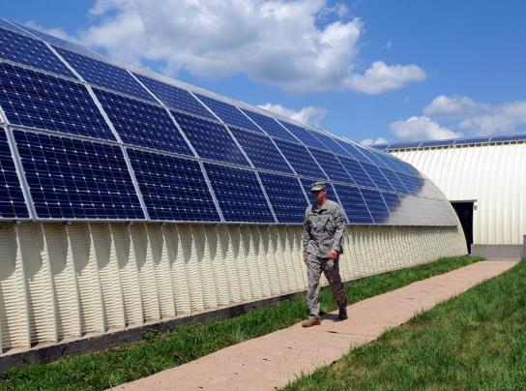
Translating research into actionable
information and innovation: EFFICIENCY
Net Zero Planner — An Integrated Modeling Tool
Deep Energy Retrofit Guide
Energy Savings Performance Contracts (ESPC)
Utility Energy Services Contracts (UESC)
Achieving efficiencies more quickly than we would with funds appropriated by Congress

Slide 28
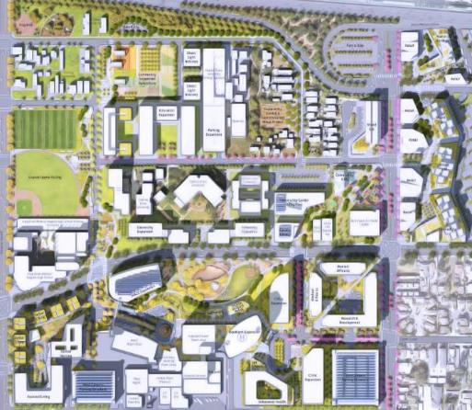
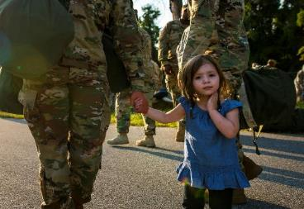
Translating research into actionable information and innovation: SUSTAINABILITY
Comprehensive Asset Master Planning Solution (CAMPS)
Programming Administration and Execution System (PAX)

Slide 29
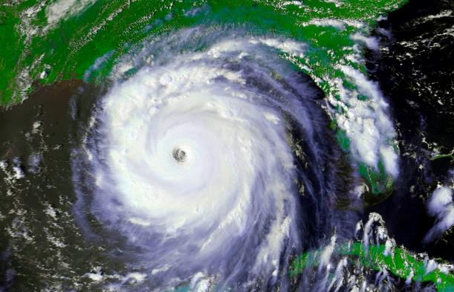
Translating research into actionable information and innovation: RESILIENCE
Resilience against all hazards including natural; human-caused
USACE Resilience Principles: Prepare, Absorb, Recover; Adapt
Strategies: Evolve Standards, Support Community Resilience, Focus on Priorities (Military Installations and Coastal Communities)
Army Screening Level Climate Change Vulnerability Assessment

Slide 30
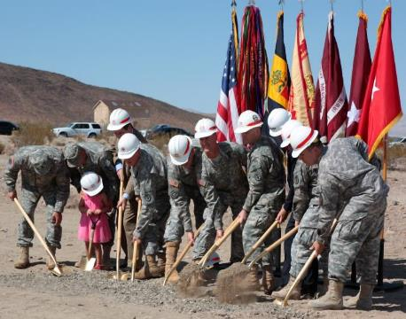
We need to keep setting the example of what right looks like:
Systems approach: efficiency, sustainability; resilience are interdependent; integrated
Innovative financing
Relentless commitment
Sharing lessons learned
Translating research into actionable information and innovation
Our greatest projects are the result of robust collaboration among our many stakeholders including our customers and our contractors.

Slide 31


Dr. Patrick McDaniel
School of Electrical Engineering and Computer Science
Pennsylvania State University
Cyber and Information Technology Trends
Notes:
Dr. Patrick McDaniel……..

Slide 32
Cyber as augmentation…
The lines between Installation Cyber and Physical activities will get smaller and smaller and disappear …
  The installation physical space be “cyber-augmented”, e.g., doors/gates track activities, HVAC systems monitor themselves
      Installation “operations” will look a lot more like the operations center for a factory—control center with visibility into every facet of domain
  Personnel will interact with installation (often through digitally augmented interfaces), and use through directed advisory systems
  Affords huge advances in efficiency, monitor-ability, and security
      Energy use optimization
      Self diagnosing and maintaining systems
      Security event prediction, mitigation, monitoring, and forensics

Slide 33
Installation and Cyber-Trends and Challenges Looking Forward
Installations of the future will support digital-age Soldiers and services, but must maintain the current levels of control and security …
Vision: Cyber will be a fluid, autonomous, self correcting and self governing collection of physical and cyber domain sensors and services
    Humans will set policy and drive high level decision-making (what) , but not low level implementation (how)
Installation to campus: Cyber activities will need to support collaboration over distances and disjoint spaces
    Dynamically defined installation?
Hybrid internal, outsourced, and commercially integrated software services – not gate and moat systems
Cyber infrastructure will be distributed, constantly self-assessing, optimizing, and reconfiguring, and …
    predictively move data/service where it is needed
    anticipate potential security concerns before they happen
    act proactively and decisively when threats are identified
    track information flow and human activity and record it
    it will be able to diagnose failures in real time and fix them

Slide 34
Future Cyber-Trends & Challenges
Key challenges
  What is the “virtual cyber-fence”?
  How do we identify and control collaborations and coalition virtual movement?
  How do we detect, isolate and (when needed) neutralize and devices controlled by humans?
  How do we integrate human scale-sensor/semantics into the regulation of the cyber domain?
  How do develop autonomous systems that resist adversarial deception and manipulation?
  How do we securely support a computation as utility model?
Technology
  Rapid, secure, on demand (or auto-sensed) allocation of collaboration enclaves
  Controlling the RF domain (not just jamming) – battle for the RF domain will be (almost) as important as the battle for physical domain
  Integrating physical-domain sensor infrastructure with Cyber-controls
  Intelligent, secure, autonomous controls acting at mission speed
  Secure computation outsourcing: from computation to storage to audit and remediation

Slide 35

LTG Kenneth Dahl
Commanding General
Installation Management Command (IMCOM)
Readiness, Resources and Recent Installation Successes
Notes:
LTG Kenneth Dahl……..

Slide 36
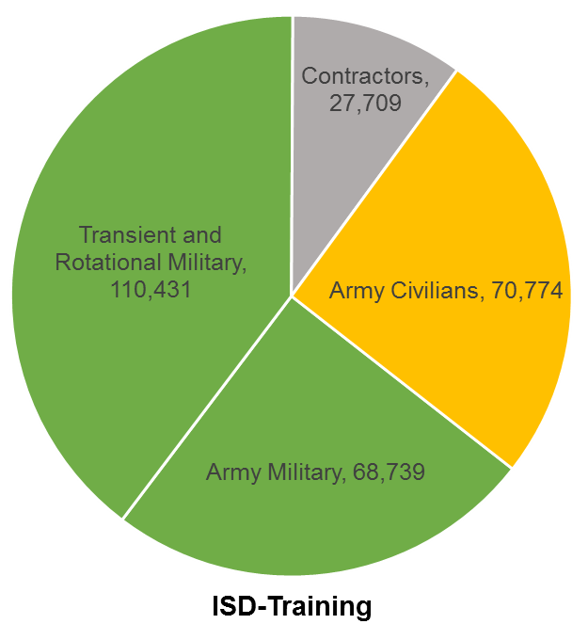
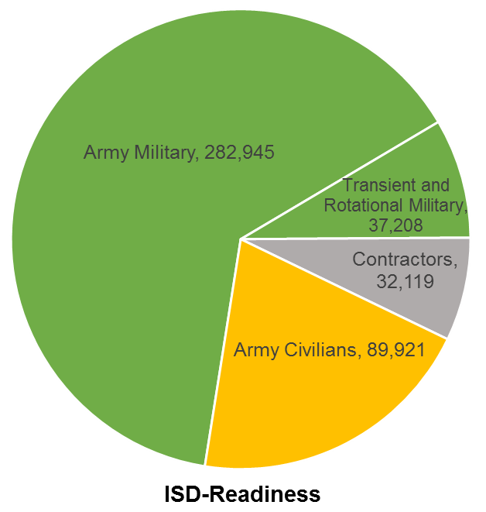
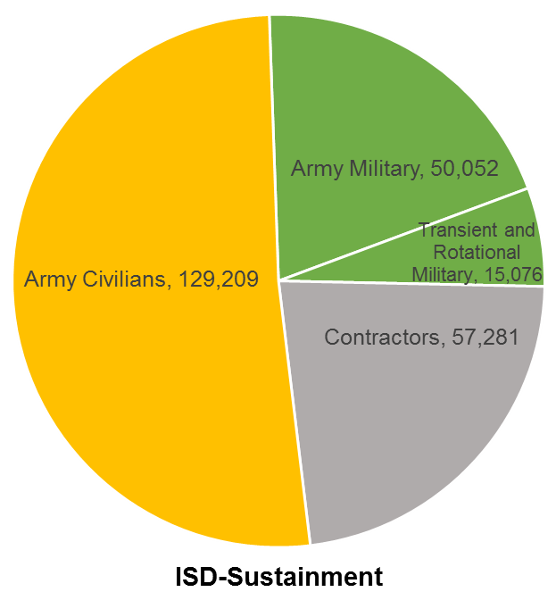
FY19 IMCOM Transformation
IMCOM HQ
IMCOM Support Directorate
Training
IMCOM Support Directorate
Readiness
IMCOM Support Directorate
Sustainment
IMCOM Pacific
IMCOM Europe
Ft Shafter, HI
Ft Eustis, VA
Ft Bragg, NC
Redstone Arsenal, AL
Sembach Kaserne, GM
Ft Benning
Ft Gordon
Ft Huachuca
Ft Jackson
Ft Knox
Ft Leavenworth
Ft Lee
Ft Leonard Wood
Presidio of Monterey
Ft Rucker
Ft Sill
West Point
Carlisle Barracks
Army Support Activity
(ASA) Eustis
Ft Hamilton
Ft Bragg
Ft Bliss
Ft Campbell
Ft Carson
Ft Drum
Ft Hood
Ft Irwin
Ft Polk
Ft Riley
Ft Stewart/Hunter AAF
JBLM/Yakima Training Area
Ft Buchanan
Ft McCoy
Hunter Liggett
ASA Dix/Devens RFTA
White Sands Missile Range
Adelphi
Aberdeen Proving Ground
Ft AP Hill
ASA Ft Sam Houston
Ft Belvoir
Ft Detrick
Detroit
Dugway Proving Ground
JB Myer Henderson Hall
Ft Meade
Miami
Natick
Picatinny
Redstone
Rock Island
Soto Cano
Yuma Proving Ground

Slide 37
Installations Reinforcing Support
Natick
West Point
Ft Devens
Ft Hamilton
Ft McNair
Ft Belvoir
MOT Concord
Camp Parks
Ft Carson
Ft AP Hill
Ft Eustis
Sharpe
Army Depot
Ft Lee
Ft Monroe
Presidio of Monterey
Pueblo
Chem Depot
Pinion
Canyon
Ft Hunter Liggett
NTC &
Fort Irwin
Yuma Proving Ground
White Sands
Missile Range
Fort Stewart
Hunter Army Airfield
Ft Bliss
Miami
Fort Buchanan

Slide 38
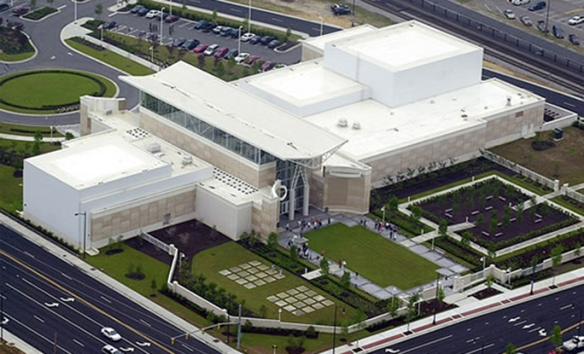
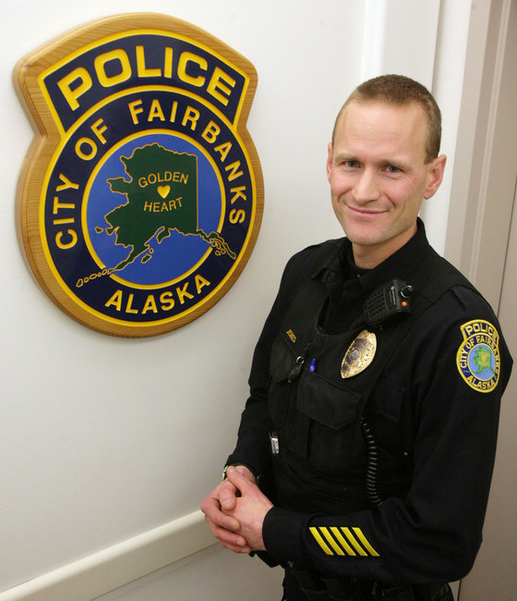

  Partnering with Local Communities

Slide 39


Dr. Sarah Slaughter
CEO and President
Build Environment Coalition
Community Partnerships
Notes:
Dr. Sarah Slaughter……..

Slide 40

Installations and Neighboring Communities: Shared Interests
Health, Safety, and Well-Being of All Members
Viability and Health of Natural Systems
Resilient Critical Community and Infrastructure Services

Slide 41

Resilience
Heat Wave
Definition: Increase Capability to Accommodate Changes over Time and Continue to Function
Changes:
  Acute disruptors
  Chronic stressors
  Social, Economic Shifts
Complementary with Sustainability
July 2016 Heat Wave

Slide 42

Opportunities for Army Installation and Community Partnerships
New or Upgraded Critical Infrastructure Facilities
New Systems for Critical Infrastructure Services (e.g., Alt. Energy)
Local Sourcing of Food, Supplies, and Services
Training and Education for Skill and Career Development
Environmental Restoration and Resource Management

Slide 43

Benefits of Installation and Community Partnerships
Mutual Strength in Social, Economic,
Natural, and Built Systems
Improved Reliability and Robustness
Under Normal and Extreme Conditions
Improved Operational Efficiency
Improved Environmental Performance
Improved Economic Efficiency for Investment and Operations Costs

Slide 44
Questions
Notes:
Ladies and gentlemen, please a round of applause for our panelists.
Now we would like to answer any questions you may have. As I mentioned at the beginning of the forum, there were index cards left on your seats. If you have a question please write it down, pass it to the center isle and we’ll collect them.
We already have received a few :
How can cyber-augmented systems help to transition to more resilience in times of natural hazards? Dr. McDaniel? LTG Semonite?
How do you see resiliency initiatives strengthening not only the Army but also the Nation as a whole? MS O’Donnell? LTG Bingham?
What are some pathways to widespread implementation of readiness initiatives, for example, working with civilian organizations or vendors? LTG Dahl? Dr. Slaughter?
In these times of fiscal constraint, innovative financing is key. Can you share with us how USACE went about validating some of the alternative financing methods you've chosen? LTG Semonite?
Making great strides is resilience and sustainability requires commitment and leadership from the top, can share your executive-level leadership perspective? LTG Bingham? LTG Dahl?
How does the 2 year BBA impact Installation readiness?
Is the Army conducting too many MILCON projects in Europe and overseas?

