Slide 1
Building and Maintaining Readiness to Win in a Complex World
AUSA Institute of Land Warfare
1 November 2016
LTG Michael D. Lundy
Commanding General
U.S. Army Combined Arms Center
CAC CIG Planner: MAJ Daniel W. Clark / 913-684-8669 / daniel.w.clark48.mil@mail.mil
As Of: 10/31/2016

Slide 2
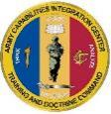
Requirements Development
TRADOC
AMC
FORSCOM
Design
Acquire
Build
Improve
Sustain
Train
Prepare
Army Capabilities
Integration Center (ARCIC)
FM/Branch Proponents
Conceptualize Change
ACP
Lessons
Learned
AOC
+ COEs
FCs
Units
COE DOTs
Combined Arms
Center (CAC)
Validation
Execute
Change
Doctrine
Organization
Training
Materiel
Leadership
Personnel
Facilities
Policy
Operationalize and Institutionalize Change
The environment and challenges drive requirements; requirements drive change

Slide 3
Key Requirements Players
Force Modernization Proponent
…develops and integrates DOTMLPF–P requirements for a particular function.
Branch Proponent
…supports force modernization proponents in developing requirements and executing approved training, leadership and education, and personnel programs.
TRADOC Capability Manager
…represents the user throughout the capability/system life cycle across all dimensions of DOTMLPF-P.
CG, MCOE
Armor Commandant
Infantry Commandant
TCM ABCT
TCM SBCT
TCM IBCT
Combat Developers represent the Operational Users

Slide 4
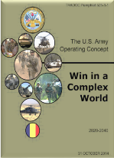
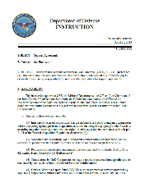
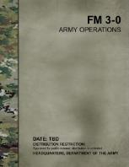
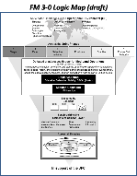
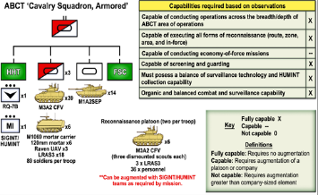
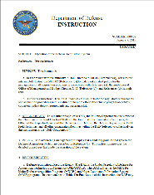
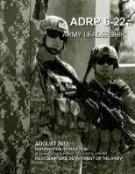
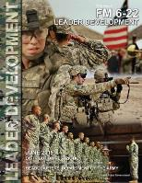
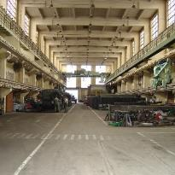
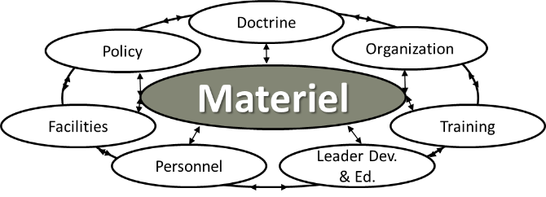
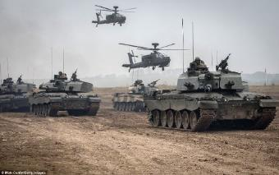
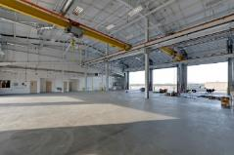
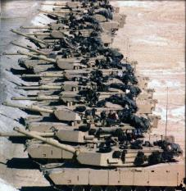
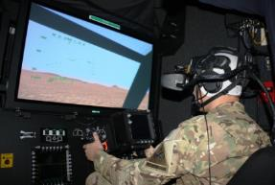
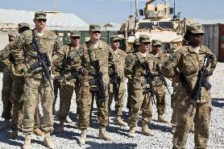
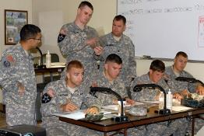
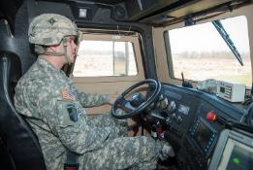
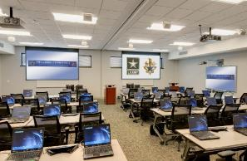
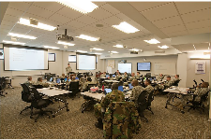
DOTMLPF-P Integration
Key considerations when developing new capabilities
Solutions must integrate across full range of DOTMLPF-P

Slide 5
Getting Requirements Right
Operational versus Technical Requirements
Battle Lab Experimentation
S&T focused on valid requirements – transition to POR
Human-Machine Interface
Cognitive Aiding and Offloading (Defrag the Hard drive)
Relationship of Requirement Solutions to other Variables
Good Enough versus Nice to Have or Unobtanium
Utility across the Range of Military Operations versus Niche Capabilities
Growth Capability - Upgradability
Open Architectures
Capability versus Vulnerability
Reliability, Sustainability, Affordability balance points
All requirements compete for limited resources

Slide 6
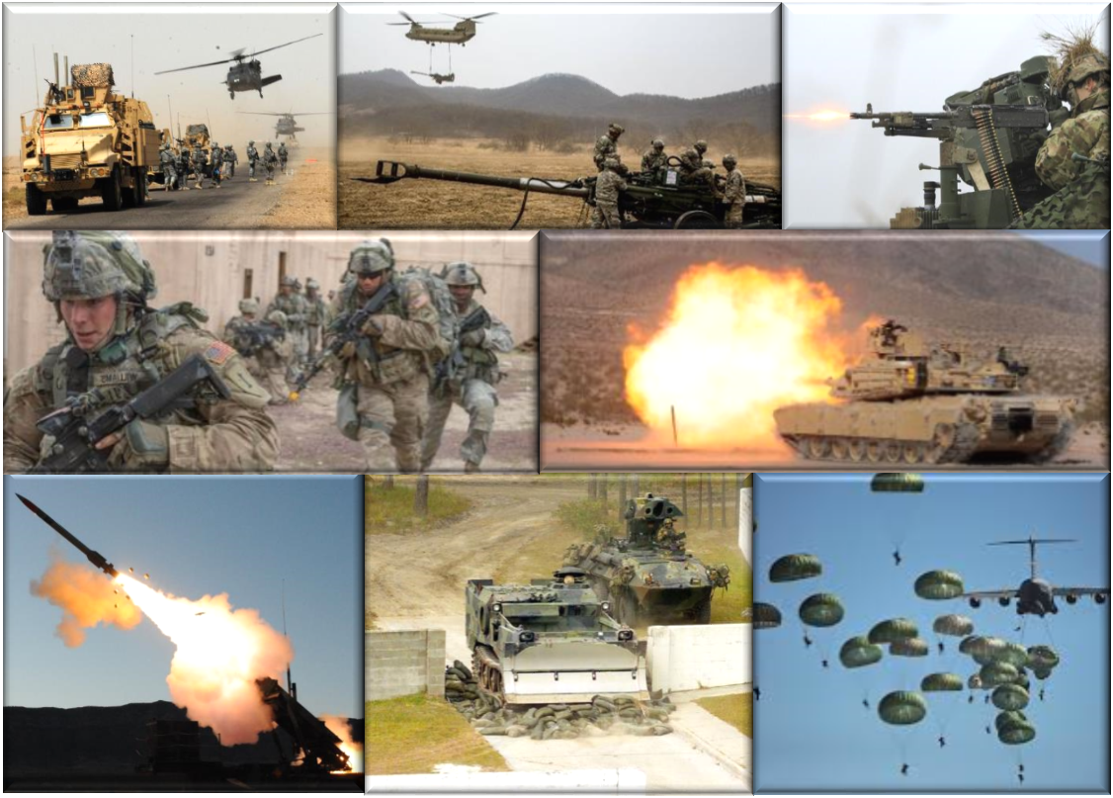
Discussion

Slide 7
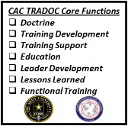
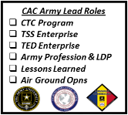
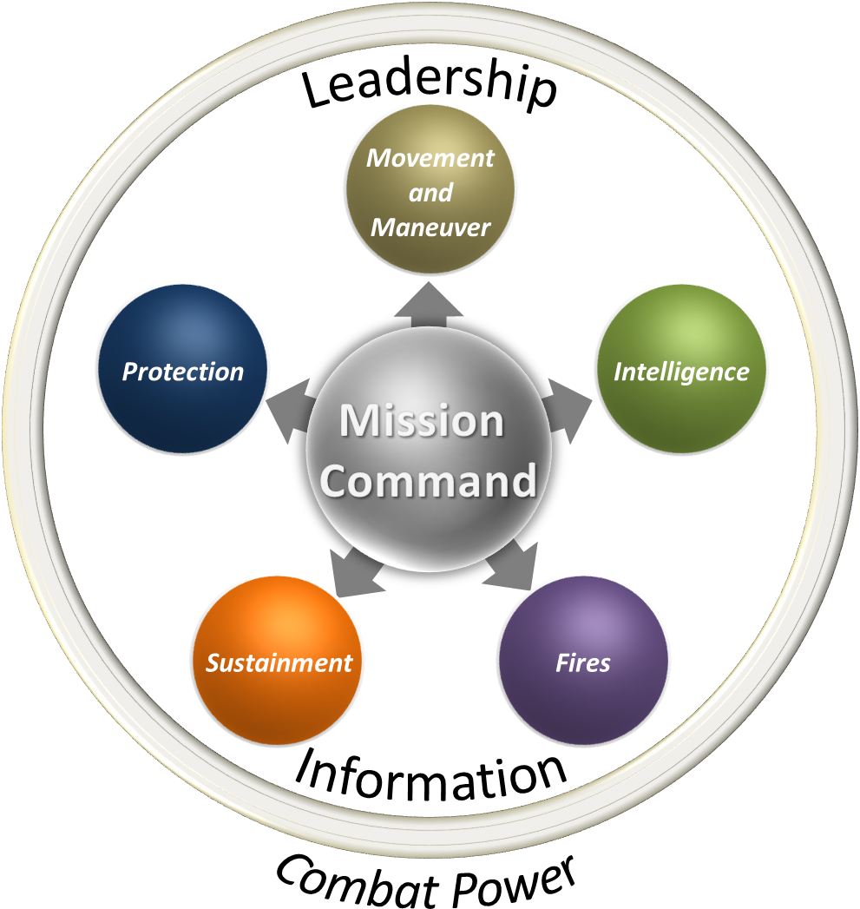
What CAC is For and How We Do it…
What we do…
CAC Enabling Proponencies
Airspace Control
Information Opns
OPSEC
Knowledge Management
Military Deception
Security Force Assistance
Personnel Recovery
Army Profession
…as the AR 5-22 Force Modernization Proponent for…
TCM EAB
DIV, CORPS, TA Portfolio
Develop Requirements
EAB Concepts
DOTMLPF-P Synch
Unified Land Operations and…
Combined Arms Operations - (Divisions, Corps, Theater Armies)
Mission Command
…and…
…develops full DOTMLPF-P requirements for Divisions, Corps and Theater Armies…
xx
xxx
xxxx
…and synchronizes and integrates Doctrine, Training, Education, and Leader Development across WfF proponents through HQDA Lead and TR Core roles…
MVMT/
MNVR
FIRES
INTEL
SUST
PROT
MSN CMD
…executing professional military education and functional training through Branch and Non-Branch schools…
…and individual and collective training and education support
through enabling capabilities…
What we’re for…
MCTP
NSC
ITE
TADSS
SRP
MCTCs
AJST ATN
…to provide the Army…
…agile, adaptive, and professional Soldiers and leaders in highly capable combined arms formations ready and able to conduct Unified Land Operations to prevent, shape, and win in the complex OE.
2

