Slide 1
 Chapter Presidents Dinner 
Honoring the Work of AUSA’s Dedicated Volunteers

Slide 2
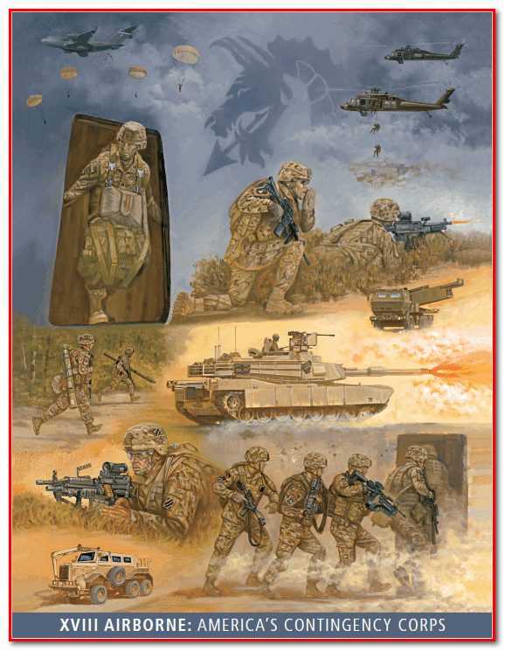

Slide 3
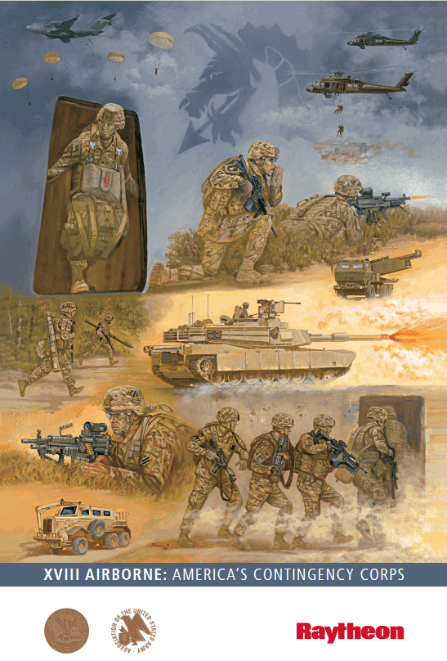

Slide 4
 Chapter Presidents Dinner 
Honoring the Work of AUSA’s Dedicated Volunteers

Slide 5
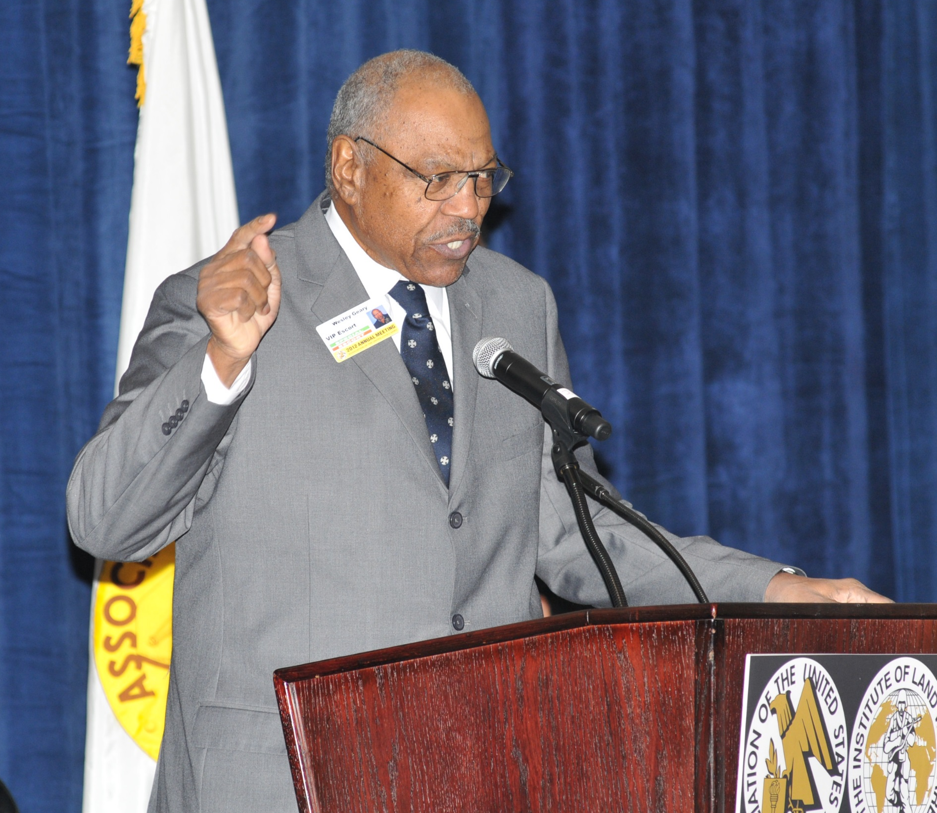

Slide 6
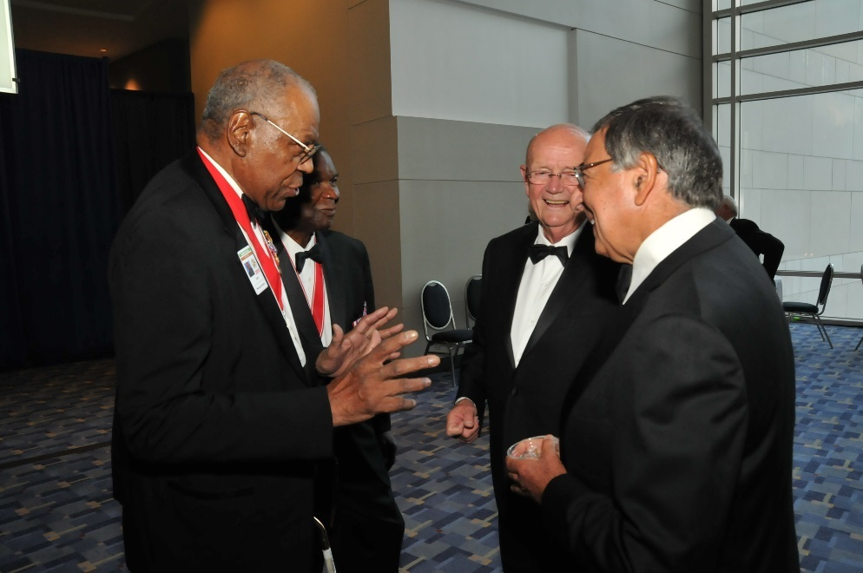
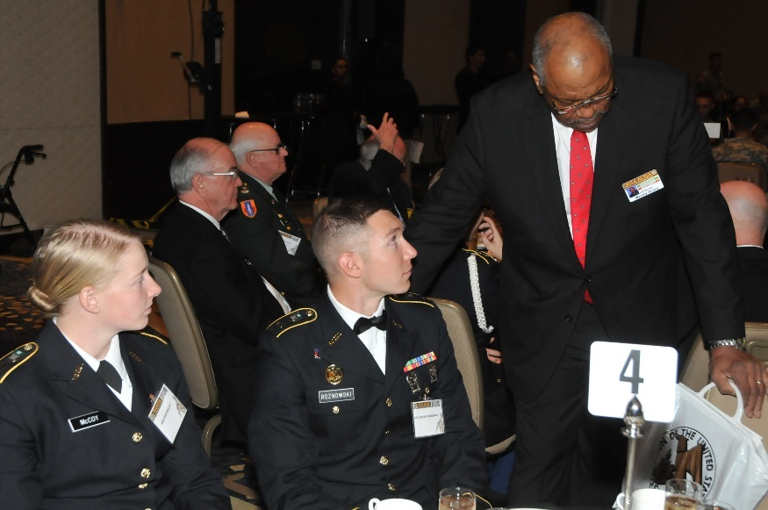
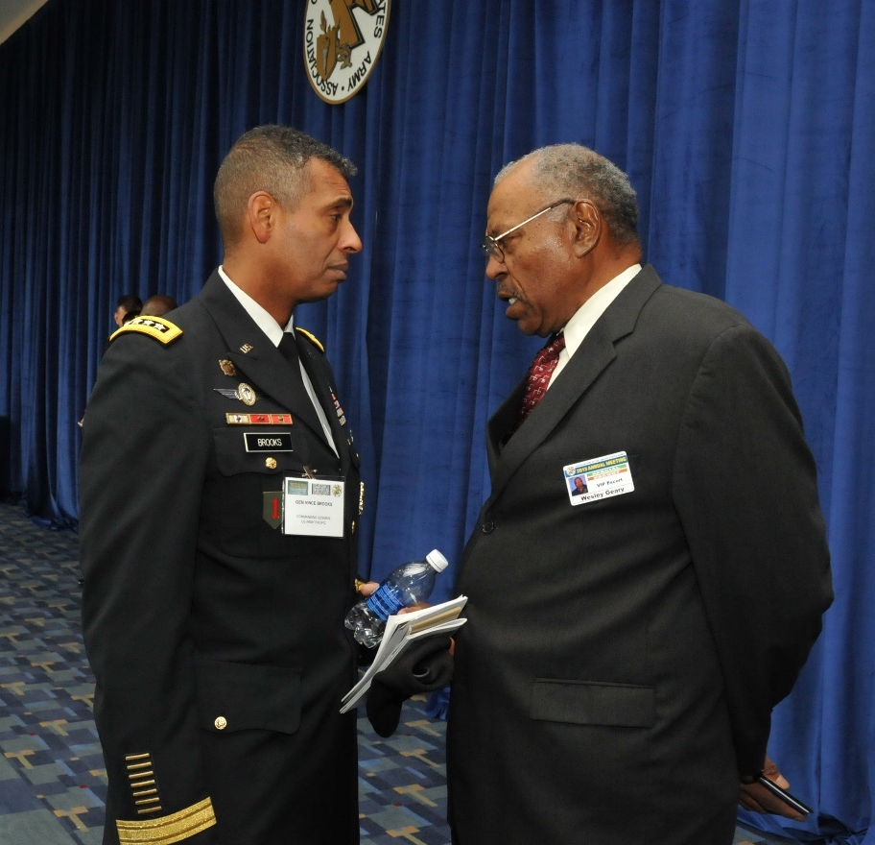
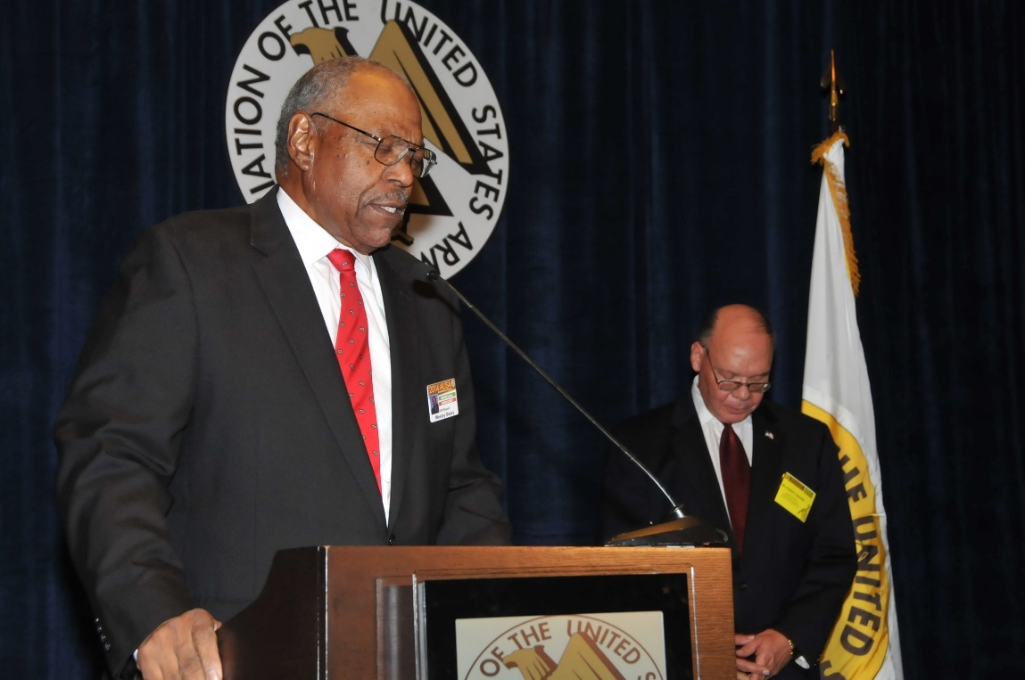
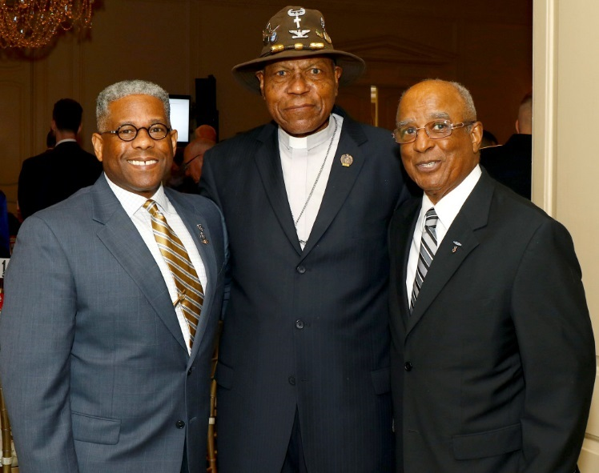

Slide 7
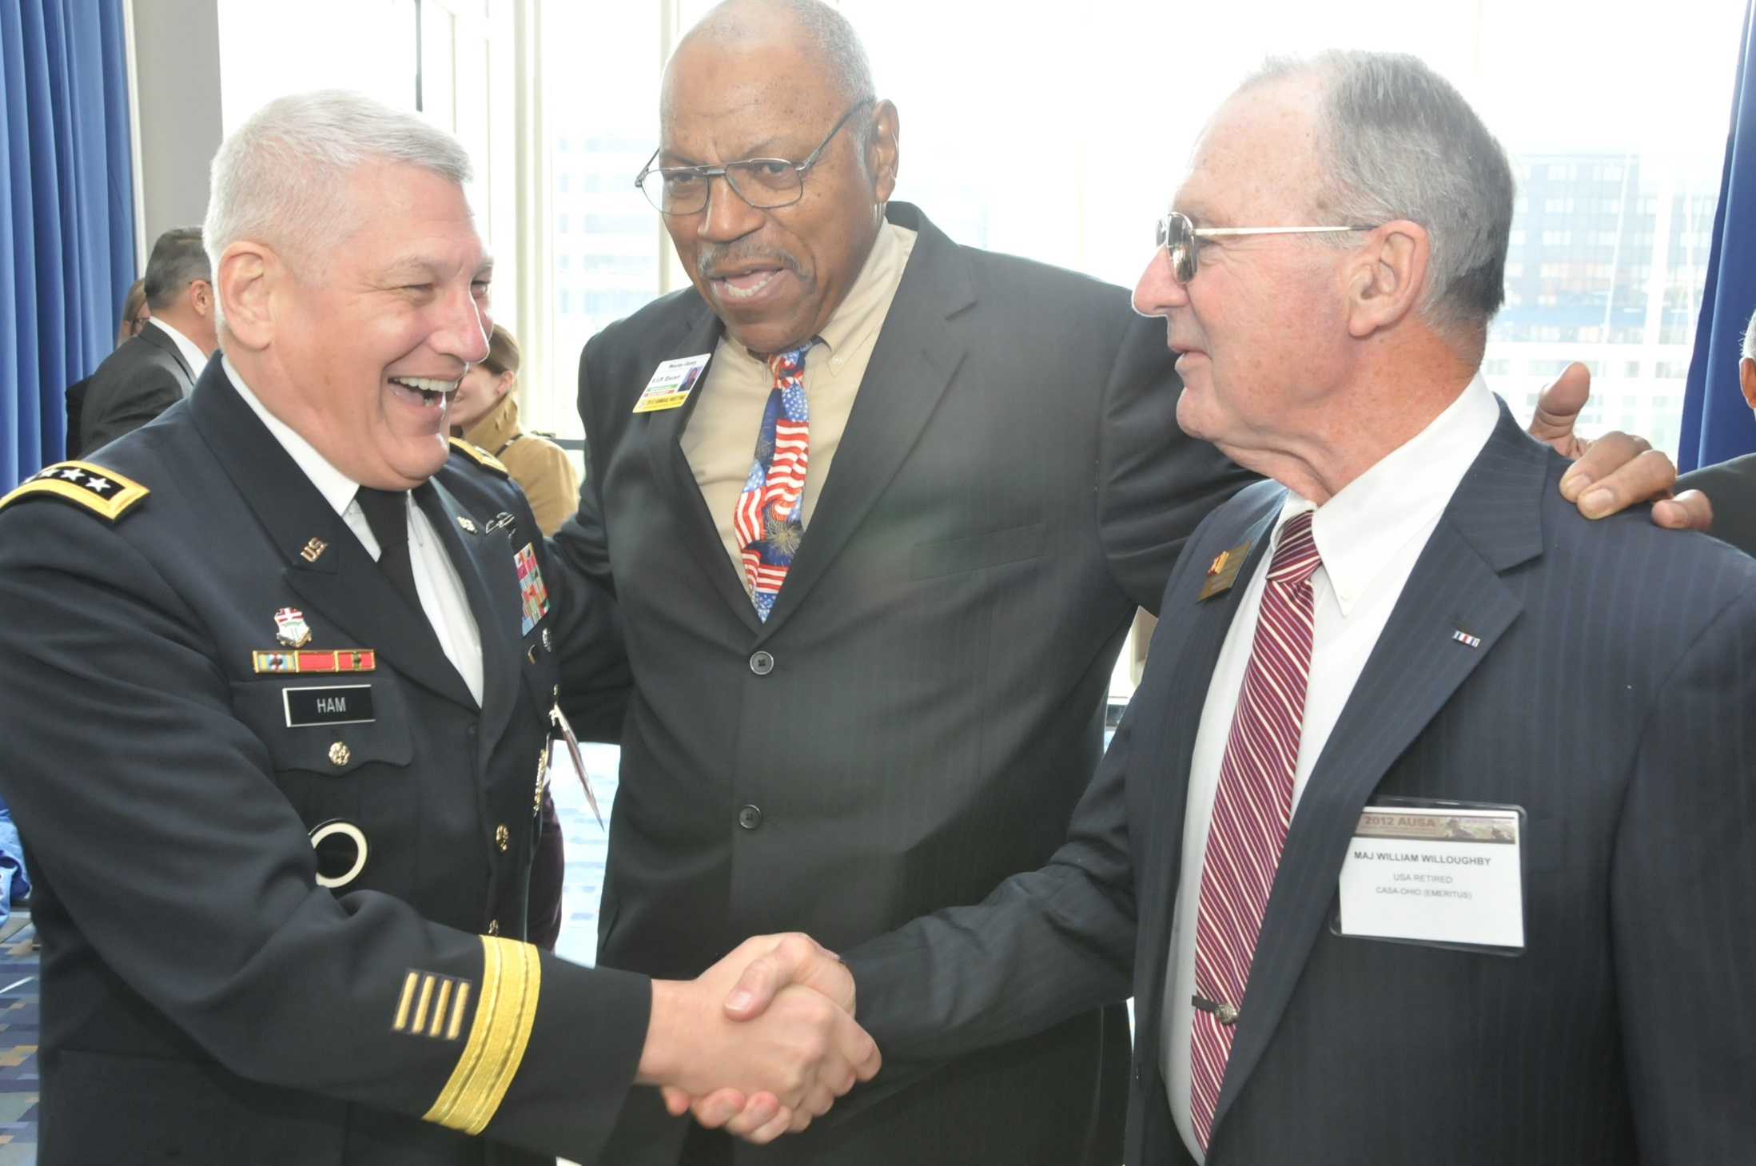

Slide 8
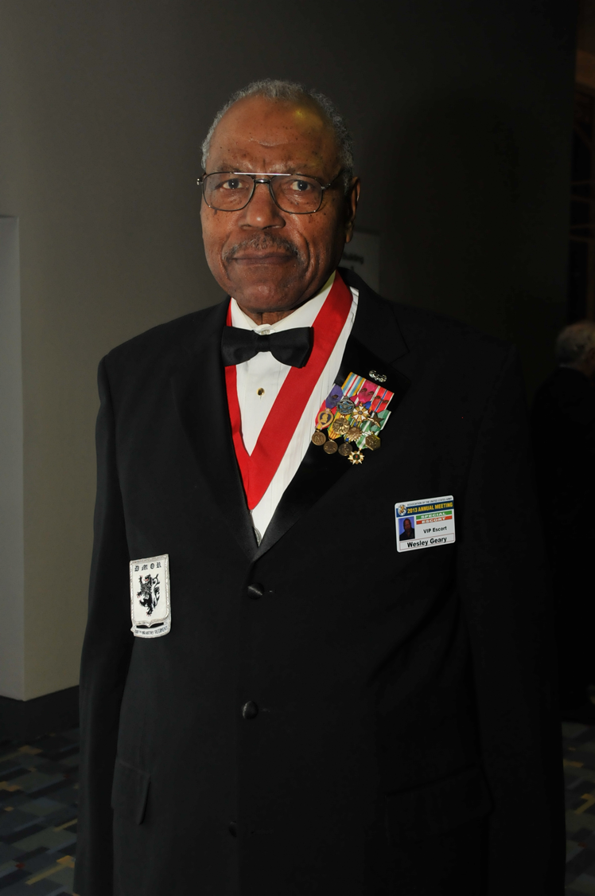

Slide 9
 Chapter Presidents Dinner 
Honoring the Work of AUSA’s Dedicated Volunteers

Slide 11
 Chapter Presidents Dinner 
Honoring the Work of AUSA’s Dedicated Volunteers

Slide 12
Awards SlideS

Slide 13
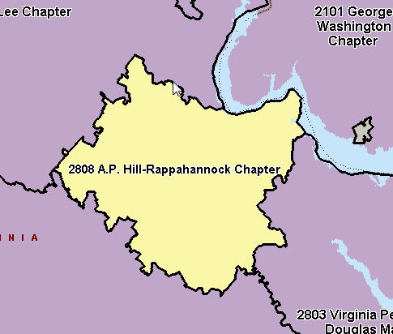
AP HILL Mr. Steve Delovich, President
Excellence In Reserve
Component Growth

Slide 14
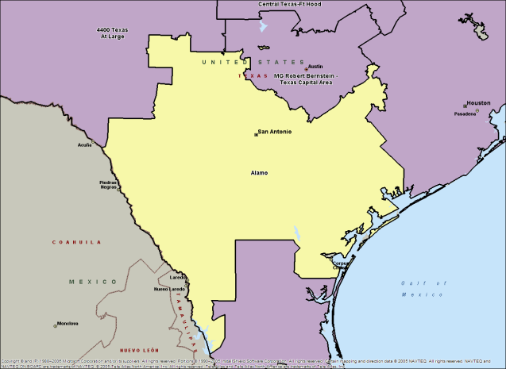
Alamo Chapter Ms. Sheli Lawson, President
Superior Chapter
Merit Chapter
Support To USAREC
Support Of ROTC
Member Communications
Army Birthday
Greatest % Increase In Membership
Best General Membership Meeting

Slide 15
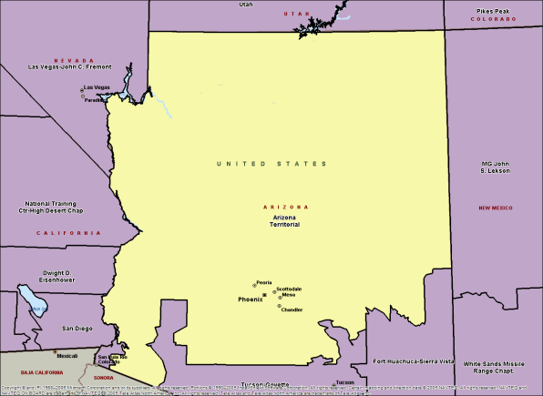
Arizona Territorial Chapter COL Jeanne Joachim Blaes, President
Best Chapter
Chapter Of Excellence
Superior Chapter
Continuous Star (107)
Vietnam Partnership
Merit Chapter
Star Chapter
Reserve Component Support
Excellence In Reserve Component Growth
Family Programs
Support To USAREC
Take The Hill
Army History
Support Of ROTC
Member Communications
Army Birthday
Institute Of Land Warfare Support
Presidents Club (Gold)
Greatest Reserve Component Increase

Slide 16
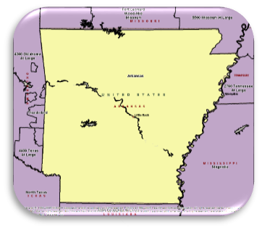
Arkansas Chapter COL Harold Tucker
Merit Chapter
Corporate Member Support
Family Programs
Take The Hill
Army History
Support Of ROTC
Member Communications
Army Birthday
Institute Of Land Warfare Support
Young Professionals

Slide 17
Arsenal of Democracy Chapter BG Mark Montjar, President
Chapter Of Excellence
Superior Chapter
Continuous Star (160)
Vietnam Partnership
Merit Chapter
Star Chapter
Corporate Member Support
Family Programs
Take The Hill
Army History
Support Of ROTC
Member Communications
Institute Of Land Warfare Support
Presidents Club (Gold)

Slide 18
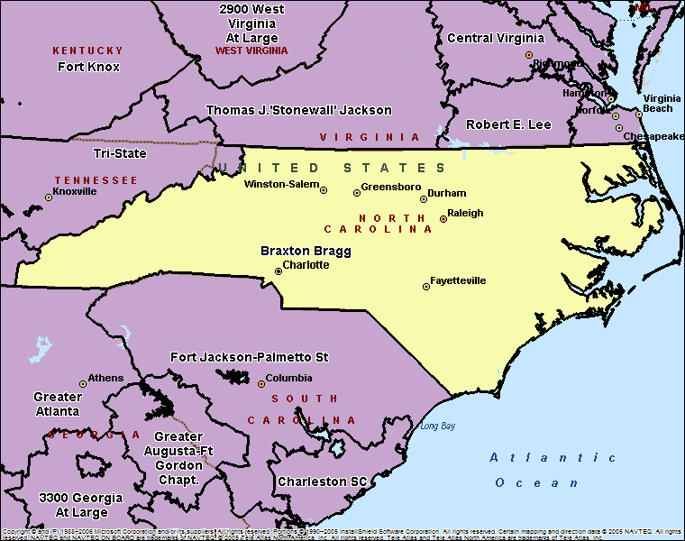
Braxton Bragg CSM Andrew McFowler, President
Merit Chapter
Excellence In Reserve Component Growth
Member Communications
Army Birthday

Slide 19
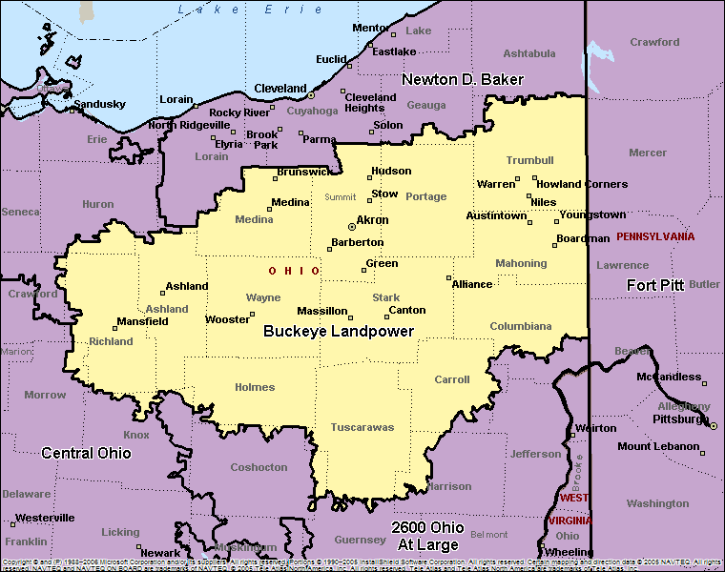
Buckeye Landpower Mr. Travis Caples, President
NONE

Slide 20
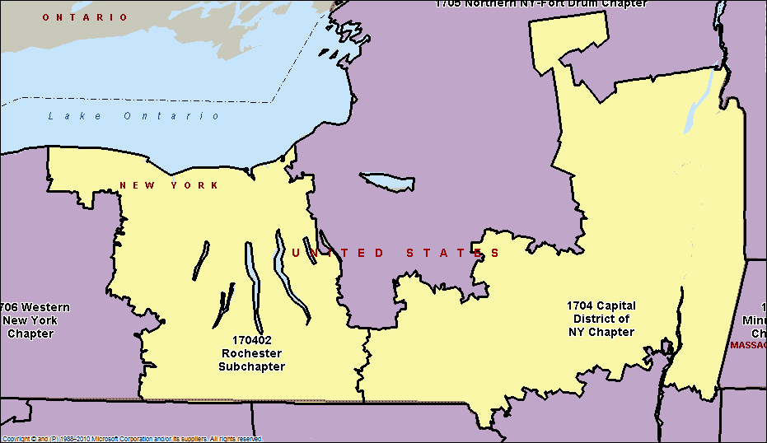
Capital District of New York Chapter CSM (R) Robert Van Pelt, President
Chapter Of Excellence
Superior Chapter
Continuous Star (96)
Vietnam Partnership
Merit Chapter
Star Chapter
Reserve Component Support
Excellence In Reserve Component Growth
Support To USAREC
Take The Hill
Army History
Support Of ROTC
Member Communications
Army Birthday
Institute Of Land Warfare Support
Presidents Club (Gold)

Slide 21
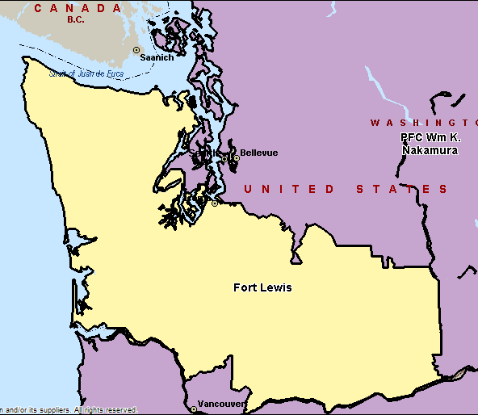
Captain Meriwether Lewis Chapter Amy Tiemeyer, President
Chapter Of Excellence
Superior Chapter
Continuous Star (43)
Merit Chapter
Star Chapter
Family Programs
Support To USAREC
Take The Hill
Army History
Member Communications
Army Birthday
Institute Of Land Warfare Support
Presidents Club (Gold)
Young Professionals

Slide 22
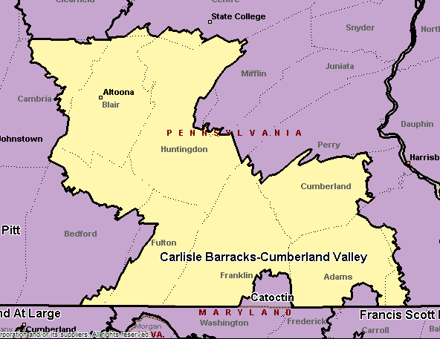
Carlisle Barracks-Cumberland Valley Col (R) Jerome Comello, President
Superior Chapter
Merit Chapter
Star Chapter
Excellence In Reserve Component Growth
Member Communications
Army Birthday
Presidents Club (Silver)

Slide 23
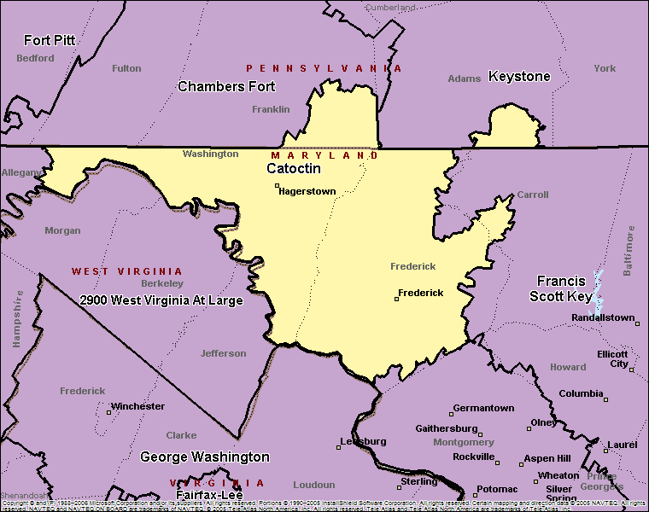
Catoctin Chapter Mr. Joe Dorsey, President
Merit Chapter
Take The Hill
Member Communications
Army Birthday
Young Professionals

Slide 24
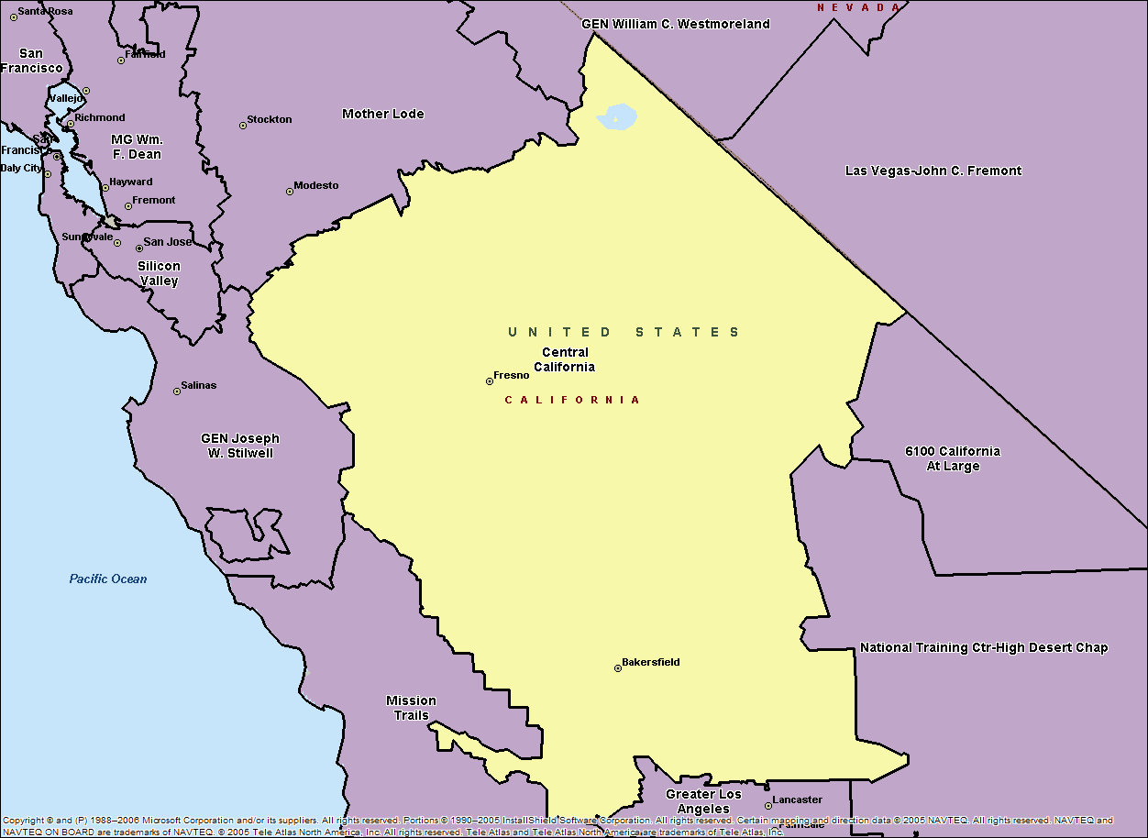
Central California Mr. Harry Paul, President
Family Programs
Take The Hill
Army History

Slide 25
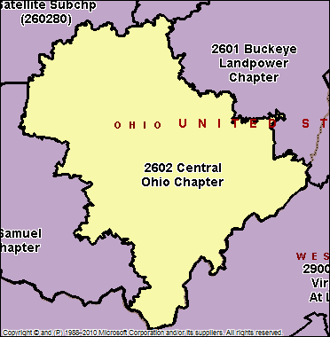
Central Ohio Chapter COL (R) John Enyart, President
ROTC Support
Chapter Of Excellence
Superior Chapter
Continuous Star (82)
Merit Chapter
Star Chapter
Excellence In Reserve Component Growth
Support To USAREC
Take The Hill
Army History
Member Communications
Army Birthday
Institute Of Land Warfare Support
Young Professionals
Presidents Club (Gold)

Slide 26
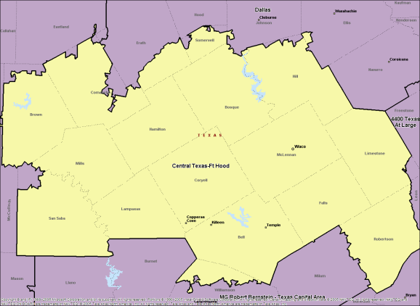
Central Texas – Fort Hood Ms Stephanie O’Banlon, President
Vietnam Partnership
Merit Chapter
Family Programs
Take The Hill
Support Of ROTC
Member Communications
Army Birthday
Institute Of Land Warfare Support

Slide 27
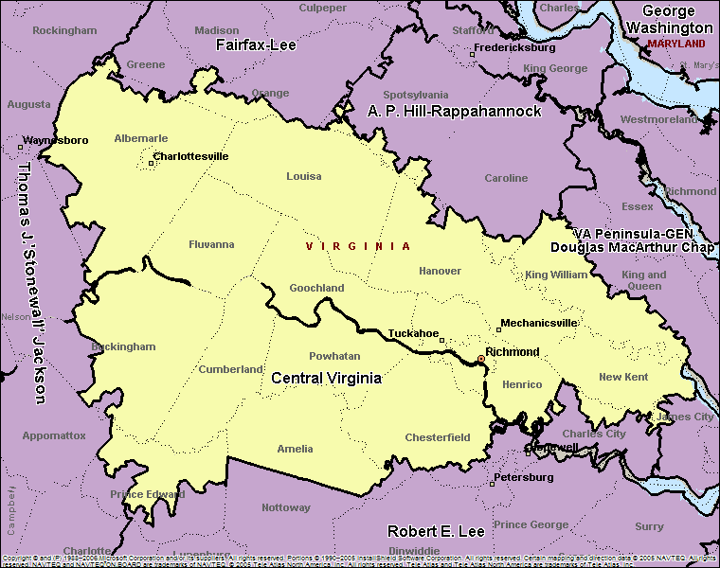
Central Virginia Chapter LTC (R) Robert Sempek, President
Excellence In Reserve Component Growth
Army Birthday
Institute Of Land Warfare Support

Slide 28
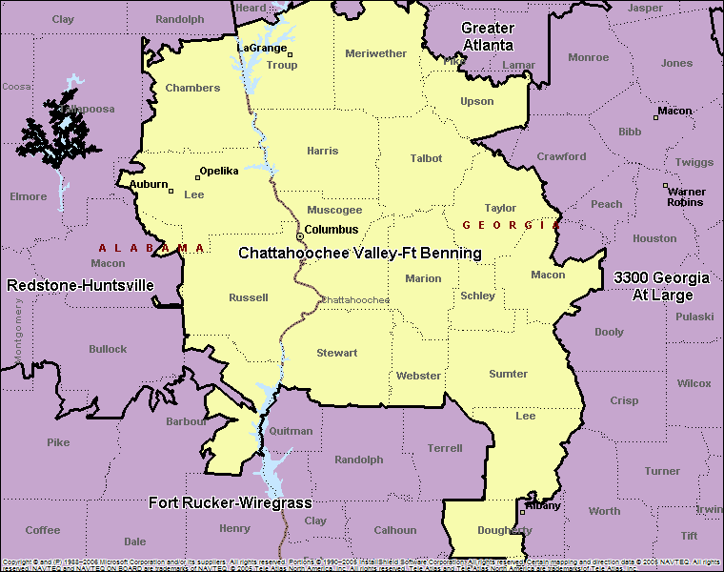
Chattahoochee Valley – Ft Benning COL Bob Kmiecik (Rocky), President
NONE

Slide 29
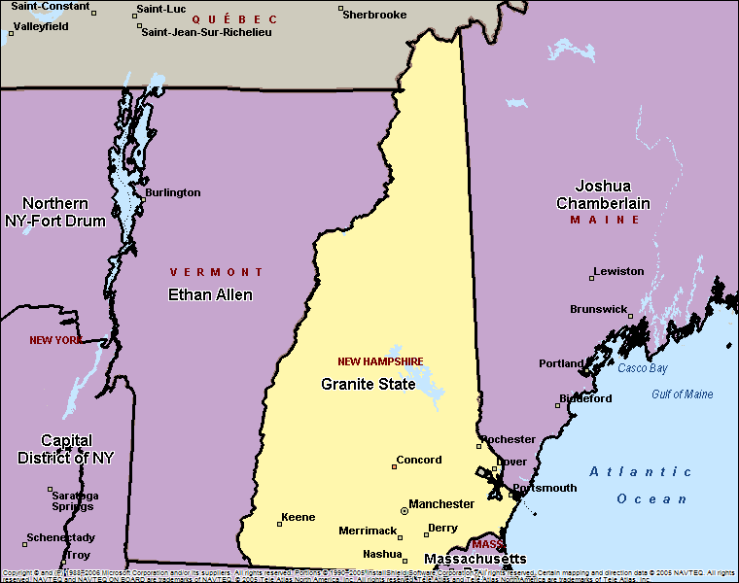
COL Edward Cross Mr. Gregory M. d’Arbonne, President
Vietnam Partnership
Merit Chapter
Excellence In Reserve Component Growth
Support To USAREC
Take The Hill
Army History
Member Communications
Army Birthday

Slide 30
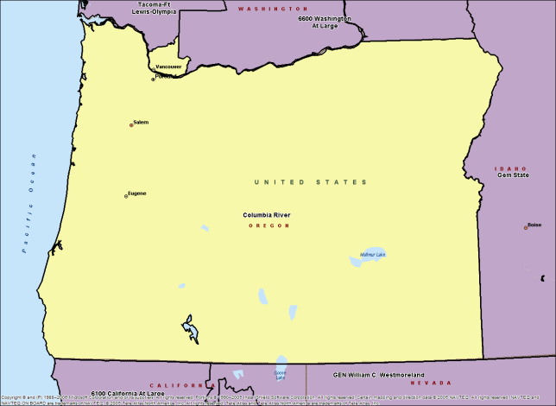
Columbia River SGM Jerry Glesmann, President
Superior Chapter
Merit Chapter
Support To USAREC
Take The Hill
Army History
Member Communications
Army Birthday
Institute Of Land Warfare Support

Slide 31
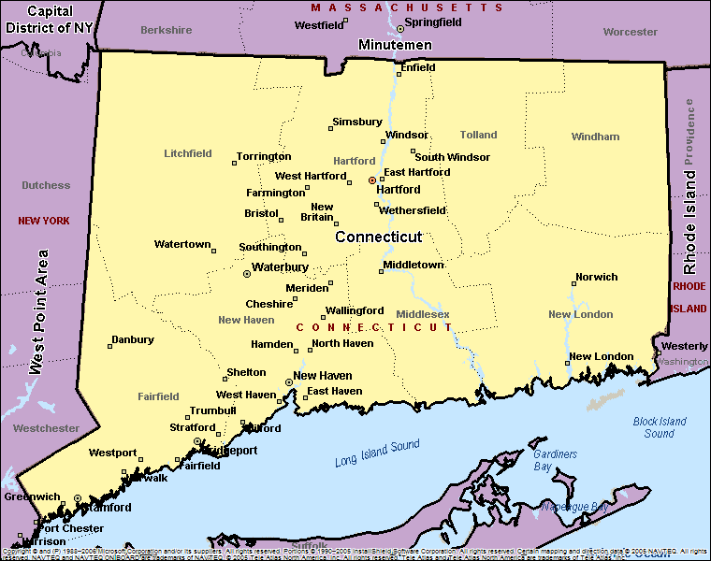
Connecticut BG Daniel J. McHale, President
Chapter Of Excellence
Superior Chapter
Merit Chapter
Star Chapter
Reserve Component Support
Corporate Member Support
Family Programs
Take The Hill
Army History
Member Communications
Army Birthday
Institute Of Land
Warfare Support
Support To USAREC

Slide 32
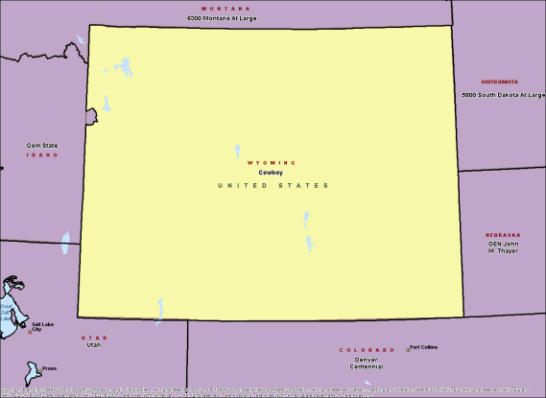
Cowboy BG Henry Castillon, President
Take The Hill
Army History
Support Of ROTC
Institute Of Land Warfare Support

Slide 33
CPL Bill McMillan-Bluegrass Chapter Christopher Dolt, President
Merit Chapter
Army History
Institute Of Land Warfare Support

Slide 34
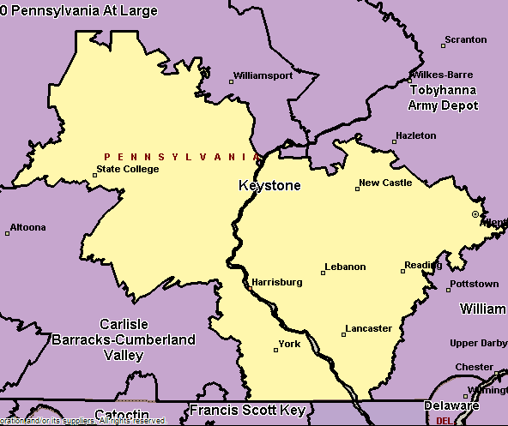
CSM James M. MacDonald-Keystone Chapter COL (R) David L. Gerstenlauer, President
Continuous Star (13)
Star Chapter
Army Birthday
Institute Of Land Warfare Support

Slide 35
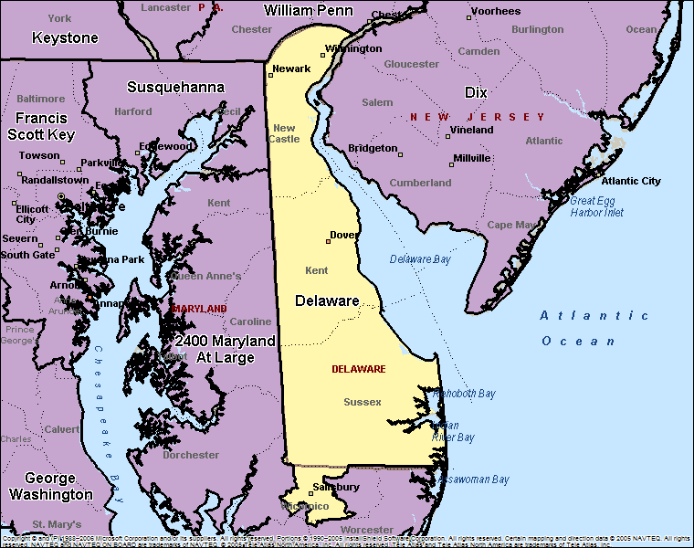
Delaware Chapter COL (R) Gary Dawson, President
Superior Chapter
Continuous Star (6)
Merit Chapter
Star Chapter
Reserve Component Support
Support To USAREC
Take The Hill
Support Of ROTC
Member Communications
Army Birthday
Presidents Club (Bronze)

Slide 36
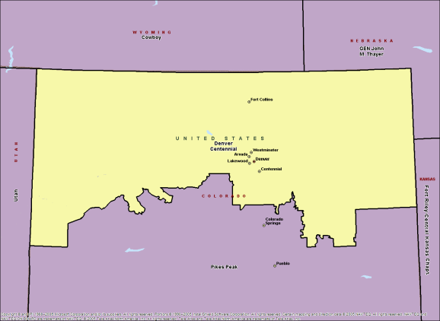
Denver Centennial Chapter LTC (R) Steven Calhoun, President
Vietnam Partnership
Take The Hill
Member Communications

Slide 37
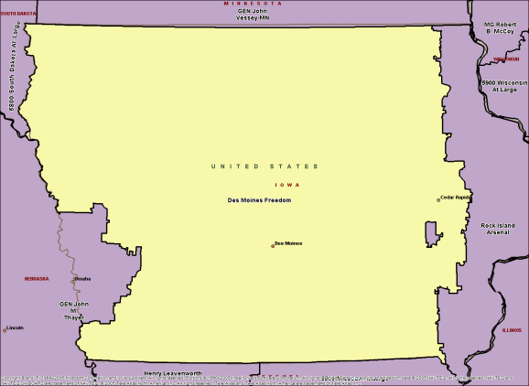
Des Moines Freedom MSG John F. Shannon, President
Member Communications

Slide 38
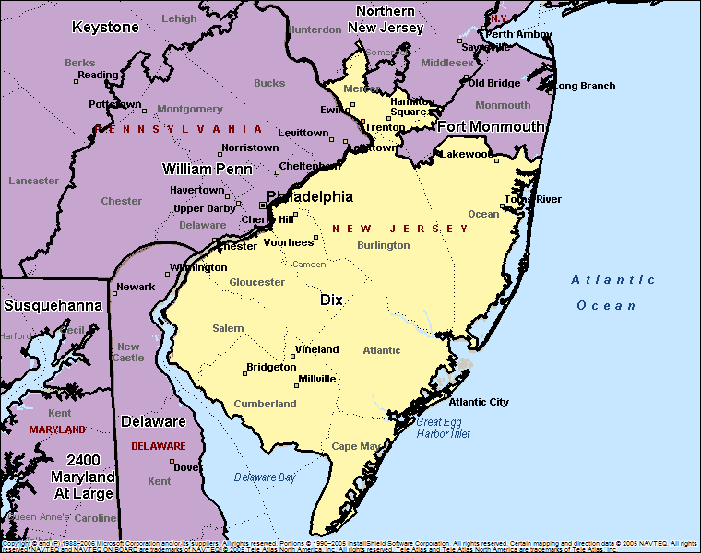
Dix Chapter CSM (R) Arthur Maggs, Jr., President
Vietnam Partnership
Merit Chapter
Family Programs
Support To USAREC
Take The Hill
Army History
Support Of ROTC
Army Birthday
Young Professionals

Slide 39
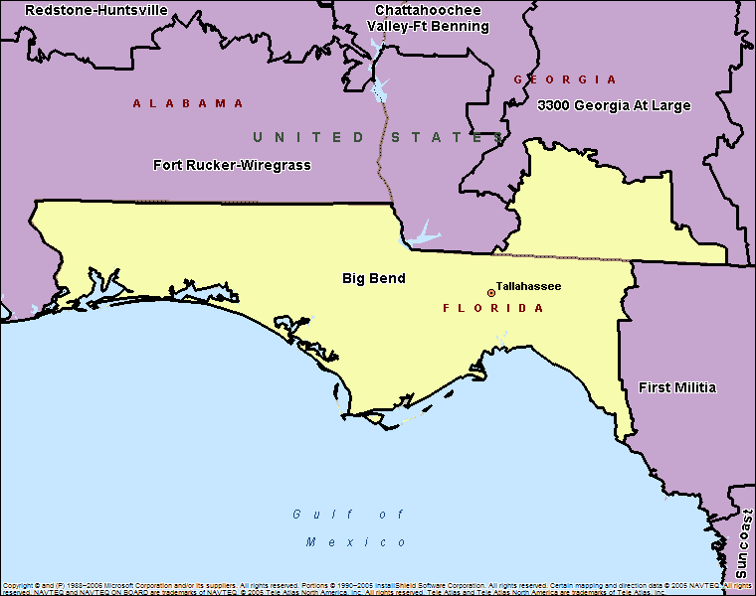
Emerald Coast COL Mike Thornton, President
Family Programs
Take The Hill
Army History
Member Communications

Slide 40
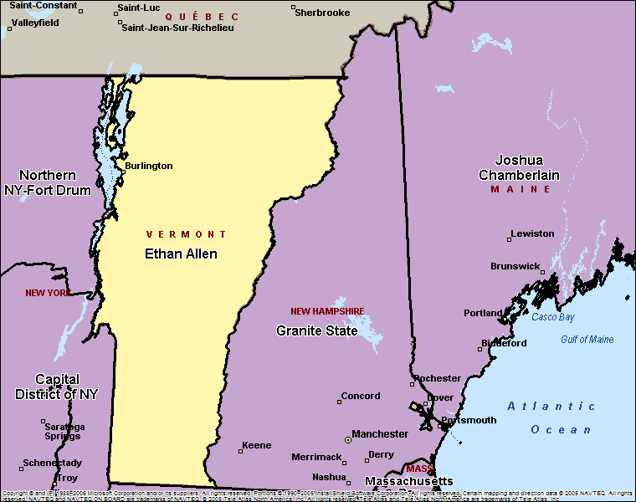
Ethan Allen Bill Tanner, President
NONE

Slide 41
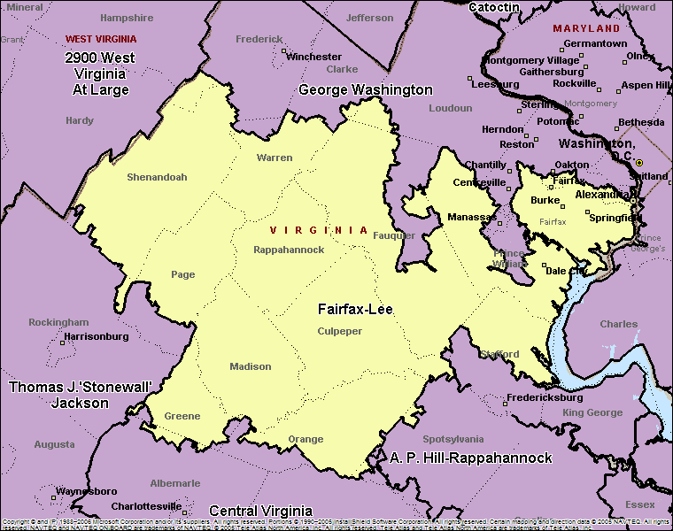
Fairfax-Lee Chapter John Hodges, President
Superior Chapter
Merit Chapter
Family Programs
Take The Hill
Army History
Member Communications

Slide 42
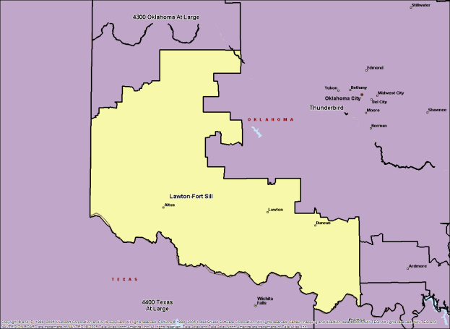
Fires Mr. Jim Harkins, President
Merit Chapter
Corporate Member Support
Family Programs
Support To USAREC
Take The Hill
Member Communications
Army Birthday
Institute Of Land Warfare Support

Slide 43
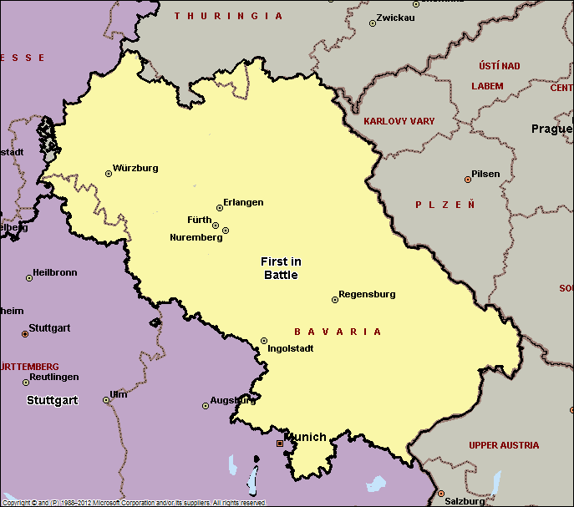
First in Battle CSM Jose A. Santos, President
NONE

Slide 44
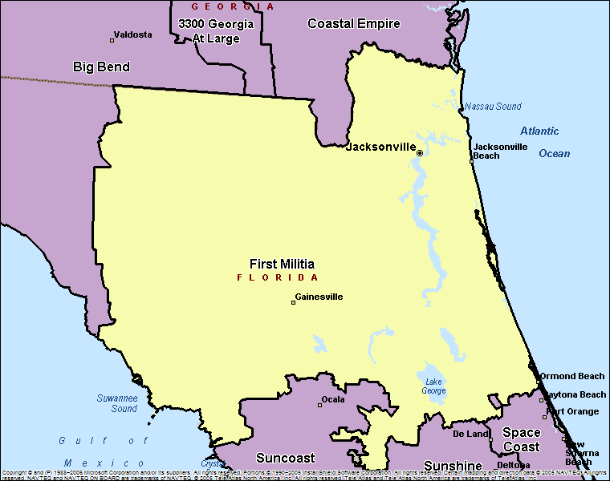
First Militia Chapter COL Dan Johnson, President
Chapter Of Excellence
Superior Chapter
Continuous Star (92)
Vietnam Partnership
Merit Chapter
Star Chapter
Corporate Member Support
Family Programs
Presidents Club (Gold)
Take The Hill
Army History
Support Of ROTC
Member Communications
Army Birthday
Institute Of Land Warfare Support
Young Professionals

Slide 45
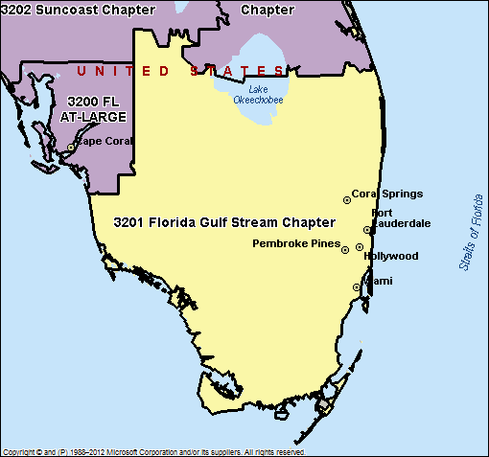
Florida Gulf Stream SGT Luis E. Lalama, President
Support To USAREC
Institute Of Land Warfare Support

Slide 46
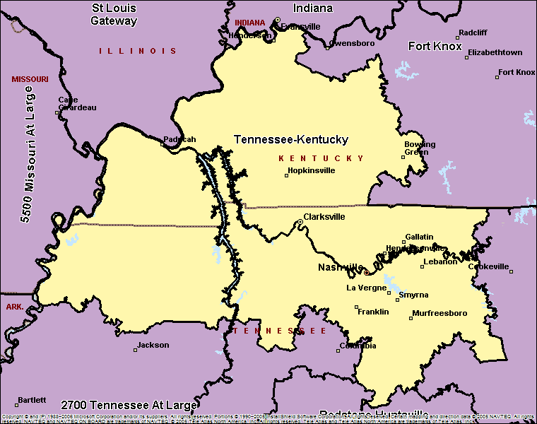
Fort Campbell Chapter Shirley West, President
Merit Chapter
Family Programs
Member Communications
Army Birthday
Young Professionals

Slide 47
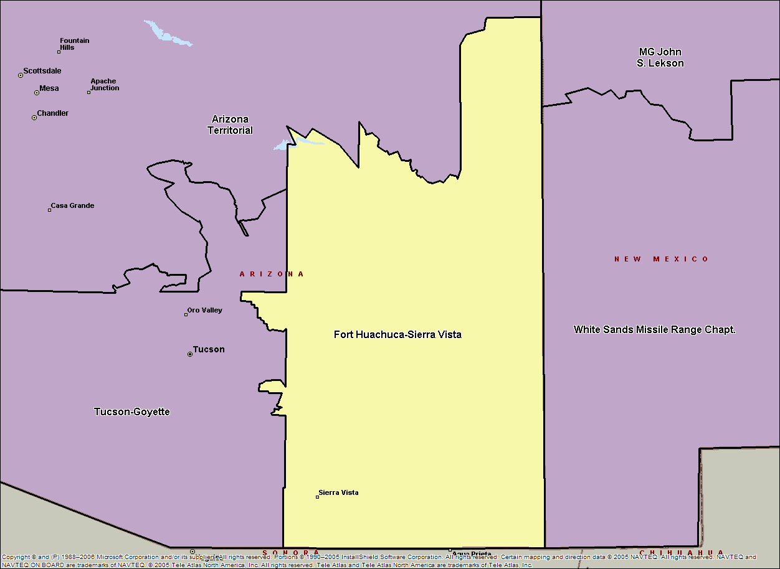
Fort Huachucca – Sierra Vista Bobby Fields, President
NONE

Slide 48
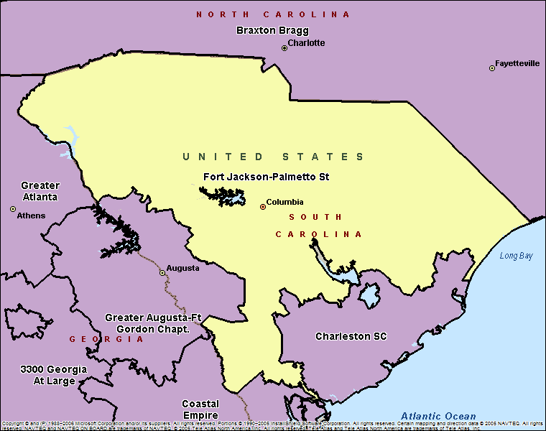
Fort Jackson-Palmetto State HON Kevin Shwedo, President
Merit Chapter
Support To USAREC
Take The Hill
Army History
Support Of ROTC
Army Birthday

Slide 49
Fort Knox Michael Devine, President
Merit Chapter
Excellence In Reserve Component Growth
Corporate Member Support
Family Programs
Support To USAREC
Take The Hill
Army History
Support Of ROTC
Member Communications
Army Birthday
Institute Of Land Warfare Support
Greatest Reserve Component Increase

Slide 50
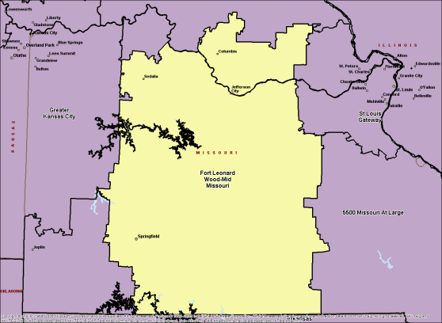
Ft Leonard Wood–Mid MO Chapter CSM Robert Aldenberg, President
Vietnam Partnership
Merit Chapter
Family Programs
Support To USAREC
Take The Hill
Army History
Support Of ROTC
Member Communications
Army Birthday
Institute Of Land Warfare Support

Slide 51
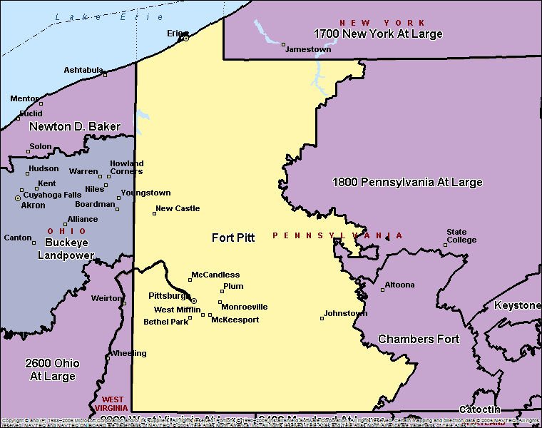
Fort Pitt Chapter Carlos Y. Carmona-Torres, President
Family Programs
Support To USAREC
Take The Hill
Army History
Member Communications
Army Birthday
Young Professionals

Slide 52
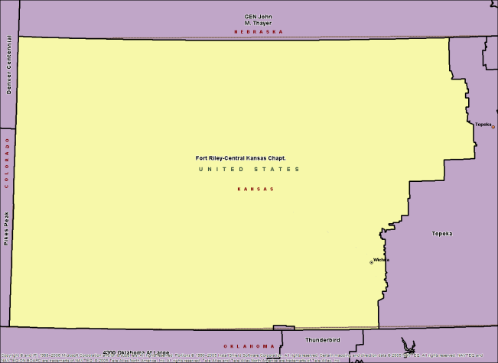
Fort Riley BG Philip Mattox, President
Vietnam Partnership
Merit Chapter
Family Programs
Take The Hill
Army History
Member Communications
Army Birthday

Slide 53
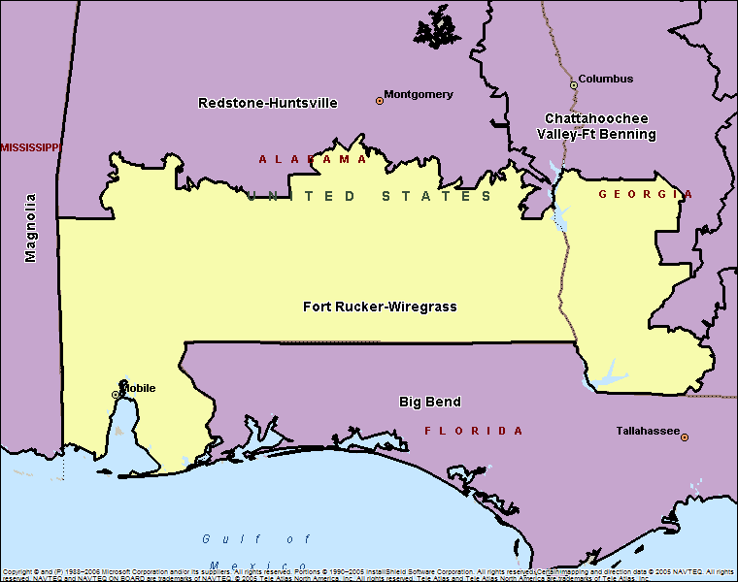
Fort Rucker-Wiregrass Chapter COL Jim Muskopf, President
Excel In Corporate Member Growth
Merit Chapter
Excellence In Reserve Component Growth
Corporate Member Support
Family Programs
Take The Hill
Army History
Member Communications
Army Birthday

Slide 54
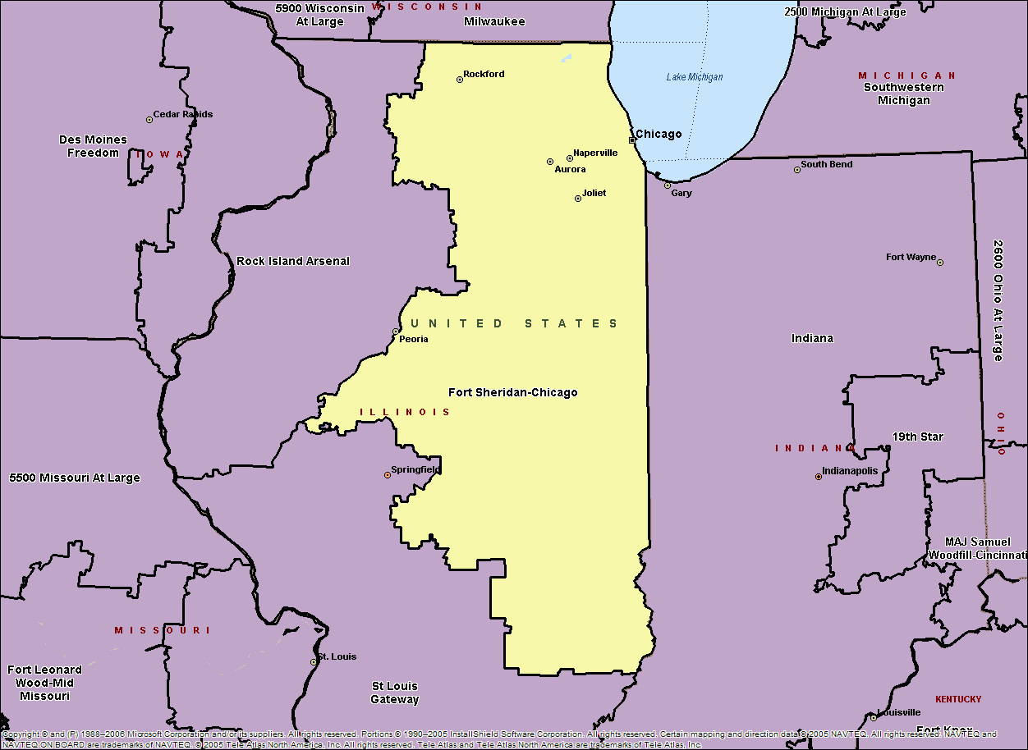
Fort Sheridan Mr. John L. Fascia, President
NONE

Slide 55
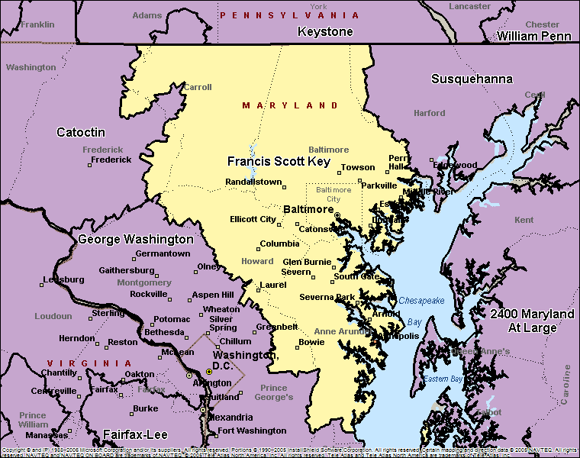
Francis Scott Key Chapter Matt Hauser, President
Vietnam Partnership
Family Programs
Take The Hill
Army History
Army Birthday
Institute Of Land Warfare Support

Slide 56
GA Omar Bradley Lance Lehr, President
Merit Chapter
Family Programs
Support To USAREC
Take The Hill
Army History
Member Communications
Army Birthday

Slide 57
Gem State LTC Marshall O. Townsend, President
Member Communications

Slide 58
GEN Creighton W. Abrams Chapter Dave Fulton, President
Excellence In Reserve Component Growth
Corporate Member Support
Family Programs
Army History
Member Communications
Army Birthday
Institute Of Land Warfare Support
Take The Hill

Slide 59
GEN John J. Pershing BG Roma J. Amundson, President
NONE

Slide 60
GEN John Vessey - MN Chapter CPT Mike Wolbrink, President
Superior Chapter
Continuous Star (199)
Merit Chapter
Star Chapter
Family Programs
Support To USAREC
Take The Hill
Army History
Support Of ROTC
Member Communications
Institute Of Land Warfare Support
Presidents Club (Gold)
Best General Membership Meeting
Greatest % Increase In Retiree Membership

Slide 61
GEN Joseph Stilwell BG Jerry Griffin, President
Take The Hill

Slide 62
GEN William Westmoreland Chapter MAJ (R) Jerry Morris, President
Best Chapter
Chapter Of Excellence
Superior Chapter
Continuous Star (96)
Merit Chapter
Star Chapter
Excellence In Reserve Component Growth
Support To USAREC
Take The Hill
Support Of ROTC
Member Communications
Army Birthday
Institute Of Land Warfare Support
Presidents Club (Gold)
Greatest % Increase In Retiree Membership

Slide 63
George Washington Chapter COL (R) Glenn Yarborough, Jr. President
Best Chapter
Chapter Of Excellence
Superior Chapter
Continuous Star (9)
Vietnam Partnership
Excel In Corporate Member Growth
Merit Chapter
Star Chapter
Excellence In Reserve Component Growth
Family Programs
Support To USAREC
Take The Hill
Army History
Member Communications
Army Birthday
Institute Of Land Warfare Support
Greatest Reserve Component Increase
Largest Chapter Membership
Greatest % Increase In Corporate Membership
Greatest % Increase In Membership

Slide 64
Greater Atlanta Coral J. Jones, President
Family Programs
Support To USAREC
Take The Hill
Army History
Support Of ROTC
Member Communications
Army Birthday
Institute Of Land Warfare Support

Slide 65
Greater Augusta-Fort Gordon Chapter COL (R) James T. Schroeder, President
Superior Chapter
Merit Chapter
Corporate Member Support
Family Programs
Take The Hill
Army History
Support Of ROTC
Member Communications
Army Birthday
Institute Of Land Warfare Support
Young Professionals

Slide 66
Greater Kansas City Chapter MAJ Emma Toops, President
Merit Chapter
Support To USAREC
Army History
Member Communications
Army Birthday
Young Professionals
Best General Membership Meeting

Slide 67
Greater Los Angeles Chapter Peter Seitz, President
Superior Chapter
Vietnam Partnership
Merit Chapter
Reserve Component Support
Family Programs
Support To USAREC
Take The Hill
Support Of ROTC
Member Communications
Army Birthday

Slide 68
Greater New York – Statue of Liberty LTC Joseph Schroder, President
Army Birthday

Slide 69
Hawaii Chapter Paul L’Ecuyer, President
Best Chapter
Best Overseas Chapter
Chapter Of Excellence
Superior Chapter
Vietnam Partnership
Merit Chapter
Star Chapter
Excellence In Reserve Component Growth
Corporate Member Support
Family Programs
Support To USAREC
Take The Hill
Army History
Support Of ROTC
Member Communications
Army Birthday
Institute Of Land Warfare Support
Young Professionals
Greatest % Increase In Retiree Membership
Greatest Government Civilian Membership
Greatest % Increase In Govt Civilian Membership

Slide 70
Henry Leavenworth COL Calvin Johnson, President
Excel In Corporate
Member Growth
Merit Chapter
Family Programs
Support To USAREC
Take The Hill
Army History
Member Communications
Army Birthday
Young Professionals
Greatest % Increase In Corporate Membership
Greatest % Increase In Govt Civilian Membership

Slide 71
Houston Metroplex Chapter Ms. Liza Garza, President
Chapter Of Excellence
Superior Chapter
Continuous Star (29)
Vietnam Partnership
Merit Chapter
Star Chapter
Reserve Component Support
Corporate Member Support
Family Programs
Support To USAREC
Take The Hill
Support Of ROTC
Member Communications
Army Birthday
Institute Of Land Warfare Support
Young Professionals
Presidents Club (Gold)

Slide 72
Indiana Chapter Dr. Cynthia Gatto, President
Merit Chapter
Reserve Component Support
Excellence In Reserve Component Growth
Family Programs
Support To USAREC
Take The Hill
Support Of ROTC
Member Communications
Army Birthday
Institute Of Land Warfare Support

Slide 73
Isthmian Mr. Walter T. Luchsinger, President
NONE

Slide 74
Japan Chapter SFC Timothy Gillinger, President
NONE

Slide 75
Joshua Chamberlain Ms. Cindi Piacitelli, President
Family Programs
Take The Hill
Army History
Army Birthday
Institute Of Land Warfare Support

Slide 76
Korea Chapter CSM (R) David Martinez, President
Superior Chapter
Merit Chapter
Star Chapter
Corporate Member Support
Family Programs
Support To USAREC
Take The Hill
Army History
Support Of ROTC
Member Communications
Army Birthday

Slide 77
Kuwait Chapter Dr. Rania Azmi, President
Chapter Of Excellence
Superior Chapter
Continuous Star (77)
Merit Chapter
Star Chapter
Take The Hill
Member Communications
Army Birthday
Institute Of Land Warfare Support
Presidents Club (Gold)

Slide 78
Las Vegas – John C. Fremont Chapter SGM (R) Robert A. Lindley Jr., President
Merit Chapter
Take The Hill
Army History
Support Of ROTC
Member Communications
Institute Of Land Warfare Support

Slide 79
Last Frontier Chapter SGM (R) Geraldine Wacker, President
Vietnam Partnership
Merit Chapter
Excellence In Reserve Component Growth
Support To USAREC
Take The Hill
Army History
Member Communications
Army Birthday
Institute Of Land Warfare Support

Slide 80
Leonidas Polk CSM Billy R. Brauer, President
NONE

Slide 81
Magnolia COL Kelly C. MacNealy, President
Excellence In Reserve
Component Growth

Slide 82
MAJ Samuel Woodfill Chapter CW4 (R) Matthew Luther, President
Chapter Of Excellence
Superior Chapter
Continuous Star (180)
Merit Chapter
Star Chapter
Excellence In Reserve Component Growth
Family Programs
Support To USAREC
Take The Hill
Army History
Support Of ROTC
Member Communications
Army Birthday
Institute Of Land Warfare Support
Presidents Club (Gold)

Slide 83
Marne Mr. Joseph R. Ford, President
Family Programs
Take The Hill

Slide 84
Massachusetts Bay COL Edward S. Graham, President
Support Of ROTC
Young Professionals

Slide 85
Mediterranean Roberto Tomaluolo, President
Excellence In Reserve Component Growth

Slide 86
MG Harry Greene, Aberdeen Chapter Tamera Rush, President
Chapter Of Excellence
Superior Chapter
Continuous Star (96)
Merit Chapter
Star Chapter
Excellence In Reserve Component Growth
Corporate Member Support
Family Programs
Take The Hill
Member Communications
Army Birthday
Institute Of Land Warfare Support
Young Professionals
Presidents Club (Gold)
Best General Membership Meeting
Greatest Government Civilian Membership
Greatest % Increase In Govt Civilian Membership

Slide 87
MG John S. Lekson COL John Brault, President
Merit Chapter
Member Communications
Army Birthday

Slide 88
MG Robert B. McCoy COL Ray Boland, President
Superior Chapter
Continuous Star (6)
Excel In Corporate Member Growth
Merit Chapter
Star Chapter
Excellence In Reserve Component Growth
Corporate Member Support
Family Programs
Support To USAREC
Take The Hill
Army History
Member Communications
Army Birthday
Greatest Reserve Component Increase
Greatest % Increase In Corporate
Membership
Greatest % Increase In Membership

Slide 89
MG William F. Dean Chapter MAJ Doug Miller, President
Superior Chapter
Merit Chapter
Reserve Component Support
Excellence in Reserve Component Growth
Support To USAREC
Take The Hill
Support Of ROTC
Member Communications
Army Birthday
Institute Of Land Warfare Support
Young Professionals

Slide 90
Mid-Palatinate Chapter CW3 Tony Williams, President
Member Communications

Slide 91
Milwaukee Chapter MSG (R) Gerald Brettschneider, President
Family Programs
Army History
Army Birthday
Institute Of Land Warfare Support
Young Professionals

Slide 92
Minutemen Norm Harkins, President
Support To USAREC
Take The Hill
Support Of ROTC
Army Birthday

Slide 93
Mission Trails Chapter VACANT, President
NONE

Slide 94
Monmouth Chapter COL (R) Samuel Fuoco, President
Best Chapter
Chapter Of Excellence
Superior Chapter
Continuous Star (9)
Vietnam Partnership
Merit Chapter
Star Chapter
Reserve Component Support
Excellence In Reserve Component Growth
Corporate Member Support
Family Programs
Support To USAREC
Take The Hill
Army History
Support Of ROTC
Member Communications
Army Birthday
Institute Of Land Warfare Support
Greatest Reserve Component Increase
Greatest % Increase In Corporate Membership
Greatest % Increase In Membership
Greatest % Increase In Retiree Membership

Slide 95
National Training Center Mr. James Welte, President
Family Programs
Take The Hill
Member Communications

Slide 96
New Orleans Mr. James L. Copeland, President
NONE

Slide 97
Newton D. Baker COL Ronald A. Schwachenwald, President
Superior Chapter
Continuous Star (9)
Merit Chapter
Star Chapter
Excellence In Reserve Component Growth
Family Programs
Support To USAREC Army History

Slide 98
North Texas – Audie Murphy Chapter COL (R) Richard Kaniss, President
Chapter of Excellence
Superior Chapter
Continuous Star (153)
Merit Chapter
Star Chapter
Corporate Member Support
Family Programs
Support To USAREC
Take The Hill
Army History
Support Of ROTC
Member Communications
Army Birthday
Institute Of Land Warfare Support
Young Professionals
Presidents Club (Gold)
Greatest % Increase In Membership
Vietnam Partnership

Slide 99
Northern New Jersey Chapter COL (R) Dennis Dougherty, President
Chapter Of Excellence
Superior Chapter
Continuous Star (49)
Vietnam Partnership
Merit Chapter
Star Chapter
Reserve Component Support
Excellence In Reserve Component Growth
Family Programs
Support To USAREC
Take The Hill
Army History
Support Of ROTC
Member Communications
Army Birthday
Institute Of Land Warfare Support
Young Professionals
Presidents Club (Gold)
Greatest Reserve Component Increase

Slide 100
Northern New York- Fort Drum Ms. Michelle Capone, President
Excel In Corporate Member
Growth
Merit Chapter
Reserve Component Support
Corporate Member Support
Family Programs
Take The Hill
Member Communications
Army Birthday
Institute Of Land Warfare Support
Young Professionals
Greatest % Increase In Retiree Membership

Slide 101
PFC Wm K. Nakamura Chapter Curtis Thompson, President
Vietnam Partnership
Support To USAREC
Institute Of Land Warfare Support
Young Professionals

Slide 102
Picatinny Arsenal-Middle Forge Chapter Nick Pugliese, President
Merit Chapter
Reserve Component Support
Family Programs
Support To USAREC
Army History
Support Of ROTC
Member Communications
Army Birthday
Greatest Government Civilian Membership

Slide 103
Pikes Peak COL Doug Harris, President
Family Programs
Take The Hill
Member Communications
Army Birthday

Slide 104
Polar Bear Ms. Maggie Vercruyssen, President
NONE

Slide 105
Puerto Rico CW4 Cristino Lozada-Cruz, President
Army Birthday
Vietnam Partnership
Merit Chapter
Institute Of Land Warfare Support

Slide 106
Redstone-Huntsville Chapter COL (R) John Wright, President
Best Chapter
Chapter Of Excellence
Superior Chapter
Continuous Star (153)
Vietnam Partnership
Merit Chapter
Star Chapter
Reserve Component Support
Corporate Member Support
Family Programs
Support To USAREC
Take The Hill
Army History
Support Of ROTC
Member Communications
Army Birthday
Institute Of Land Warfare Support
Young Professionals
Presidents Club (Gold)
Best General Membership Meeting
Greatest Government Civilian Membership
Greatest % Increase In Govt Civilian Membership

Slide 107
Rhode Island Chapter LTC (R) Robert Galvanin, President
Chapter Of Excellence
Superior Chapter
Continuous Star (154)
Merit Chapter
Star Chapter
Reserve Component Support
Family Programs
Support To USAREC
Take The Hill
Army History
Support Of ROTC
Member Communications
Army Birthday
Institute Of Land Warfare Support
Presidents Club (Gold)

Slide 108
Robert E. Lee COL David Jay Kolleda, President
Family Programs
Member Communications
Army Birthday
Institute Of Land Warfare Support

Slide 109
Rock Island Arsenal Chapter COL Jeff Carr, President
Chapter Of Excellence
Superior Chapter
Continuous Star (159)
Vietnam Partnership
Merit Chapter
Star Chapter
Family Programs
Take The Hill
Army History
Member Communications
Institute Of Land Warfare Support
Young Professionals
Presidents Club (Gold)

Slide 110
San Diego Chapter Patrick McCarthy, President
Excellence In Reserve Component Growth
Support To USAREC

Slide 111
San Francisco Patrick McAndrew, President
Continuous Star (8)
Star Chapter
Excellence In Reserve Component Growth
Take The Hill
Support Of ROTC
Member Communications

Slide 112
SGM Jon R. Cavaiani Chapter Rev Susan Plucker, President
Superior Chapter
Vietnam Partnership
Merit Chapter
Excellence In Reserve Component Growth
Family Programs
Support To USAREC
Take The Hill
Member Communications
Army Birthday
Institute Of Land Warfare Support
Young Professionals

Slide 113
Silicon Valley Chapter MG (R) Rob Ostenberg, President
Vietnam Partnership
Merit Chapter
Support To USAREC
Take The Hill
Army History
Member Communications
Army Birthday
Institute Of Land Warfare Support

Slide 114
Space Coast Chapter LTC Gerald Soltis, President
Army Birthday

Slide 115
St Louis Gateway Chapter Mr. Brett Cox, President
Chapter Of Excellence
Superior Chapter
Merit Chapter
Star Chapter
Excellence In Reserve Component Growth
Support To USAREC
Take The Hill
Army History
Member Communications
Army Birthday
Institute Of Land Warfare Support

Slide 116
Stuttgart Chapter Maj (R) Michael Pierce , President
Superior Chapter
Merit Chapter
Star Chapter
Corporate Member Support
Family Programs
Support To USAREC
Take The Hill
Army History
Member Communications
Army Birthday
Institute Of Land Warfare Support

Slide 117
Suncoast COL Jorge Rodriguez, President
NONE

Slide 118
Sunshine Chapter COL (R) DeLloyd Voorhees, President
Superior Chapter
Continuous Star (224)
Merit Chapter
Star Chapter
Reserve Component Support
Corporate Member Support
Family Programs
Support To USAREC
Take The Hill
Support Of ROTC
Member Communications
Army Birthday
Young Professionals
Presidents Club (Gold)

Slide 119
Texas Capital Area Chapter MSG Gerdo Cesar Soto, President
Chapter Of Excellence
Superior Chapter
Continuous Star (6)
Merit Chapter
Star Chapter
Corporate Member Support
Family Programs
Take The Hill
Member Communications
Army Birthday
Institute Of Land Warfare Support

Slide 120
Thomas J. “Stonewall” Jackson Chapter COL (R) John Miller, President
Chapter Of Excellence
Superior Chapter
Continuous Star (29)
Vietnam Partnership
Merit Chapter
Star Chapter
Reserve Component Support
Excellence In Reserve Component Growth
Family Programs
Support To USAREC
Take The Hill
Army History
Support Of ROTC
Member Communications
Army Birthday
Institute Of Land Warfare Support
Young Professionals
Presidents Club (Gold)

Slide 121
Thunderbird Chapter CAPT Rob Allen Jr., President
Vietnam Partnership
Excellence In Reserve Component Growth
Support Of ROTC

Slide 122
Tobyhanna Army Depot Chapter LTC Kenneth Quimby, President
Chapter Of Excellence
Superior Chapter
Continuous Star (191)
Merit Chapter
Star Chapter
Army History
Member Communications
Army Birthday
Institute Of Land Warfare Support
Presidents Club (Gold)
Greatest Government Civilian Membership

Slide 123
Topeka VACANT, President
NONE

Slide 124
Tri-State 1SG Cynthia Humphrey, President
Merit Chapter
Support To USAREC
Take The Hill
Army Birthday
Young Professionals

Slide 125
Tucson-Goyette Chapter LTC (R) Donald Spiece, President
Chapter Of Excellence
Superior Chapter
Continuous Star (100)
Vietnam Partnership
Merit Chapter
Star Chapter
Excellence In Reserve Component Growth
Family Programs
Support To USAREC
Take The Hill
Army History
Support Of ROTC
Member Communications
Army Birthday
Institute Of Land Warfare Support
Young Professionals
Presidents Club (Gold)

Slide 126
Utah COL Penelope L. Cook, President
Superior Chapter
Merit Chapter
Reserve Component Support
Take The Hill
Army History
Member Communications
Army Birthday
Institute Of Land Warfare Support
Best General Membership Meeting

Slide 127
Virginia Colonial Mr. Brad Herndon, President
Merit Chapter
Take The Hill
Member Communications
Institute Of Land Warfare Support

Slide 128
West Point Area John L. Buckheit, President
Excellence In Reserve Component Growth

Slide 129
Western New York Chapter SFC Christopher Park, President
Star Chapter

Slide 130
White Sands Missile Range Mr. Allen B. Tyree, President
NONE

Slide 131
William Penn Chapter James Donahue, President
Superior Chapter
Vietnam Partnership
Merit Chapter
Support To USAREC
Take The Hill
Army History
Member Communications
Army Birthday
Institute Of Land Warfare Support
Young Professionals

Slide 132
 Chapter Presidents Dinner 
Honoring the Work of AUSA’s Dedicated Volunteers

