Slide 1
AUSA Hot Topic: Ground Platforms
November 1, 2016
Buck Tanner

Slide 2
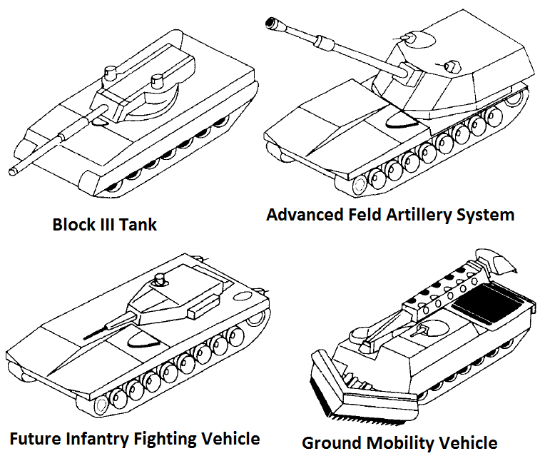
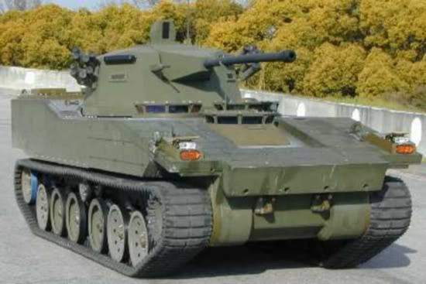
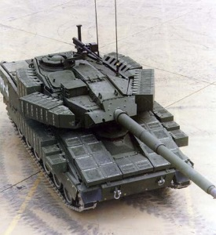
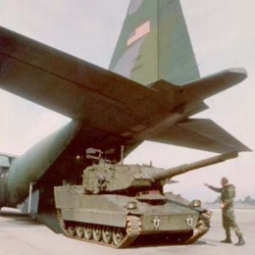
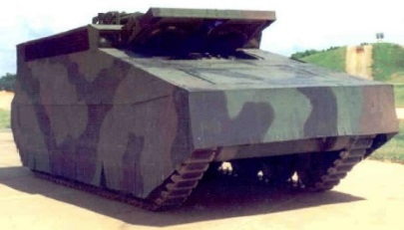
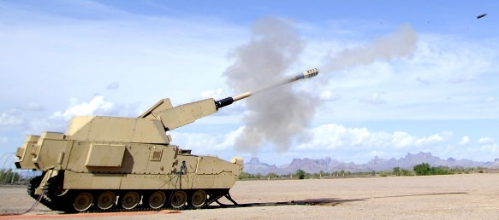
Need a range of systems
Armed Systems Modernization (mid 1980’s to mid 1990’s)
40 and 60 tons
Family of systems (common components)
‘Early’ Systems (early 1990’s)
Composite Armored Vehicle
Future Scout and Cavalry System
Armored Gun System
Army After Next (mid1990’s)
Family (3 weight classes) of systems (8T; 26T; 40T)
Manned Ground Vehicles (2002-2009)
Family of systems (common chassis)
18T; 24T; 27T; 31T; 35T

Slide 3
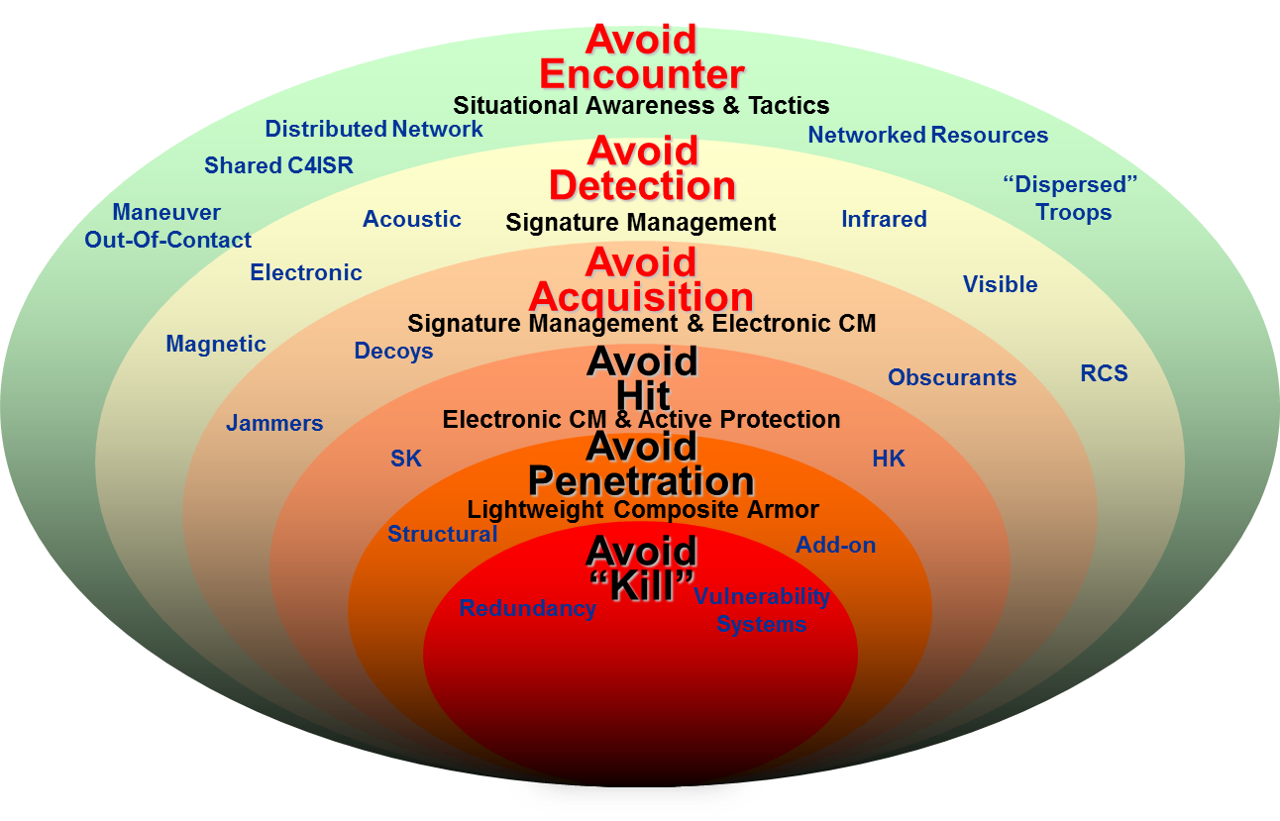
Weight Reduction Approaches
Reduce crew size
Robotics (remove/remote soldier)
Increase lethality:
LOSAT/CKEM
Reduced recoil guns: Raven
Increase survivability:
APS (Hit avoidance)
Sig man (Detection avoidance)

