Slide 1
Outpacing Infectious Disease
COL Matthew Hepburn, M.D., MC, USA
Program Manager, Biological Technologies Office
Briefing prepared for AUSA
22 Sep 2016

Slide 2
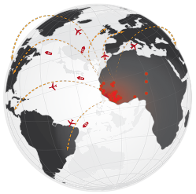
BTO Vision for Pandemic Preparedness
Develop scalable operational technologies that have the capability to predict, prevent, diagnose, and treat pandemic infectious disease outbreaks
Microphysiological Systems (MPS)
ADEPT- PROTECT
Rapid Threat Assessment (RTA)
Vaccines
ADEPT- Controlling Cellular Machinery (CCM)
Safety/Efficacy
Technologies for Host Resilience (THoR)
Prometheus
Predict
Prevent
Discovery
Prognostics
Biochronicity
Prophecy – Pathogen Defeat
INTERCEPT
ADEPT – Diagnostics on Demand (DxOD)
ADEPT- CCM-Therapeutics
Therapeutics
Distributed/In vivo
ADEPT – CCM-Diagnostics
Pathogen Predators
Treat
Diagnose
In vivo Nanoplatforms (IVN) – Diagnostics (Dx)
IVN – Therapeutics (Tx)
Dialysis Like Therapeutics
Devices
Clinical
Battlefield Medicine
Prophecy – Mobile Analysis Platform (MAP)

Slide 3
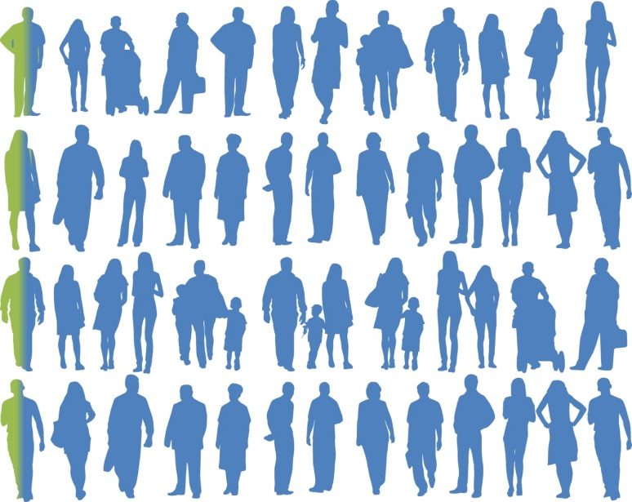
Outpacing Infectious Diseases
Generation
Firebreaks
0
1
2
Infected, identified early with local diagnosis
Infected individuals
Protected transiently by transferring immune responses
Protected long-term with new, rapid vaccine methods
Notes:
Rapid response to disease threats, improved individual readiness, and total force health protection

Slide 4
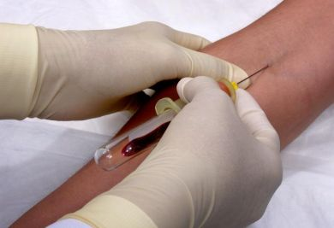
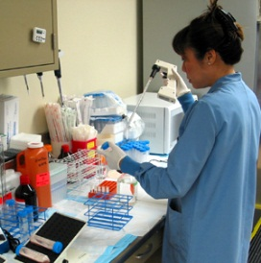
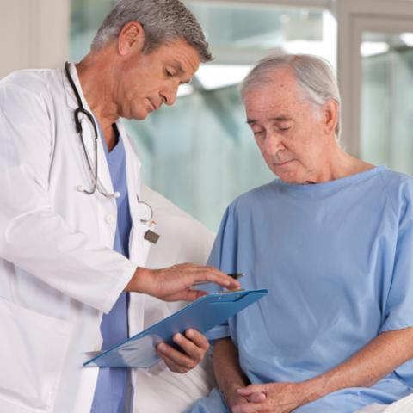
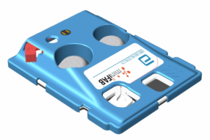
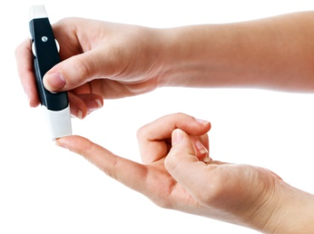
Fielding Rapid & Accurate Diagnostics
Today
transport
hours to days
Trained phlebotomist
Clinical laboratory analyses
Results from physician
DARPA Mobile Analysis Platform (MAP)
or
30-45 min
Collect sample at the bedside
Analyze and transmit results
Load sample

Slide 6
Syndrome-based assays in development
Environmental biothreat assay
Respiratory virus assay
Febrile illness assay
Current capabilities: Ebola, Lassa, Marburg
Current capabilities: Flu A, Flu B, RSV, enterovirus 68, MERS-CoV
Prospective clinical testing 2016-2017
Select infectious agents
Collaborating with JPEO to transition device for Joint Handheld Bio-Agent Identifier Program
Host response assay
Goal: amplify diagnostic host mRNAs to distinguish between bacterial and viral infections, or non-infectious fever
Collaborating with Duke University to identify host targets
Sexually transmitted infections assay
Goal: Chlamydia trachomatis, Neisseria gonorrheae, Trichomonas vaginalis, Mycoplasma genitalium
Additionally distinguishes between ciprofloxacin sensitive and resistant gonorrhea
Goal: develop regionally specific panels for Africa (Ebola, Lassa, malaria, CCHF) and the Americas (malaria, Dengue, Chikungunya, Zika, leptospirosis)

Slide 7
Clinical and Operational Test Plan (2016)
Naval Health Research Center
Marine Corps Warfighting Lab
Objective: Prospective clinical testing of respiratory virus assay
Location(s): Kearny Mesa, Camp Pendleton, 29 Palms
Objective: Communications testing and integration into medical common operating picture; RIMPAC
Location(s): USMC Warfighting Lab, Quantico VA
Military HIV Research Program
Objective: Prospective clinical testing of respiratory virus assay
Location(s): MHRP clinics in Lagos and Abuja, Nigeria
National Institutes of Health
Objective: Clinical testing and sampling methodology refinement in flu human challenge study cohorts
Location(s): NIH Clinical Center, Bethesda MD

Slide 8
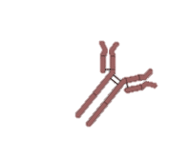
Rapid Immunoprophylaxis Strategy
Provide the genetic sequences that encode the protective antibodies directly to humans so that their own cells receive the instructions for producing a potent antibody
GGTACTTACTCACTAA
Notes:
One approach to establishing immune protection quickly add is to bypass the adaptive immune response. We can do this by getting to those “good” antibodies and delivering them to humans directly, i.e., not counting on the human immune response to produce the correct antibody response and not hoping it develops fast enough to be protect that individual against pathogen exposure. All it takes is a small blood sample. We can provide the genetic sequences that encode the protective antibodies directly to humans so that their own cells receive the instructions for producing a potent antibody—and the host is not dependent on the development of the adaptive immune response. For successful immune prophylaxis via encoded antibody, highly protective human mAbs are needed. And for an emerging threat, the sequences of protective mAb cocktail are needed FAST. So we are finding the best antibodies, getting their sequence, and working on ways to delivery those sequences directly to humans so that their own cells produce the encoded protective antibodies…

Slide 9
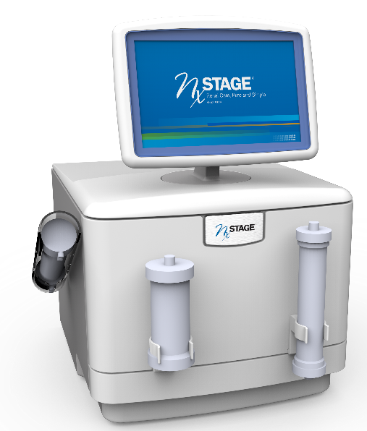
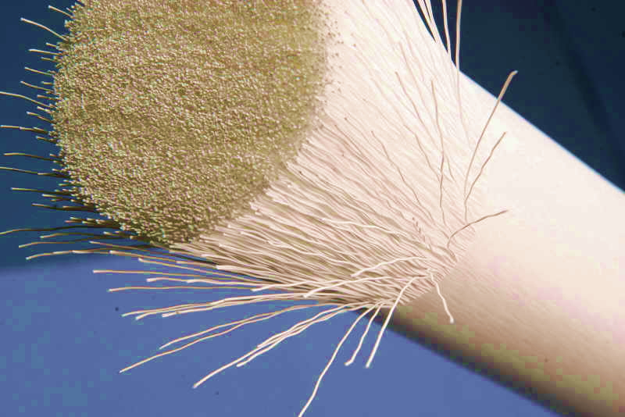
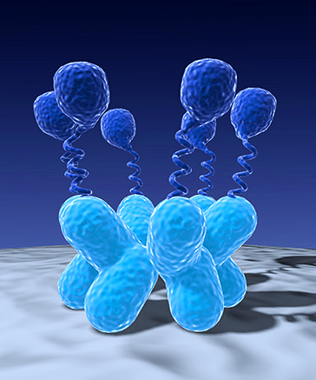
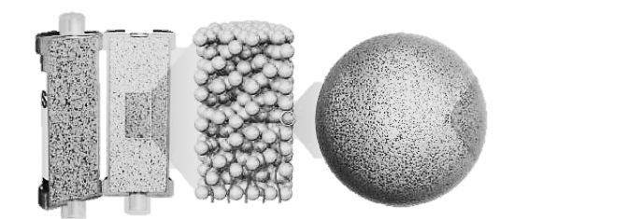
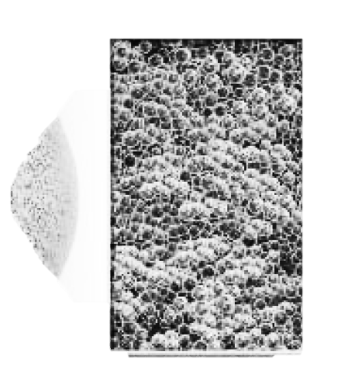
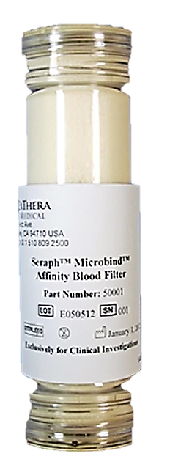
Dialysis Like Therapeutics (DLT)
Goal: Selectively remove pathogens, toxins, and other harmful components from the bloodstream with portable dialysis and extracorporeal filters
Portable Dialysis Machine
Extracorporeal Filter Technologies
Mannose Binding Lectin (MBL)
MBL is a protein that binds to the carbohydrate groups found on the surface of pathogens that induce sepsis, including bacteria, viruses, fungi, parasites and toxins, but does not bind to healthy human cells.
Source: Wyss Institute & Opsonix
Porous Polymer Beads
Pores remove a wide range of molecules that cause inflammation (e.g. cytokines) from whole blood based on pore capture and surface adsorption.
Source: Cytosorbents
Heparan Sulfate Coated Beads
Disease-causing microorganisms bind to sugar groups such as heparin sulfates. As blood flows through the filter, pathogens, toxins and inflammatory cytokines bind to the surface of the beads.
Source: ExThera Medical
Source: NxStage Medical
Galanthus Nivalis Agglutinin (GNA)
GNA is a protein that binds to sugar groups (e.g. mannose) on the surface of pathogens. GNA is immobilized on a hemodialysis filter and removes a wide variety of viruses.
15” x 20” x 17” - < 100 lbs.
Source: Aethlon Medical

