Slide 1
Outpacing Infectious Diseases
COL Matthew Hepburn, MC, USA
Program Manager, Biological Technologies Office
Briefing Prepared for:
“Army Medicine Enabling Army Readiness Today and Tomorrow”
Association of the United States Army
22 Sept 2016
Distribution A. Approved for Public Release: Distribution Unlimited

Slide 2
DARPA’s Mission: Breakthrough Technologies For National Security
Precision Guidance & Navigation
Communications/Networking
IR Night Vision
Stealth
UAVs
Investing today
for the next generation
1960s
1970s
1980s
1990s
2000s
2010s
2020s
2030s
ARPAnet/Internet
Microelectronics: VLSI, CAD, manufacturing, IR, RF, MEMS
Information Technology: timesharing, client/server, graphics, GUI, RISC, parallel computing, speech recognition
Materials Science: semiconductors, superalloys, carbon fibers, composites, thermoelectrics, ceramics
These new capabilities require a healthy ecosystem across Service S&T, universities, and industry
DARPA’s role: pivotal early investments that change what’s possible

Slide 3

Characteristics of DARPA
$3B funding Agency – all research is performed extramural (no DARPA labs)
Agency is Program Manager centric – Bottoms up and active management
Program Managers are transitory (2 – 5 year tours) – Sets rapid pace
Interested in compelling outcomes that provide new capability
Revolutionary change (not evolutionary extensions or incremental gains)
High risk is ok -- If the outcome of a project is certain, with only dollars and time needed to complete the work, it may not be a program for DARPA.
Demonstrate technology, at times at the system level with hardware

Slide 4
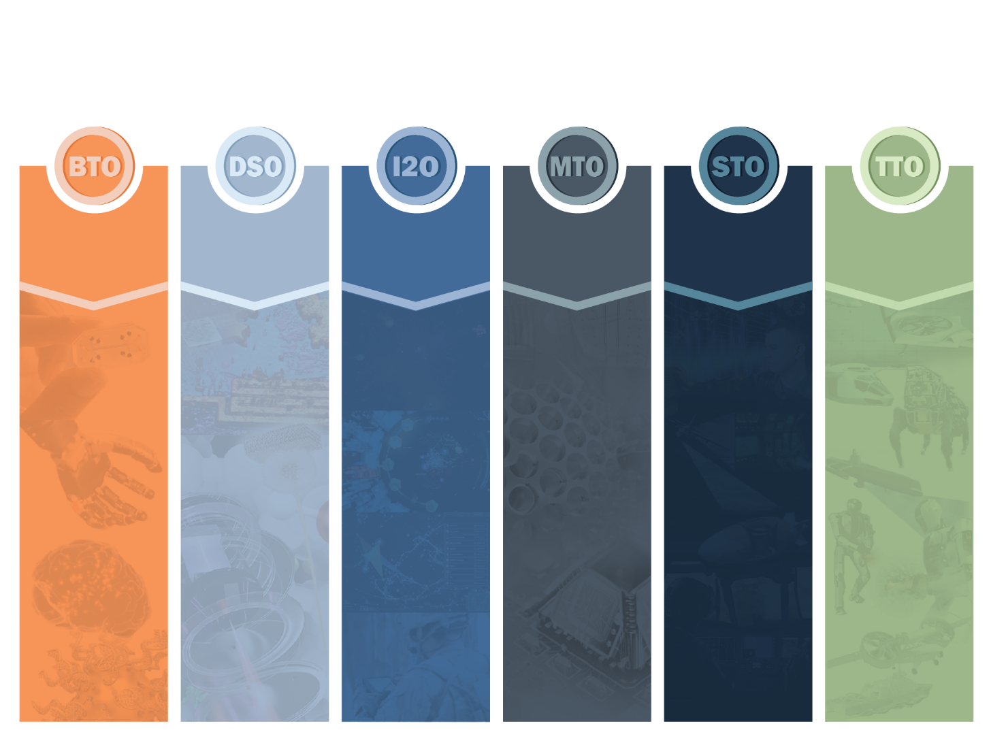
DARPA Technology Offices
BIOLOGICAL
TECHNOLOGY
OFFICE
DEFENSE SCIENCE
OFFICE
INFORMATION
INNOVATION
OFFICE
MICROSYSTEMS
TECHNOLOGY
OFFICE
STRATEGIC
TECHNOLOGY
OFFICE
TACTICAL
TECHNOLOGY
OFFICE
Biological Complexity at Scale
Neurotechnologies
Engineering Biology
Restore, Maintain and Improve Warfighter Abilities
Math, Modeling & Design
Physical Systems
Human-Machine Systems
Empower the Human within the Information Ecosystem
Guarantee Trustworthy Computing and Information
Electromagnetic Spectrum
Tactical Information Extraction
Globalization
System of Systems (SoS)
Battle Management/Command and Control (BMC2)
Communications and Networks (C&N)
Electronic Warfare (EW)
Intelligence Surveillance, and Reconnaissance (ISR)
Positioning, Navigation, and Timing (PNT)
System Focus Areas:
Ground
Maritime
Air
Space
Crosscutting Themes:
Agile development
Cooperative Autonomy
Unmanned Systems
Power and Propulsion

Slide 5



Biological Technologies Office (BTO)
Neurotechnology
ElectR_{x}
HAPTIX
NESD
NeuroFAST
RE-NET
Restoring Active Memory
Revolutionizing Prosthetics (RP)
SUBNETS
Outpacing Infectious Diseases
ADEPT
Battlefield Medicine
Dialysis-Like Therapeutics
In Vivo Nanoplatforms Microphysiological Systems
Pathogen Predators
Prometheus
Prophecy
Rapid Threat Assessment
Technologies for Host Resilience
Warrior Web
Tools for Synthetic Biology
Biochronicity
Biological Control
BRICS
Living Foundries
© Berkeley Lab

Slide 6
How DARPA thinks about research programs
Basic Science Opportunity Space
State of the Art
Strategic Capability

Slide 7
Handheld Sample-to-Answer Molecular Diagnostic

Slide 8
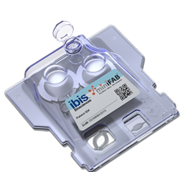
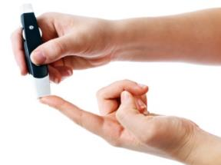

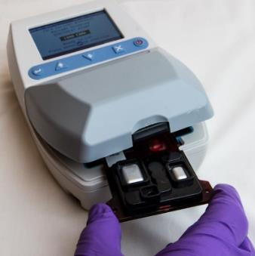
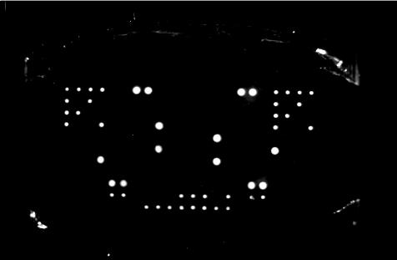
MAP: Mobile Analysis Platform
1
Collect Sample & Load
or
2
Analyze
30 - 45 minutes
Lysis
RT
PCR
Remove primer
Hyb
Wash
Image

Slide 9
Assays in Development
Environmental biothreat assay
Respiratory virus assay
Febrile illness assay
Current capabilities: Ebola, Lassa, Marburg
Current capabilities: Flu A, Flu B, RSV, enterovirus 68, MERS-CoV
Aiming for prospective clinical testing this fall
Select infectious agents
Host response assay
Goal: amplify diagnostic host mRNAs to distinguish between bacterial and viral infections, or non-infectious fever
Sexually transmitted infections assay
Goal: Chlamydia trachomatis, Neisseria gonorrheae, Trichomonas vaginalis, Mycoplasma genitalium
Additionally distinguishes between ciprofloxacin sensitive and resistant gonorrhea
Goal: add bacterial pathogens such as Streptococcus pneumoniae
Developing lysis protocol for blood samples
Goal: add malaria, and Dengue and Chikungunya viruses

Slide 10
In vivo Biosensors

Slide 11
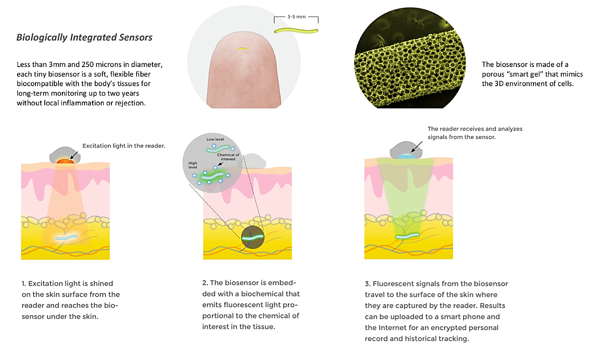
Non-invasive monitoring of physiology

Slide 12
Predicting Contagiousness

Slide 13

Prognostic to Predict Contagiousness
Goal: Discover Prognostic Biomarkers that Predict if a Person Will Become Contagious
Problem: The spread of disease is caused by people who are contagious prior to developing symptoms
Contagious
Symptom Onset
Seek Doctor
Diagnoses
Exposure
Spread Disease
Diagnostic Testing
If contagion can be predicted and prevented prior to symptoms, then outbreak of infectious
disease can be forecast and mitigated
Intervention
Contagious
Symptom Onset
Exposure
Early Host Molecular Prognostic Testing
Spread Disease

Slide 14
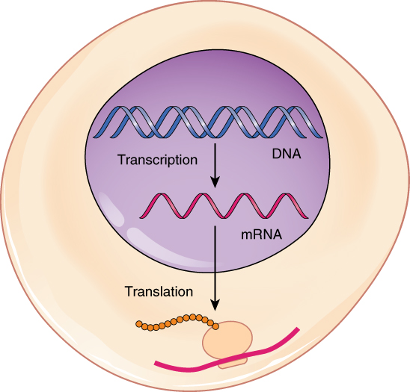


Measure Early Biomarkers
Our immune cells become activated just hours after exposure to a pathogen, triggering gene expression
These early biomarkers can be found in a drop of blood
Immune Cell
Cytokine Proteins
Immune-modulating cytokines
Intracellular DNA and RNA
RNA
Extracellular DNA and RNA in vesicles (exosomes)
Protein
Gene expression may be characterized by the quantity of RNA produced in a cell

Slide 15
Disease Forecasting

Slide 16
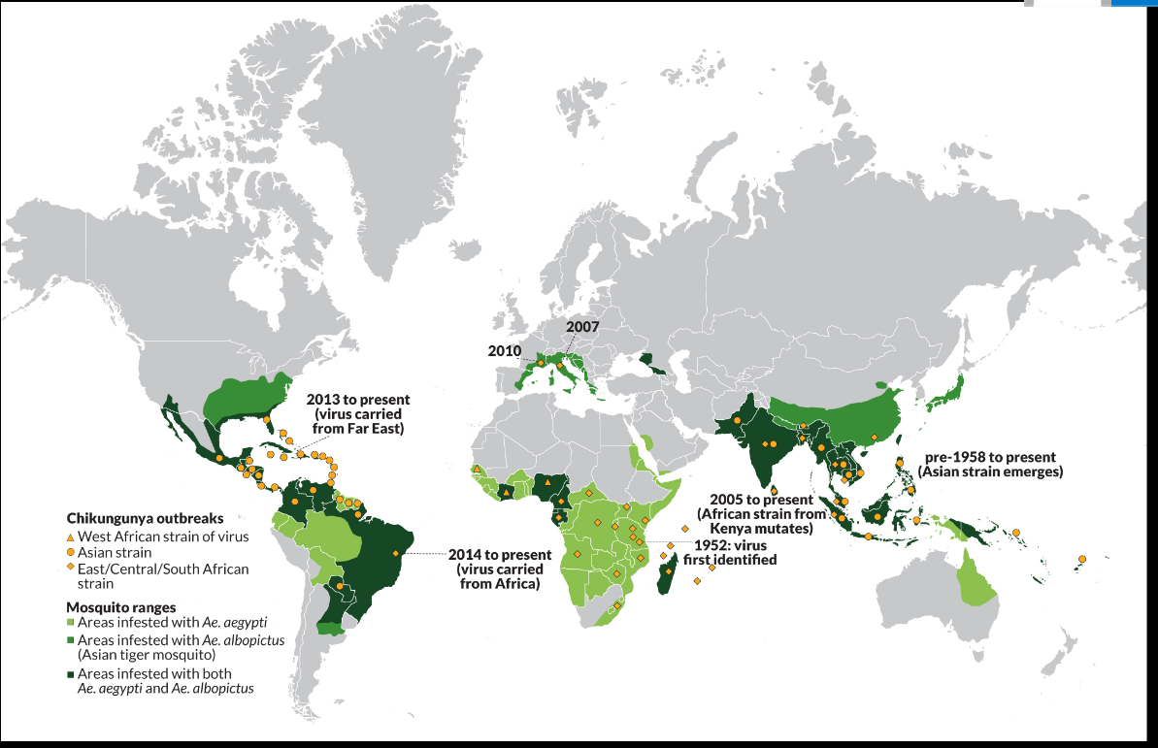

Prize Challenge to Forecast Spread of Chikungunya
sciencenews.org
  > 400 Registered Solvers
  Challenge submission timeline:
Prize Structure: 1st place = $150,000
2nd place = $100,000
Honorable Mention = $50,000 x 4
Top Methodology = $10,000 x 5
  Sept ‘14 Oct ‘14 Nov ‘14 Dec ‘14 Jan ‘15 Feb ’15
6
month
forecast
5
month
forecast
4
month
forecast
3
month
forecast
2
month
forecast
1
month
forecast

Slide 17
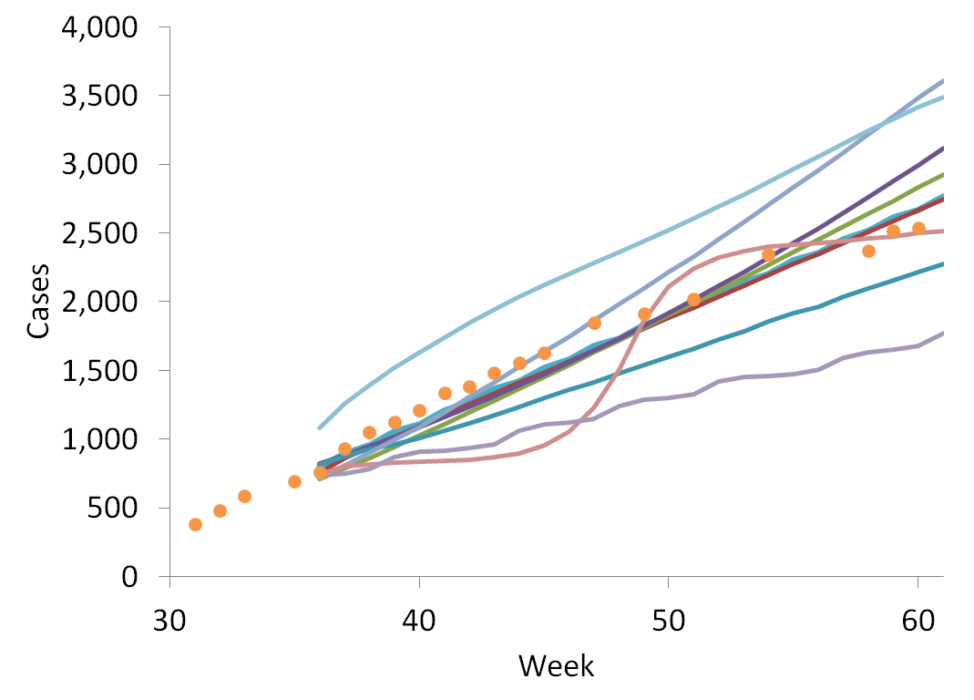
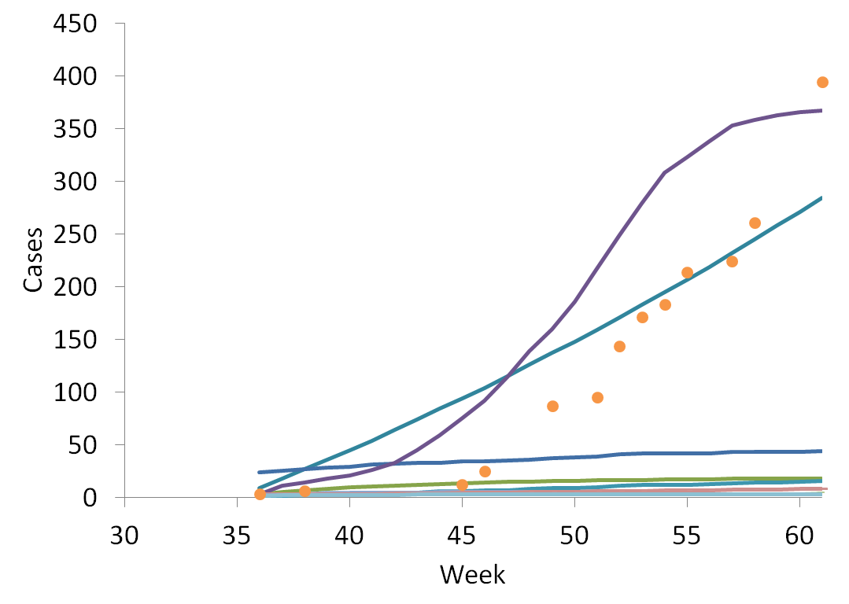
Lessons Learned: Chikungunya Challenge
Start of Challenge
USA – Data Available Prior to Challenge Start
Most solvers extrapolated based on existing data
Ex: Simple Model - SI (susceptible-infected) model
Data employed
  PAHO case report data
  Air travel
Actual
Forecasts
Mexico – No Reporting Prior to Challenge Start
Most solvers could not predict spread to a new country
Ex: Complex Models - Ecological niche + transportation + disease transmission components
Data employed
  PAHO case report data
  Air travel
  30 year climate data
  Distribution of vector (mosquito)
Start of Challenge
Actual
Forecasts

Slide 18
Gene-encoded Immunity

Slide 19
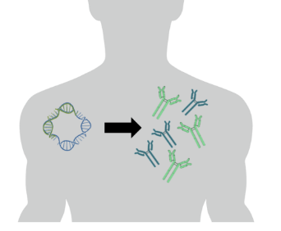
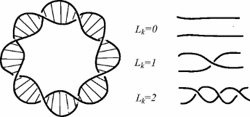








Antibodies for Immediate Immunity
Give the “code” and let the patient make the antibody
Best, protective antibodies identified and improved
Blood
DNA Blueprint for
best antibodies
Sick
Convalescent survivor
Protection for months
Notes:
Early antibody therapy was based on blood serum collected from animals who had been inoculated with bacterial toxins. These horses became a valuable source of antitoxin against diphtheria. In the 1920s, an estimated 100,000 to 200,000 diphtheria cases occurred in the United States each year. Even with treatment, the disease killed as many as 15,000 people every year. In the winter of 1925, a physician in Nome, Alaska faced a crisis—what initially appeared to be simple sore throats or tonsillitis became an outbreak of diphtheria that could kill most of the region's population of about 10,000 people. Diphtheria is a highly contagious upper respiratory tract illness caused by the toxin-producing bacterium Corynebacterium diphtheriea. The disease can be treated with an antitoxin (serum containing antibody to neutralize the toxin), or more recently, prevented by vaccines. However, before these medicines were available, diphtheria was commonly known as the “strangling angel of children.” Diphtheria causes the throat to become blocked with a thick, leathery coating that makes breathing very difficult. Without treatment, death by suffocation is very likely, especially for young children. When 2 children died, the physician, Dr. Welch, ordered a quarantine, but diphtheria is so contagious that many people were likely to already have been exposed, and he knew more cases would appear rapidly. The town’s supply of conventional therapy, antitoxin, was expired and in low supply. He sent dozens of telegrams pleading for fresh antitoxin, leaders in D.C. located some in Anchorage—hundreds of miles away. Between Anchorage and Nome there were no roads, no railways, no air service availability, and sea ice prevented ships from reaching Nome. The only way to Nome was the 674-mile Iditarod Trail. Alaska’s governor approved a plan for 20 mush-drivers and 150 sled dogs to relay the antitoxin to Dr. Welch, a journey that typically took 15-20 days, but in this case took 5 days and 7 hours. Two weeks later, the quarantine was lifted. Although 5 children died in total, many hundreds of lives were spared because hundreds of people worked together with unbridled creativity to deliver diphtheria antitoxin to Nome.

Slide 20
Filtering Pathogens from the Bloodstream

Slide 21
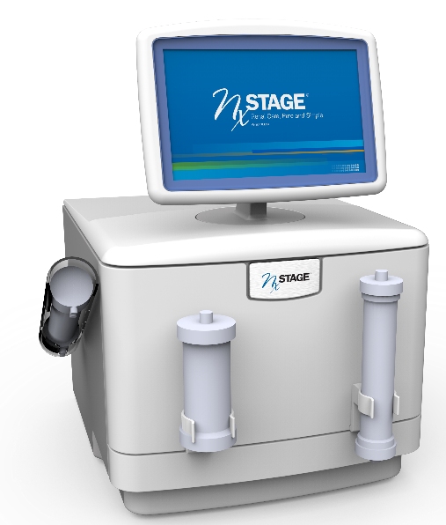
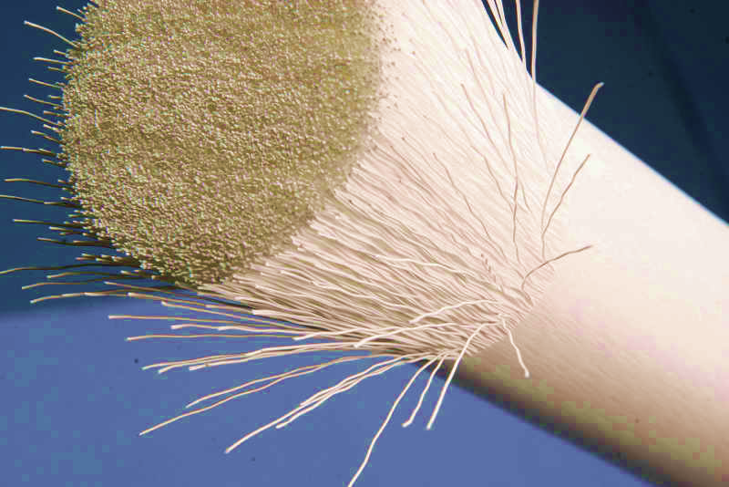
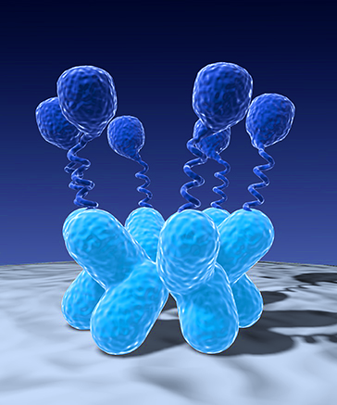

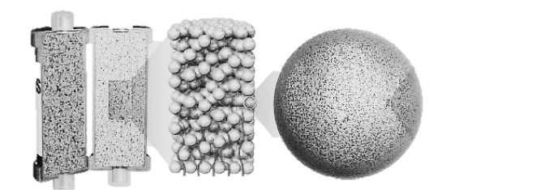
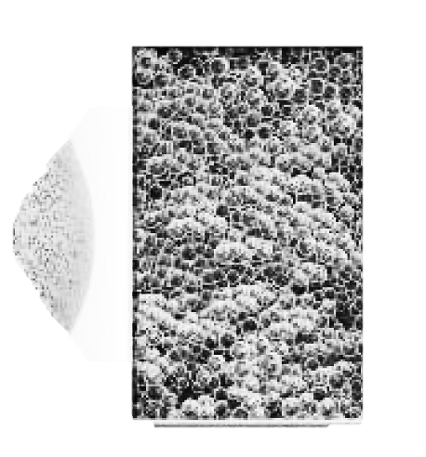

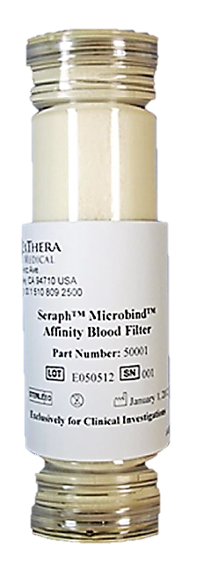
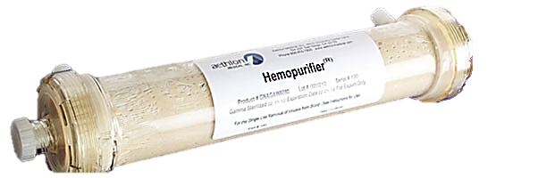
Dialysis-Like Therapeutics
Goal: Selectively remove pathogens, toxins, and other harmful components from the bloodstream with portable dialysis and extracorporeal filters
Extracorporeal Filter Technologies
Mannose Binding Lectin (MBL)
MBL is a protein that binds to the carbohydrate groups found on the surface of pathogens that induce sepsis, including bacteria, viruses, fungi, parasites and toxins, but does not bind to healthy human cells.
Source: Wyss Institute & Opsonix
Porous Polymer Beads
Pores remove a wide range of molecules that cause inflammation (e.g. cytokines) from whole blood based on pore capture and surface adsorption.
Source: Cytosorbents
Heparan Sulfate Coated Beads
Disease-causing microorganisms bind to sugar groups such as heparin sulfates. As blood flows through the filter, pathogens, toxins and inflammatory cytokines bind to the surface of the beads.
Source: ExThera Medical
Source: NxStage Medical
Galanthus Nivalis Agglutinin (GNA)
GNA is a protein that binds to sugar groups (e.g. mannose) on the surface of pathogens. GNA is immobilized on a hemodialysis filter and removes a wide variety of viruses.
15” x 20” x 17” - < 100 lbs.
Portable Dialysis for Critical Care Applications
Next-generation hemodialysis system with 40% reduction in weight, volume; higher flow rate capability; and 75% reduction in operator interactions during device priming and setup.
Source: Aethlon Medical

