Slide 1
Sleep: A Force Multiplier for Health and Readiness
Panel #2: Optimizing Medical Readiness Of The Total Army
Anne Germain, Ph.D.
University of Pittsburgh School of Medicine
Associate Professor of Psychiatry, Psychology,
and Clinical and Translational Science
Director, Neuroscience Clinical and Translational Research Center
Director, Military Sleep Tactics and Resilience Research Team
22 September, 2016

Slide 2
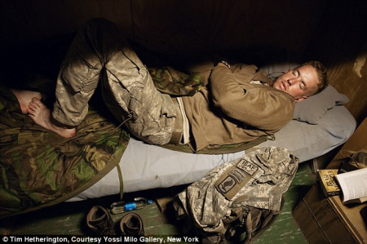
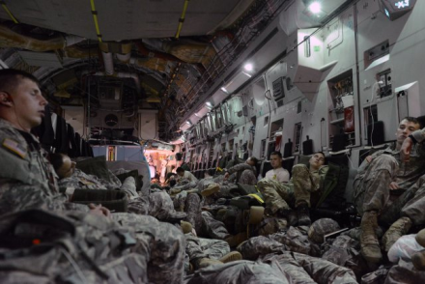
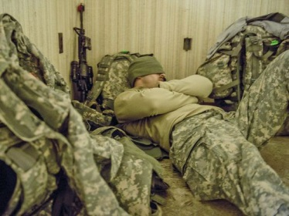
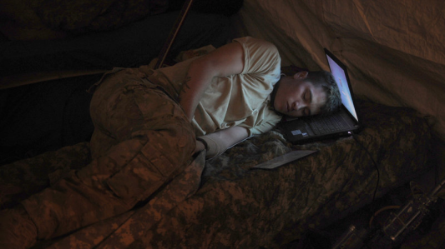
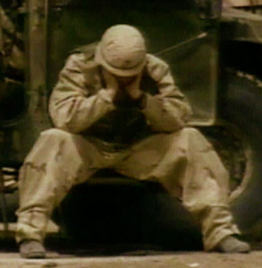
“In peace and war, the lack of sleep works like termites in a house: below the surface, gnawing quietly and unseen to produce gradual weakening, which can lead to sudden and unexpected collapse.” Maj. Gen. Aubrey “Red” Newman, Follow Me , 1981
Anne Germain, Ph.D.

Slide 3
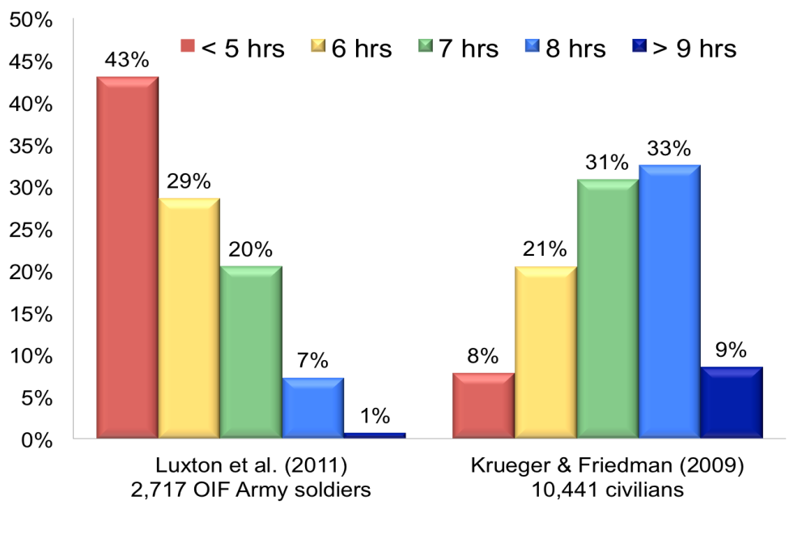
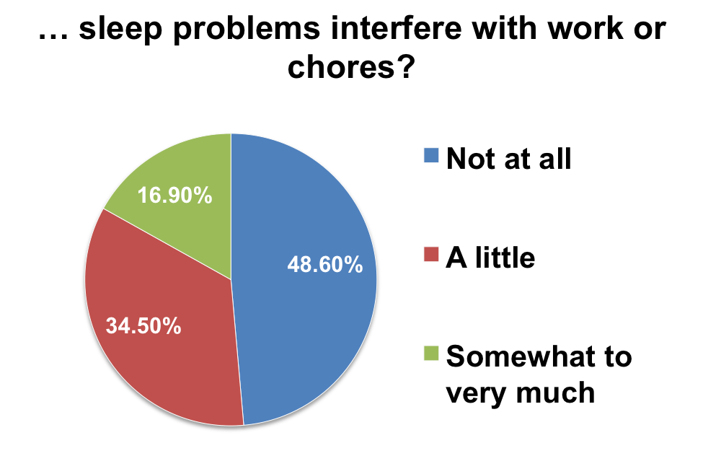
Sleep, Health, and Readiness
RAND, 2015
Sleep Disturbances
Compromised Health and Readiness
Compromised Health
Mental
Physical
Increased risk behaviors*
Increased fatigue
Risk of injury
Reduced productivity
Compromised cognitive readiness
Anne Germain, Ph.D.

Slide 4
Cognitive-Behavioral Treatment of Insomnia
Insomnia: | Inability to sleep despite adequate opportunity to sleep
CBT-I: | Set of behavioral rules (4) that sustain regular, sufficient, restorative, and predictable sleep.
Magnitude of CBTI effects: | Moderate to very large Over 4*-8 weeks (ind. or group) > 70% Treatment Response > 35 % Remission
First line, evidence-based (EB) treatment of insomnia endorsed by: | American Academy of Sleep Medicine National Institute of Health American College of Physicians
“Sleep Hygiene” is NOT an EB treatment of insomnia.
Anne Germain, Ph.D.

Slide 5
CBTI: Challenges & Opportunities
Challenges | Opportunities
(Erroneous) Cultural perceptions of (limited) sleep needs | Education & training Dissemination of research and pragmatic findings
Demand >>>>> Offer | General sleep education Professional training in EB behavioral sleep medicine At point of entry of care
Implementation in non-specialty care settings | Develop adaptive tools to assess sleep Creative resource allocation to complete trainings and certifications Promote stepped-care / self-help methods + follow-up Effectiveness of alternative methods of CBTI delivery (mHealth, online, apps”)
Sustainability in non-specialty care settings | Support and CE for clinicians Promote self-help and stepped-care models Program evaluation with relevant functional outcomes Access to the experts
Anne Germain, Ph.D.

Slide 6
Take Home Messages
Restorative sleep is a pillar of health & readiness.
Promote healthy sleep behaviors
Support sleep banking / recovery whenever possible.
Improve access and delivery of EB sleep care.
CBTI is the #1 treatment for insomnia, and..
The demand currently exceeds the offer for EB services.
Urgent need to develop, test, deploy, and evaluate alternative methods of delivery for CBTI.
Anne Germain, Ph.D.

Slide 7
4 Rules for Restorative Sleep
Don’t go the bed unless you are sleepy.
Don’t stay in bed unless you are sleeping.
Match your time in bed to total sleep time + 30 minutes.
Get up at the same time every day of the week, no matter how many hours of sleep you got.
Anne Germain, Ph.D.

Slide 8
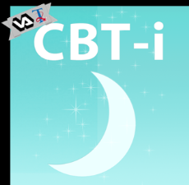
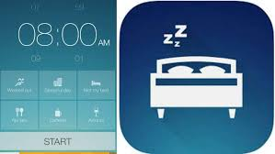
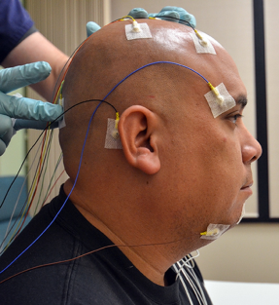
Stepped-Care Candidate Elements
Anne Germain, Ph.D.

