Slide 1
WELCOME to the Association of the U.S. Army BREAKFAST & BRIEFING (14 May 2019)
Guest Speaker: COL Jim Clifford
Garrison Commander, Cyber Center of Excellence & Fort Gordon

Slide 2
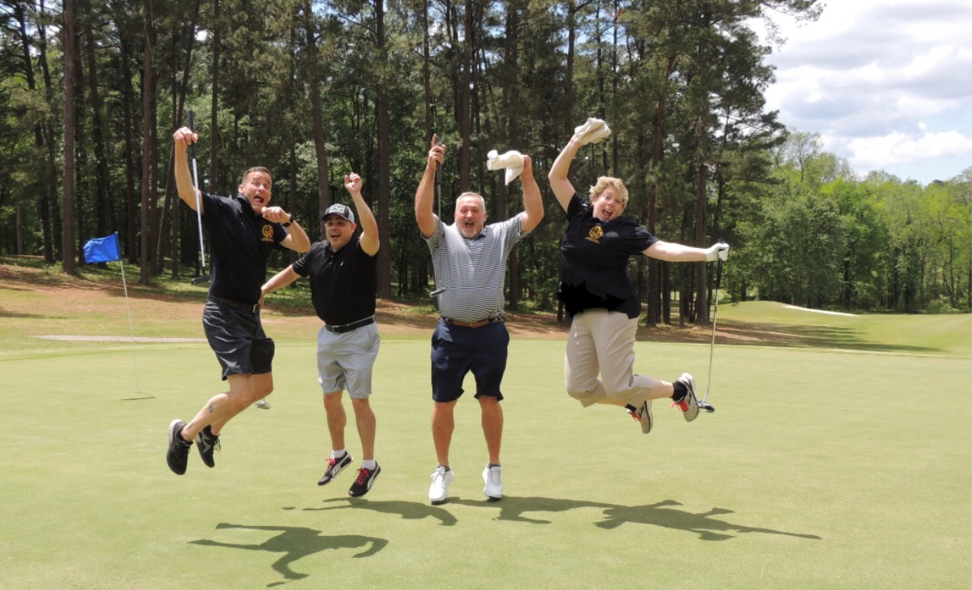
THANK YOU – AUSA GOLF TOURNAMENT SUPPORTERS!
WE RAISED OVER…
$15,000

Slide 3
3RD REGION AWARD WINNERS
BEST CHAPTER (MED SIZE) – Greater Augusta – Ft. Gordon Chapter
INDIVIDUAL MERIT AWARD –
COL(R) Jim Schroeder
Betty Carter
INDIVIDUAL PATRIOTISM AWARD – Jim Thorpe
LIBERTY AWARD – SFC(R) Jim Whelan
CORPORATE SUPPORT AWARD –
MOSAIC
SME CPA
GA POWER
OUTSTANDING ACHIEVEMENT AWARD –
Alejandra Miles
Ft. Gordon Christmas House
CERTIFICATE OF APPRECIATION AWARD – CH(R) Jim Truitt / Kim Gibbons

Slide 4
welcome
COL Jim Clifford
Garrison Commander, Cyber Center of Excellence & Fort Gordon

Slide 5
THANK YOU SPONSORS
Chuck & Bill – The T-Shirt Guys -- SCHOLARSHIP
Candlewood Suites
Security Federal Bank
Mayo & Associates
Sitel Group
MAU Workforce Solutions
Queensborough National Bank & Trust Co.
Defoor Realty

Slide 6
NEXT BREAKFAST & BRIEFING 11 June 2019
Guest speaker: COL John Chu,
Commander, NSA-GA/780 MI Group
See you Next MONTH…

