Slide 1
The Total Force in the Pacific
General Robert B. Brown
Commanding General, US Army Pacific
One Team!
UNCLASSIFIED
Notes:
Thank LTG Luckey and other panelists for the opportunity to contribute
Echo and reaffirm that readiness is the number one priority.
US Army Pacific appreciates the opportunity to contribute to the Army Reserve Seminar discussion

Slide 2
The Army in the Pacific
Korea
Japan
Alaska
Washington
Eighth Army
US Army Alaska
I Corps
US Army Japan
2d ID
19th EXP SUST CMD
I Corps
Fwd
593d Exp Sust Cmd
California
Power Projection
351st Civil Affairs
(USAR)
Forward Postured Forces
Guam
Improving Access, Posture, and Interoperability
Guam ARNG
National Guard State Partnership Program
US Army Hawaii
8th Theater Sust
Cmd
311th SIG Cmd
9th Msn Spt Cmd (USAR)
Indonesia - Hawaii
Philippines - Hawaii/ Guam
Thailand - Washington
Cambodia - Idaho
Vietnam - Oregon
Bangladesh - Oregon
Mongolia - Alaska
Tonga - Nevada
Malaysia - TBA
25th ID
25th ID
RHC-P
94th AAMDC
Total U.S. Army in the Pacific:
~85,000 Regular Army
~9,000 Guard & Reserve
~12,000 Army Civilians
~106,000 Total
UNCLASSIFIED
Notes:
Forward Postured Forces
Support to major OPLANs
Risk equals necessity for persistent presence
Forces committed
Area of Emphasis – South and SE Asia
Minimal assigned Army forces
Two treaty allies
Continual threat of humanitarian disasters
Opportunities open and close continuously
Pacific Activity Sets for HA/DR in Malaysia and Thailand
Pacific Pathways Rotation
Power Projection
Majority of Assigned Forces
Based far from where likely employed
Require immediate strategic mobility

Slide 3
AMERICA’S ARMY IN THE PACIFIC
PEOPLE ARE OUR ADVANTAGE!
Reserve Forces in Theater
ALASKA
(Ft. Wainwright)
E
HAWAII
JAPAN
9MSC
USARPAC
-SU
Det Japan
ALASKA (JBER)
I
X
X
E
X
3
MSG
3301
MSB
MEB
QM
(MA)
TSG
AK
KOREA
International Date Line
X
FSC
658
USARPAC
-SU
Det Korea
X
322
CA
Army Reserve
Forward Postured Forces
X
4960
MFTB
X
USARPAC
-SU
305
MPAD
30
MH
124
CH
SAIPAN
X
302
QM
TSG
TSG
OAHU
X
Equator
1984 USAH
GUAM
E
E
E
3303
MSB
MP
E
302
TTB
548
TC
QM
(MA)
302
QM
TSG
MAR
QM
(MA)
AMERICAN SAMOA
127
CH
3302
MSB
3304
MSD
3305
MSD
FSC
TSG
AS
QM
(MA)
UNCLASSIFIED
Notes:
Note all the reserve compo support in the Pacific – required in everything we do; 2/3 of our sustainment is reserve
Pacific Army Reserve to provide ready units to support PACOM AOR requirements in a contested environment across multiple domains
Army Reserve is responsive in the Pacific providing enabling capacities through the establishment of relationship and decision makers in support of the homeland defense, DSCA, security cooperation, and humanitarian assistance
Pacific Army Reserve provides skilled, educated and experienced citizen-Soldiers prepared to support the current fight as cohesive units trained for the future fight against simultaneous or near-simultaneous contingencies
Pacific Army Reserve prioritizes and synchronizes exercises and engagements to build and sustain readiness to maintain the most capable, combat-ready, and lethal reserve force
The Pacific Army Reserve supports the broad range of actions in order to shape and posture the contested environment across multiple domains to deter aggression, sustain operations, and establish the conditions in the Indo-Asia Pacific in support of strategic plans executed through steady state operations without significant resources from outside the AOR.
Total Force with Forward Presence. As we see in the Slide, the Pacific Army Reserve provide that critical forward presence providing those unique civilian-military skill sets and capabilities to the USARPAC Army Total Force in the Indo-Asia-Pacific region. This provide an enabling capacity to the PACOM AOR in order to improve access and Interoperability with the civilian based force.
Operation Force. USARPAC identified 9MSC as one of the operational HQ and is integral to USARPAC and the Joint Force assuring security, stability, and strategic options.
Regional and Global Support. Reserve Forces provides USARPAC capacity to respond regionally and globally with ready Soldiers and units. Pacific Army Reserve forces supported 7 x overseas contingency operation (FY 15-17) along with forty plus regional engagements. As demand increases, Pacific Army Reserve priorities and synchronizes exercises and engagements to sustain readiness and support Theater Campaign Support Plan.
Overseas Contingency Operation
2 X Chaplain Detachment in Romania (127/124 CH DET)
Mobilization Support in Guam (331 MSBn)
PSD Detachment in Afghanistan (368 MP)
Customs Detachment in Afghanistan (368 MP)
MP support to GTMO (368 MP)
LSV Crew support to Kuwait (548 TC)
As a result of the dynamic nature of the environment, it become imperative that the Total Force is implemented into operational plans. Thus, this requires innovative methodologies to employ a responsive reserve force. One unique initiative currently being execute in Guam is our “in place mobilization plan”. This proof of concept will shorten deployment timelines, while decreasing resource demands, and providing a more responsive reserve force to PACOM AOR.
[Example of an engagement that demonstrated validation of readiness, validation of our civilian skill-sets]
In May and June, the 1984th United States Army Hospital participated in TROPIC CARE, a Joint Innovative Readiness Training (IRT) mission providing quality healthcare to underserved rural communities on Hawaii (Big) Island and Maui. This exercise demonstrated the unit is capable of completing its mission essential tasks alongside medical professionals from the Total Army, other services, NATO, and state government and volunteers.

Slide 4
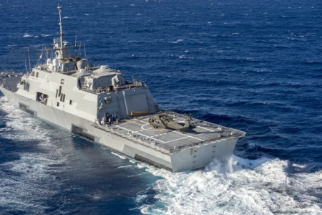
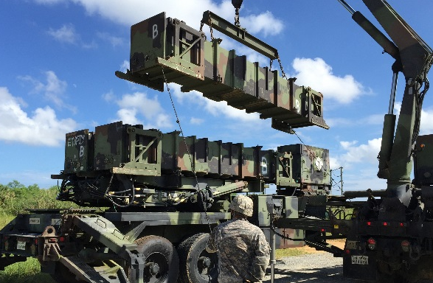
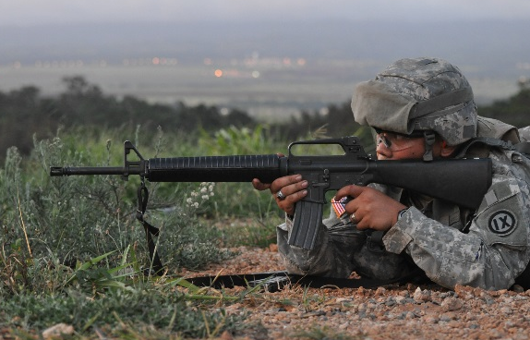
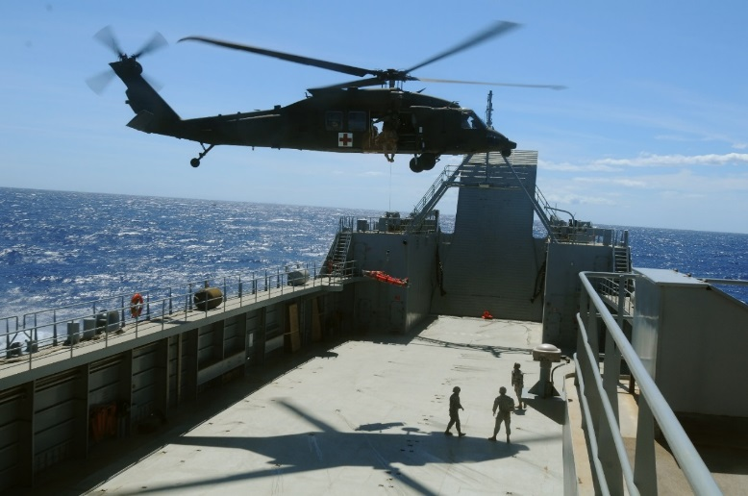
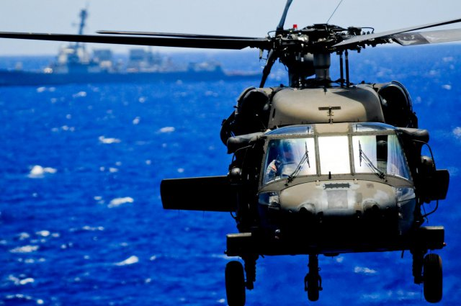
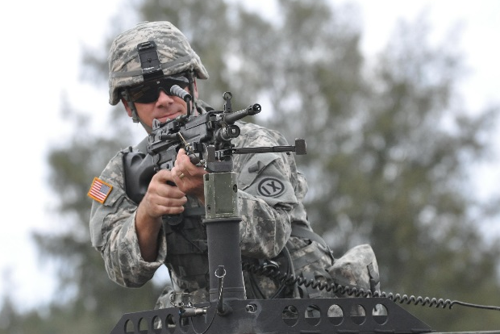
The Total Force Advantage
Total Force provides the needed operational capabilities and the strategic depth required for future crisis, contingencies and campaigns in the Pacific
UNCLASSIFIED
Notes:
To employ MDB, requires a setting of the foundation – which in turn requires the reserve component to help develop relationships, position forces, sustain forces, and support the joint force

Slide 5
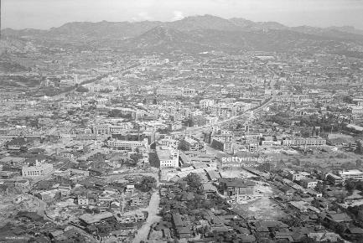
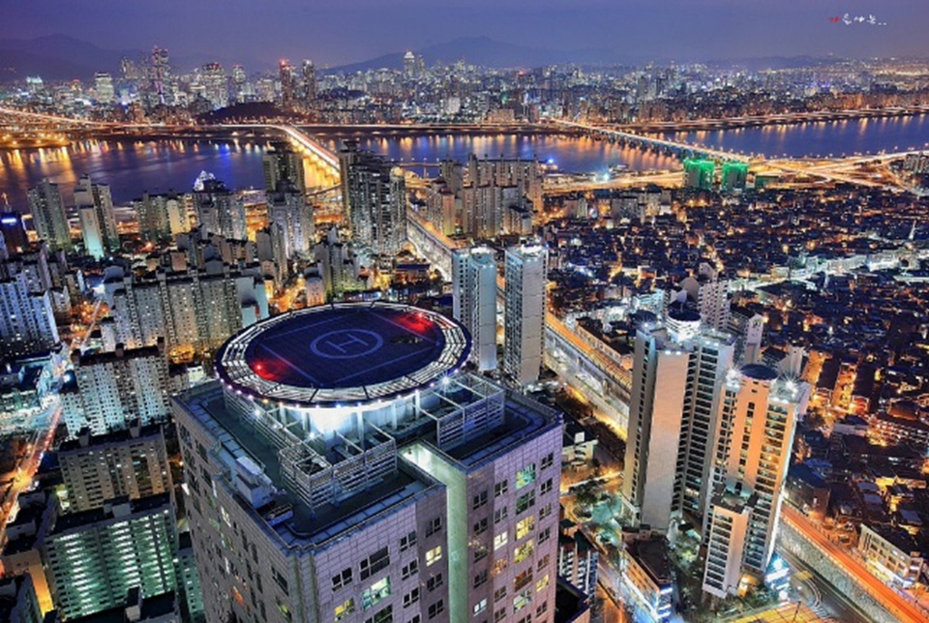
From Complicated to Complex
1953
2016
UNCLASSIFIED

Slide 6
Human Dimension in the Pacific
“We are the Pacific”
“We are the Culture”
7% Guamanian
11% Micronesian
.
.
4% Japanese
.
.
4% Korean
.
2% Chinese
Soldiers speak 35 different languages, providing linguist support to USARPAC/ 9th MSC missions, operations and exercises.
Language lab provides skills resources through:
- Initial and refresher courses
- Individual study
- Language proficiency tests
Funds provided through The Army Language Program (TALP) will support:
- Computers
- Training materials (software, workbooks)
- Foreign language movies and print-material
- Off-site refresher training (at Defense Language Institute or other resident schools)
.
1% Vietnamese
.
.
4% Other Asian
Descent
.
5% Other Pacific-
Islander
2% Other
UNCLASSIFIED
As of 23 JUN 16
Notes:
Language numbers are a/o 27Apr2016
~ 650 Soldiers with additional languages (that we are currently tracking)
Numbers of Soldiers speaking “native languages” (Samoan, Chinese, Korean, Japanese, Tagalog) are likely much higher.
35 consolidated languages ----42 languages/dialects total. 6 Arabic dialects; 3 Spanish dialects
Of these, 15 are PACOM AOR languages/dialects (French also spoken out here, but included in European)
4 – North/South American
10 - European
7 - African (includes Arabic dialects of North Africa)
6 - Middle east/Southwest Asia
Army Strategic Language List (a/o 1JUN2015) lists languages currently eligible for additional, monthly pay (47 languages/dialects total)
9th MSC has 18 languages eligible for pay (if Soldiers take and pass a DLPT)
9th MSC had one of the first Soldiers to max out on monthly pay ($1000/month)
~11 Solders are currently getting paid for speaking additional languages

Slide 7
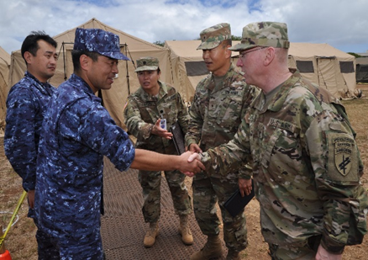
Pacific Pathways
Strategic approach to both training and security cooperation:
Builds Readiness at the Tactical, Operational, and Strategic levels
Demonstrates ability to rapidly deploy (tailorable, scalable, and expeditionary)
Positions Army Forces west of International Date Line for 10 months of the year
Provides opportunities to develop and employ Multi-Domain Battle concepts and future technologies
Creates Partner relationships, trust, and confidence from the Soldier to the Theater Commander level
Reconnaissance + Rehearsals + Relationships =
Readiness
Pacific Pathways combines existing exercises, strategic reach, and multinational partnerships to provide Strategic Options to the Commander, PACOM and our National Leadership
UNCLASSIFIED
Notes:
USARPAC is responsible for maintaining globally responsive forces, planning for and executing engagement activities in the Indo-Asia Pacific on a daily basis. One of the Pacific Army Reserves roles is to support Indo-Asia Pacific TSCP and Engagement programs requirements. These programs sustain positive Army relationships while building warfighting proficiency and enhancing allied and partner interoperability and capacity.
9MSC has also been instrumental in establishing Reserve to Reserve engagements with allies and partners in order to build the Reserve capacity within the AOR.
An advantage our Reserve Soldier residing throughout the Pacific AOR communities they have an inherent cultural infinity providing a unique multiplier in building and sustaining relationships. This includes a number of reserve Soldiers who can converse in other languages which significantly assist in bridging challenging communication barriers.
[Example of building mission command capacity while internally and with partner nations]
Events like the IMUA DAWN Combined Arms Rehearsals exemplify how we develop our teams through building mission command capacity. The 303d Movement Enhancement Brigade trained side-by-side with Japanese counterparts to prepare for the command post exercise working through design and mission analysis fundamentals to build plans supporting Humanitarian Assistance, Disaster Relief, and Non-combatant Evacuation operations.

Slide 8
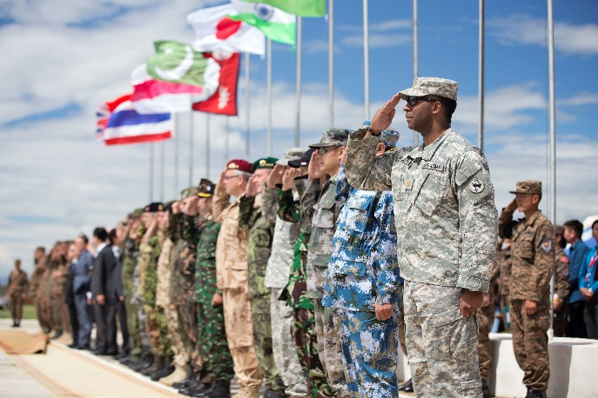
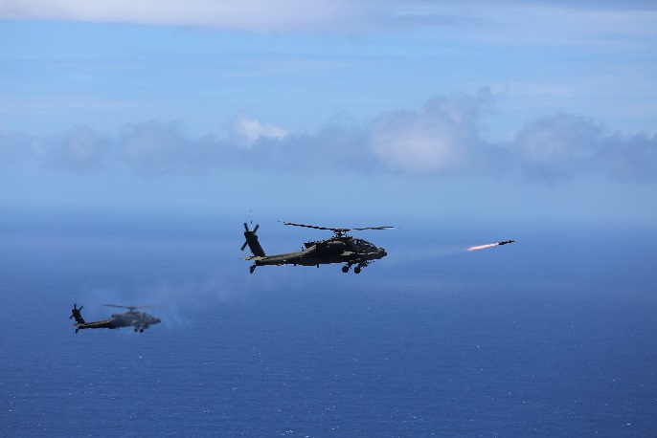
Rebalance to the Pacific
Military Rebalance – Total Army Effort
Army – 70k to 106k
Engagements – 120 to 550
Role in War Plans
– 21x Brigades (8x BCTs),
2x Division HQs, 1x Corps HQs
From Bilateral to Multilateral – Significant Change in Focus
Army has Critical Role and Opportunity …
- Multi-Domain Battle
- Army possesses the strategic capabilities, reach and depth to enable Joint Integration
UNCLASSIFIED

Slide 9
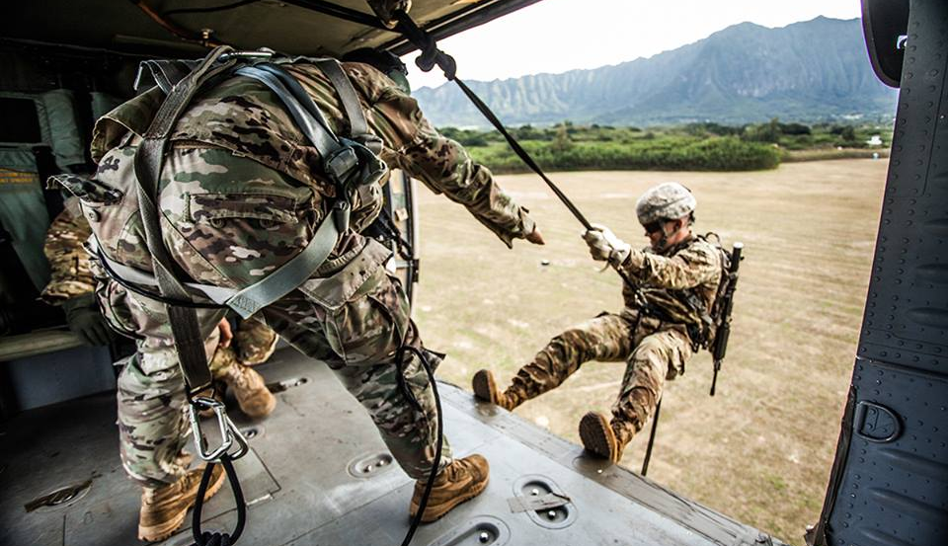
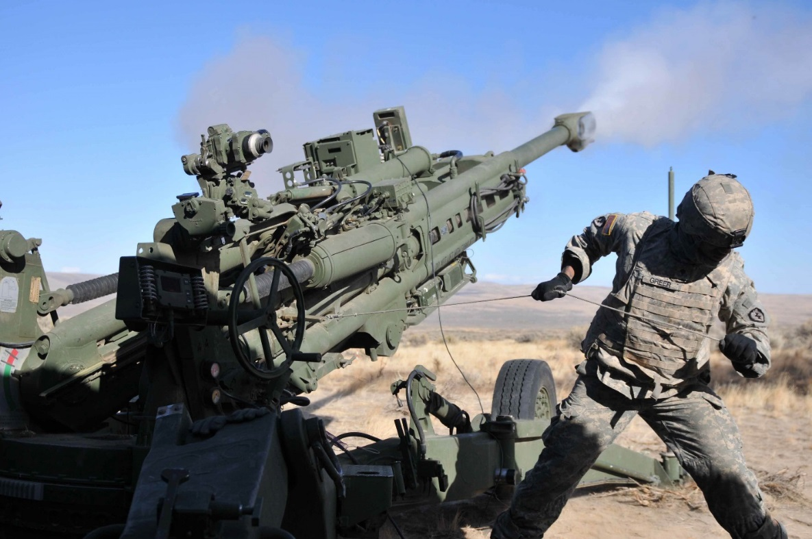
Building the Foundation
The Indo-Asia Pacific is a complex, dynamic environment
Army provides trained and ready land forces to the Pacific Command to deter, and if necessary defeat, emerging challenges in the region
The Army’s contribution to Joint power is generated and possible because of our readiness – tactical, operational, and strategic
Readiness includes our operational preparation of the environment through over 200+ partner nation engagements, exchanges, and exercises – Pacific Pathways as training, relationship building, and options creator
Setting the theater through the planning and exercise of strategic and agile networks – enable the foundation of the Joint Force
UNCLASSIFIED
Notes:
Readiness – number one priority

Slide 10
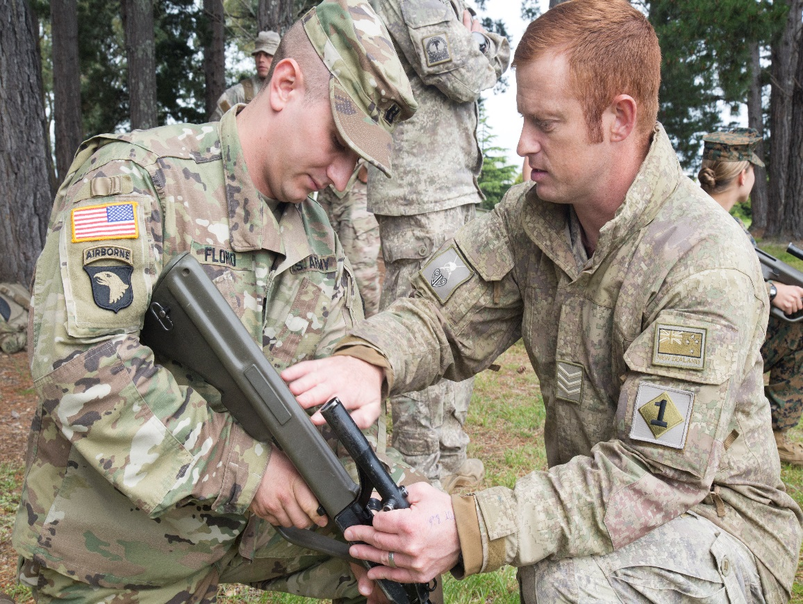
Pacific Pathways
Strategic approach to both training and security cooperation:
Builds Readiness at the Tactical, Operational, and Strategic levels
Demonstrates ability to rapidly deploy (tailorable, scalable, and expeditionary)
Positions Army Forces west of International Date Line for 10 months of the year
Provides opportunities to develop and employ Multi-Domain Battle concepts and future technologies
Creates Partner relationships, trust, and confidence from the Soldier to the Theater Commander level
Reconnaissance + Rehearsals + Relationships =
Readiness
Pacific Pathways combines existing exercises, strategic reach, and multinational partnerships to provide Strategic Options to the Commander, PACOM and our National Leadership
UNCLASSIFIED
Notes:
Many aspects of multi-domain battle can be integrated into exercises now; we do not need to wait on new technologies; use concepts and technologies we possess now in new and innovative ways.
Incorporate Army and Marine HIMARS and Army Patriot to showcase both offensive and defensive capabilities
Army aviation ISO Marine amphibious and JSOF operations
Joint forced-entry operations to seize/re-capture key terrain/facilities

Slide 11
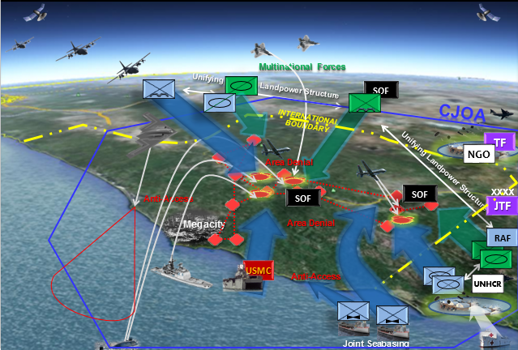
The Path to Multi-Domain Battle
“… the Army’s got to be able to sink ships, neutralize satellites, shoot down missiles and deny the enemy the ability to command and control its forces.” – ADM Harry Harris
Setting the Path with ‘The 5 Ms’ - Combining Multi-Domain, Multi-National and Multi-Interagency to create Multiple Options and present Multiple Dilemmas to our Adversary
UNCLASSIFIED

